Slide 1
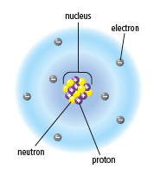
Atomic Theory
Atoms are made up of smaller particles called subatomic particles.

Slide 2
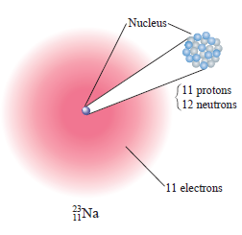
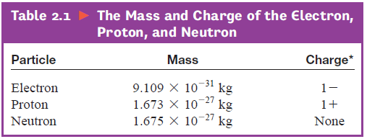
THE MODERN VIEW OF THE ATOM
It is composed of electrons, protons and neutrons
ELECTRONS:
Orbit the nucleus
Charge of -1
Very low mass

Slide 3
THE MODERN VIEW OF THE ATOM
It is composed of electrons, protons and neutrons
Protons:
In the nucleus
Charge of +1
Much higher mass then electrons

Slide 4
THE MODERN VIEW OF THE ATOM
It is composed of electrons, protons and neutrons
Neutrons:
In the nucleus
Charge of 0
Almost identical mass as protons

Slide 5

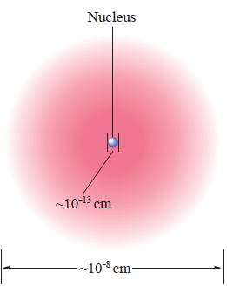
THE MODERN VIEW OF THE ATOM
The relative size of the nucleus and atom!

Slide 6
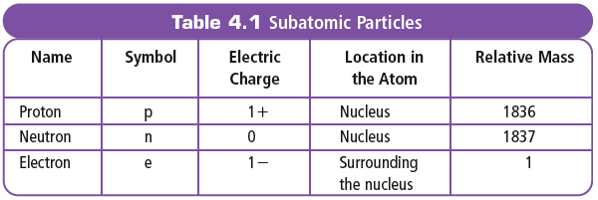
Atomic Theory
# of PROTONS = # of ELECTRONS in an neutral atom

Slide 7
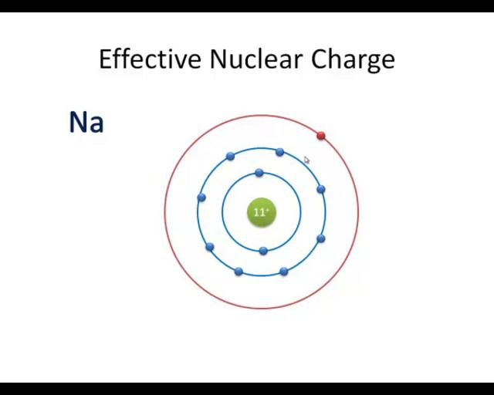
Nucleus – Nuclear Charge
Nuclear Charge
= charge on the nucleus
= number of protons
= ATOMIC NUMBER

Slide 8
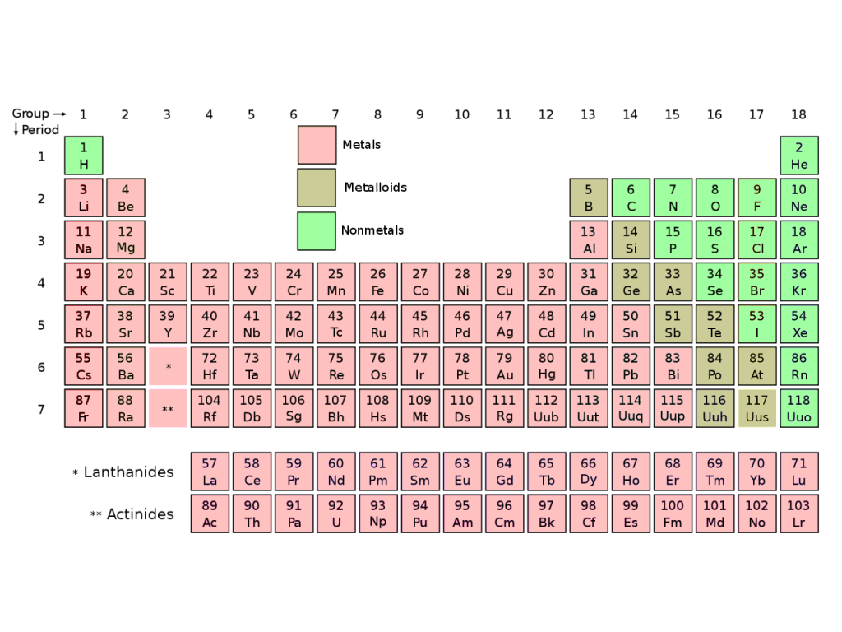
BLM 2-4 to 2-10

Slide 9
The Periodic Table

Slide 10
The Periodic Table
Which letter(s) are missing in the periodic table?

Slide 11
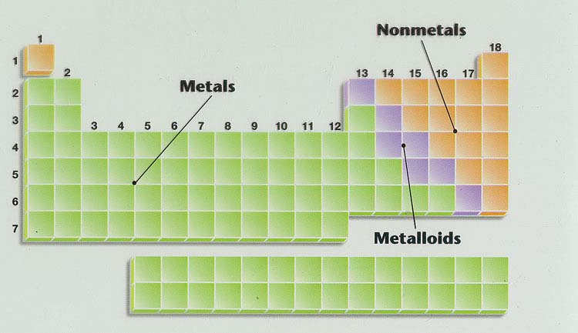
The Chemical Elements

Slide 12
The Chemical Elements

Slide 13
GROUPS
1 – 18
OR

Slide 14
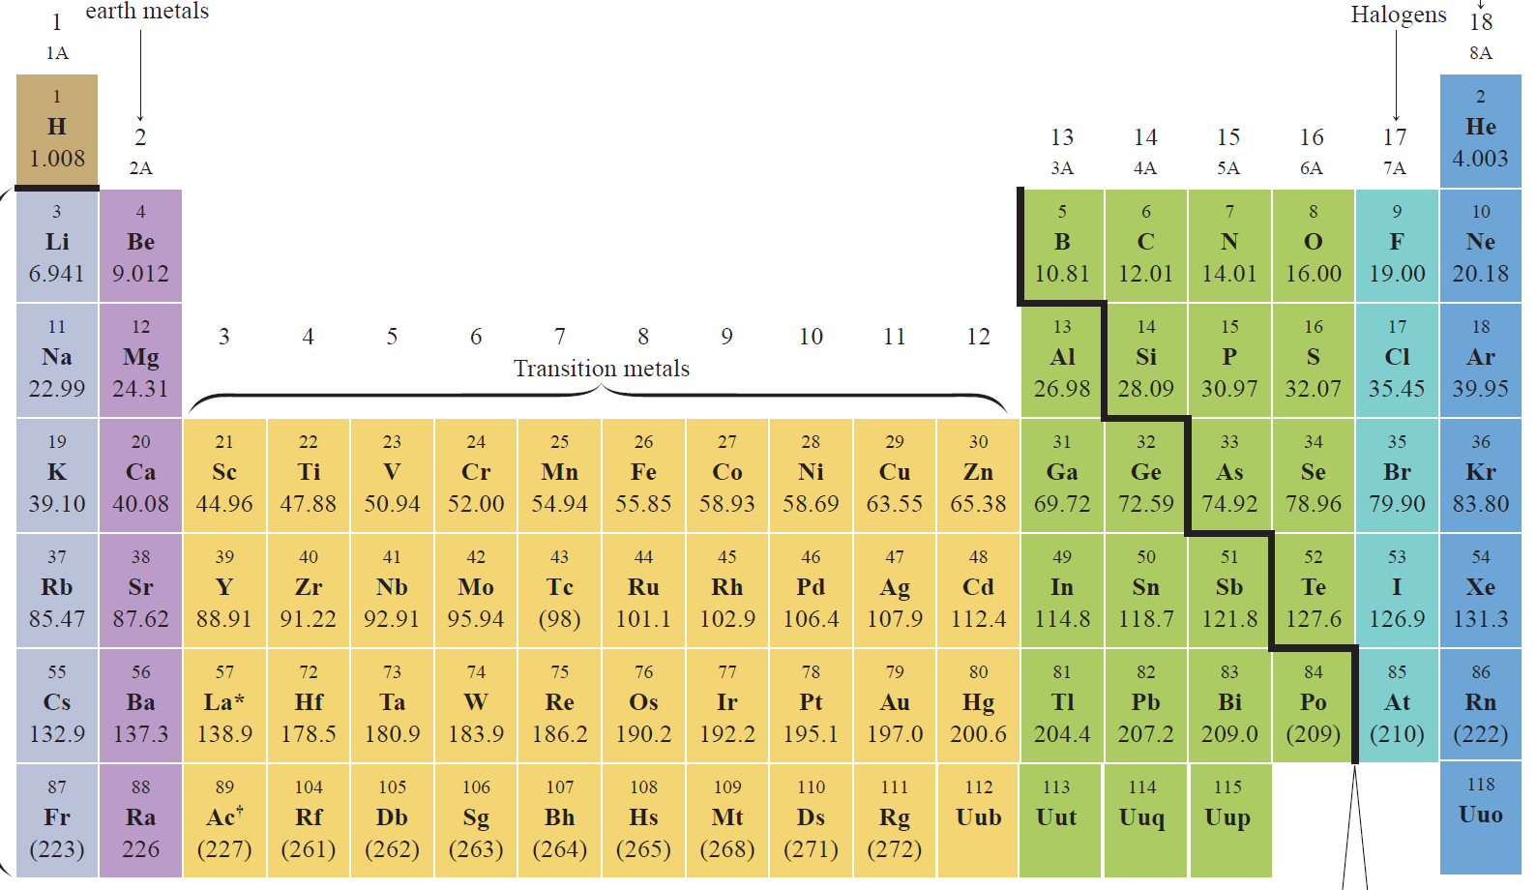
GROUPS
1 – 18 OR
1A – 8A + 1B – 8B
3B
4B
5B
6B
7B
8B 8B 8B
1B
2B

Slide 15
Periods (1 – 7)

Slide 16
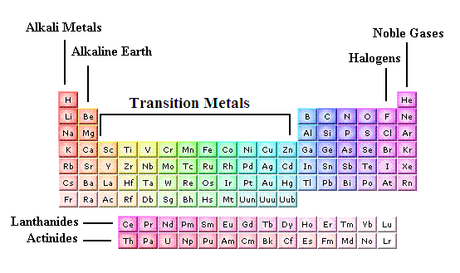
SOME GROUPS OF THE PERIODIC TABLE

Slide 17
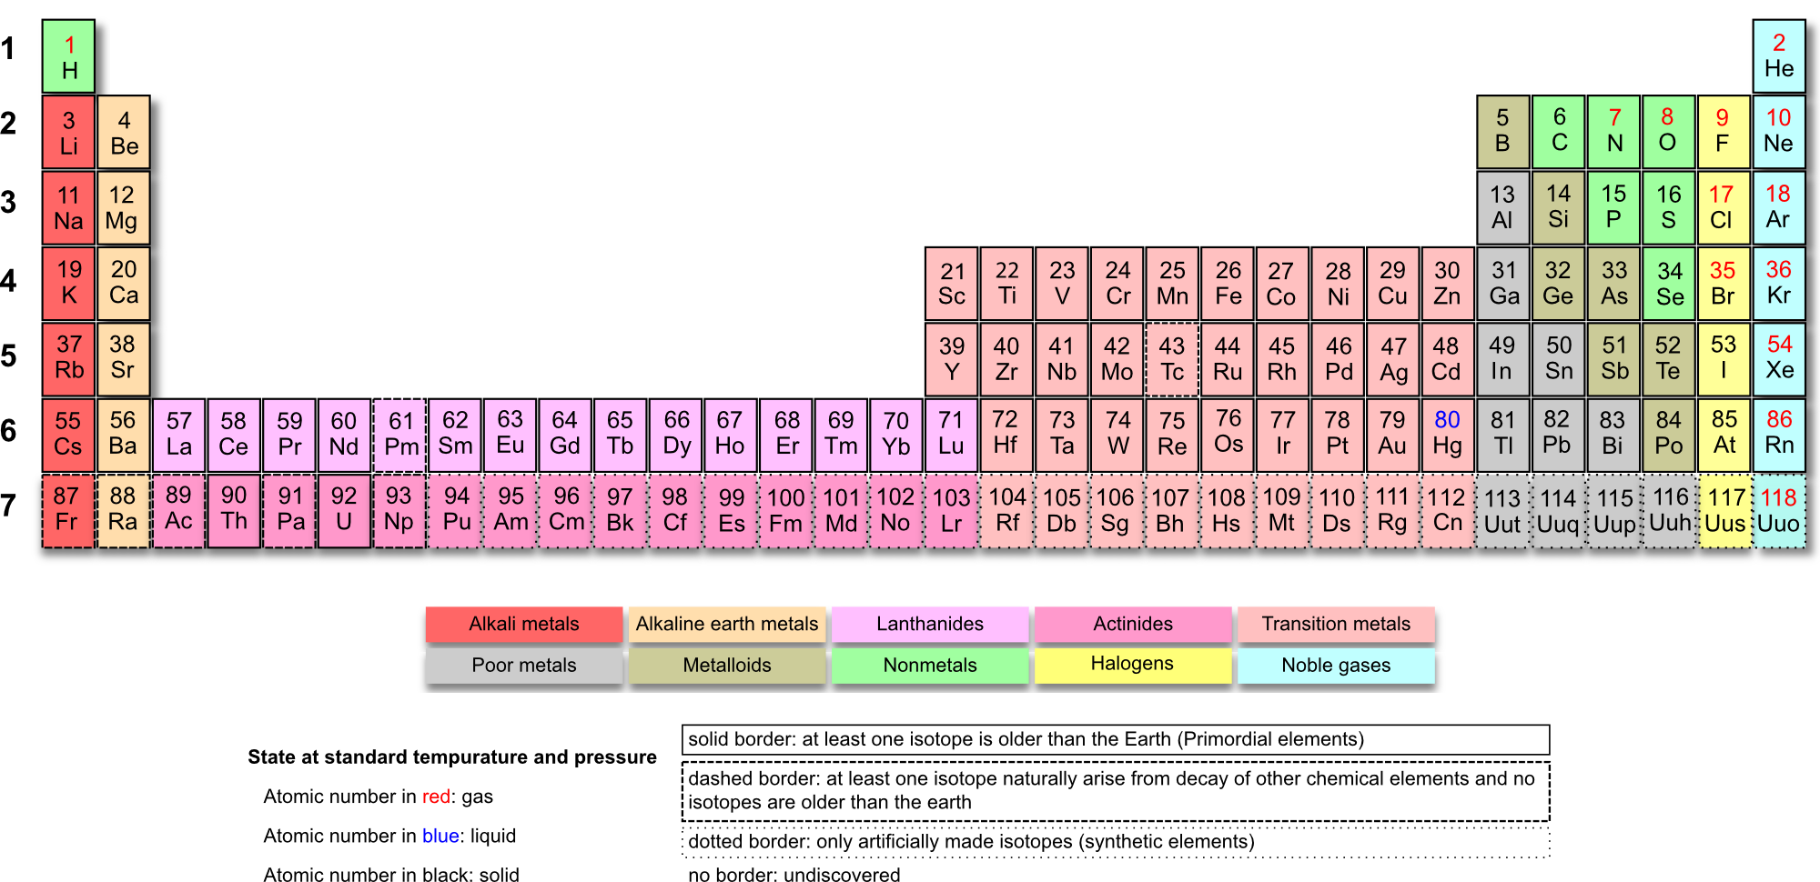
The ACTUAL THE PERIODIC TABLE

Slide 18
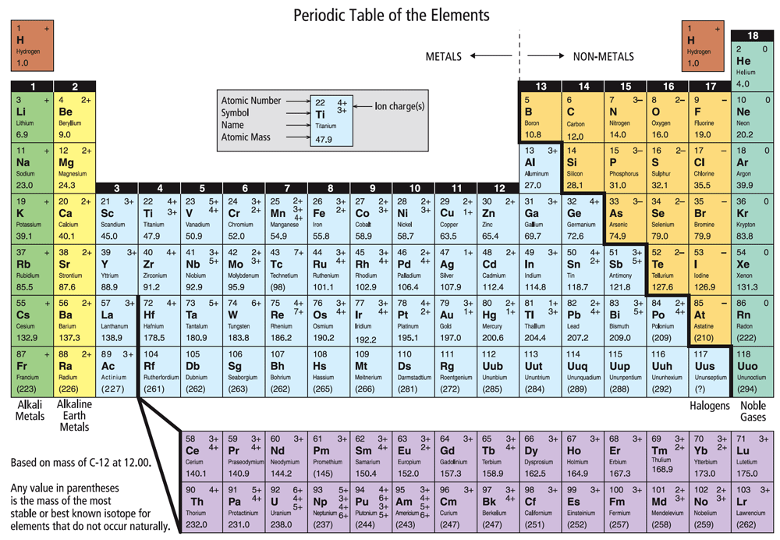
The Periodic Table
Where are the following?
Atomic number
Period
Group/Family
Metals
Non-metals
Transition metals
Metalloids
Alkali metals
Alkaline earth metals
Halogens
Noble gases
INCREASING REACTIVITY

Slide 19

Periodic Table and Ion Formation
Atoms gain and lose electrons to form bonds.
i.e. become positively or negatively charged

Slide 20
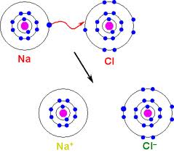
IONS
Atom or a group of atoms with net negative or positive charge

Slide 21
IONS
Atom or a group of atoms with net negative or positive charge
POSITIVELY CHARGED ION =
NEGATIVELY CHARGED ION =
CATION
ANION

Slide 22
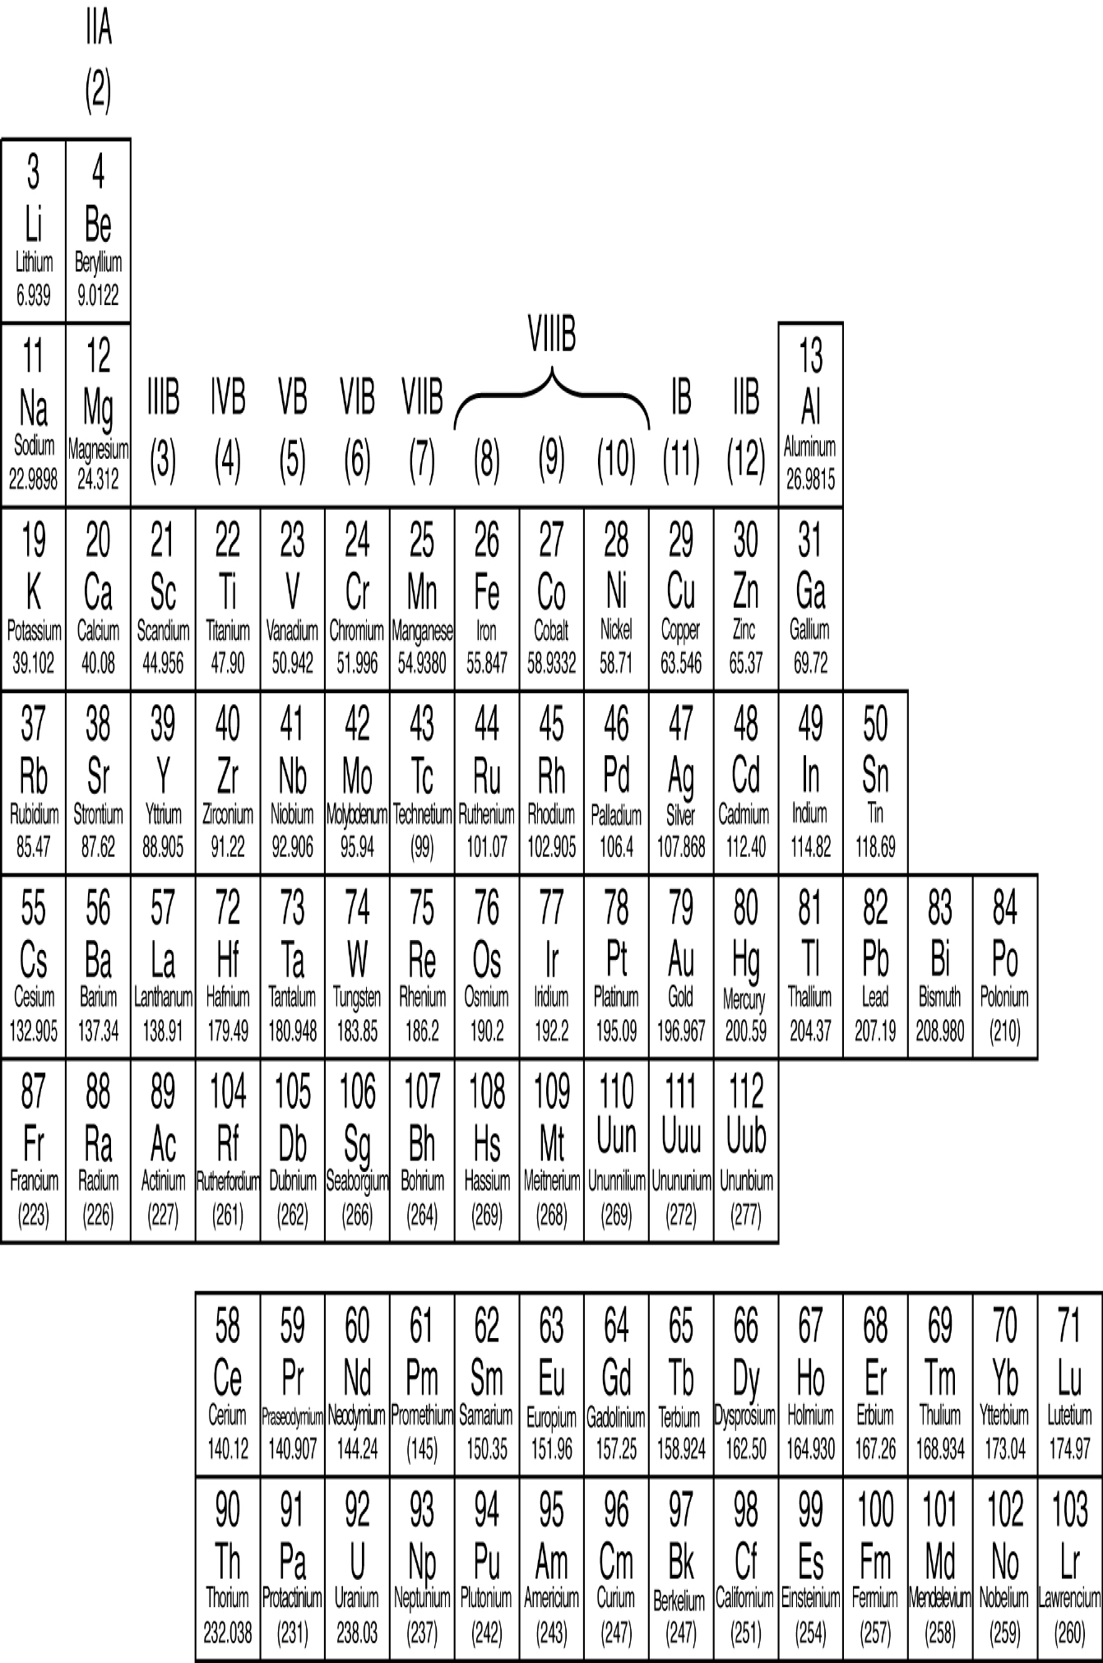
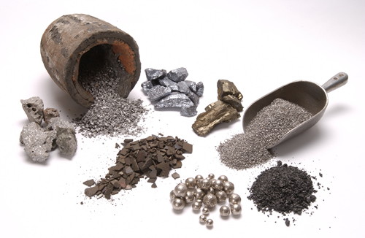
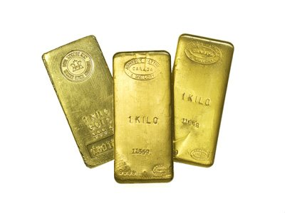
Metals

Slide 23
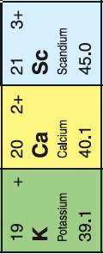
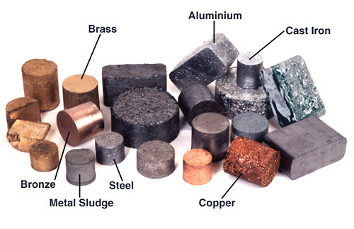
Metals
Always form ions with a POSITIVE charge

Slide 24
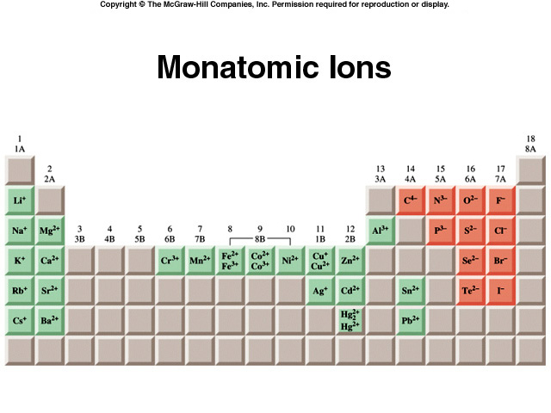

Slide 25
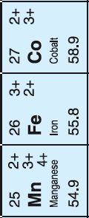
Multivalent Metals
Metals that have can lose electrons in more than one way

Slide 26
Multivalent Metals
DO YOU KNOW WHICH ONES ARE THERE?
iron, cooper, vanadium, chromium, manganese, cobalt, nickel, palladium, platinum, gold, lead, tin, titanium, germanium, platinum, thallium

Slide 27
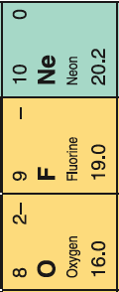
Non - Metals
Almost always form ions with a NEGATIVE charge

Slide 28
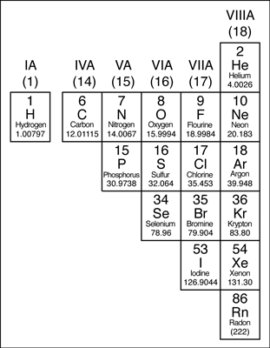
Non - Metals
Almost always form ions with a NEGATIVE charge
WHAT NON-METAL IS AN EXCEPTION?
Hydrogen

Slide 29
BOHR DIAGRAMS
There is a pattern to the arrangements of electrons in atoms
Atoms have SHELLS of electrons around the nucleus

Slide 30
BOHR DIAGRAMS
Each shell can hold a certain number of electrons
First shell:
2 electrons
Second shell:
8 electrons
Third shell:
8 electrons
Fourth shell:
8 electrons

Slide 31
BOHR DIAGRAMS
Diagram that shows how many electrons are in each shell
First shell:
2 electrons
Second shell:
8 electrons
Third shell:
8 electrons
Fourth shell:
8 electrons

Slide 32
Patterns of Electron Arrangement in Groups
If there are 8 electrons in a last shell = STABLE OCTET
Which group has a STABLE OCTET in its outer most shell?

Slide 33
ATOMS WANT TO HAVE A STABLE OCTET!!!!!! ALL THE TIME!!
If there are 8 electrons in a shell = STABLE OCTET
All ATOMS want to be like NOBLE GASES!

Slide 34
Valence Shell = OUTERMOST SHELL

Slide 35
VALENCE ELECTRONS
Electrons in the VALENCE SHELL are called VALENCE ELECTRONS

Slide 36
How many VALENCE ELECTRONS in GROUP 1?

Slide 37
How many VALENCE ELECTRONS in GROUP 2?

Slide 38
How many VALENCE ELECTRONS in GROUP 16?

Slide 39
What Do You Notice about # of Valence Electrons for Elements in the Same Group?

Slide 40
What Do You Notice about # of Energy Levels (occupied shells) for Elements in the Same Period?

Slide 41
What Element is this?
_{18 p}
^{22 n}
argon

Slide 42
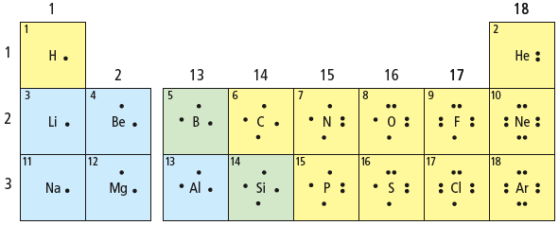
LEWIS DIAGRAMS
Show only an atom’s valence electrons and the chemical symbol.

Slide 43
LEWIS DIAGRAMS
Show only an atom’s valence electrons and the chemical symbol.

Slide 44
Rule # 1
Dots representing valence electrons are placed around the element symbols

Slide 45
Rule # 2
Electron dots are placed singly until the fifth electron is reached then they are paired.

Slide 46
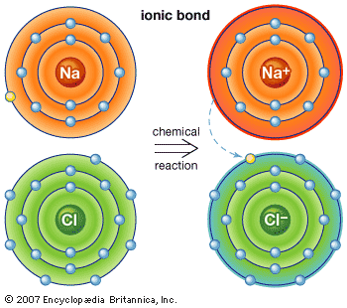
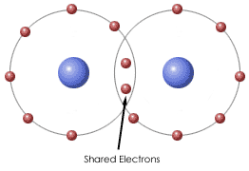
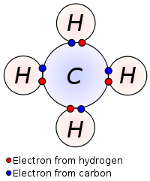
MOLECULES and IONIC COMPOUNDS
Atoms combine with different atoms to form compounds (thanks to electrons)
Forces that hold atoms together are called CHEMICAL BONDS
SHARING ELECTRONS
DONATING ELECTRONS
Covalent Bonds
Ionic Bonds

Slide 47
MOLECULES and IONIC COMPOUNDS
Atoms combine with different atoms to form compounds (thanks to electrons)
Forces that hold atoms together are called CHEMICAL BONDS
MOLECULES
IONIC COMPOUNDS
Covalent Bonds
Ionic Bonds

Slide 48
MOLECULES and IONIC COMPOUNDS
Atoms combine with different atoms to form compounds (thanks to electrons)
These bonds arise when VALENCE ELECTRONS interact
Each atom attempts to have as many of valence electrons as the nearest noble gas.

Slide 49
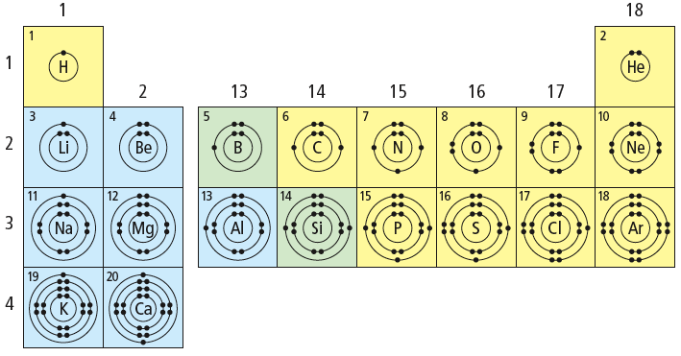
Each atom attempts to have as many of valence electrons as the nearest noble gas.
Metals want to lose electrons

Slide 50
Each atom attempts to have as many of valence electrons as the nearest noble gas.
Non - Metals want to gain electrons

Slide 51
Each atom attempts to have as many of valence electrons as the nearest noble gas.
How many electrons does sodium, Na, want to have?
10 electrons

Slide 52
Each atom attempts to have as many of valence electrons as the nearest noble gas.
How many electrons does oxygen, O, want to have?
10 electrons

Slide 53
IONS
Atom or a group of atoms with net negative or positive charge
POSITIVELY CHARGED ION =
NEGATIVELY CHARGED ION =
CATION
ANION

Slide 54
IONIC COMPOUNDS
Formed by an attraction of positively charged ion and negatively charged ion
Chemical formula
NaCl

Slide 55
IONIC COMPOUNDS
Formed when electrons are transferred from a metal to a non - metal
Chemical formula
NaCl

Slide 56
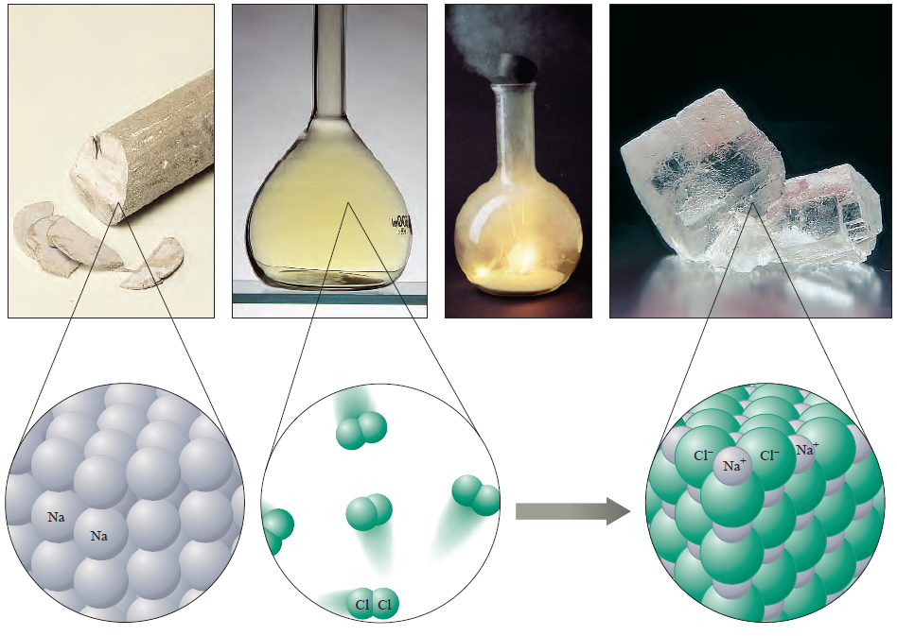
IONS
Cations and Anions are attracted to each other → IONIC BONDING
NaCl

Slide 57
IONIC COMPOUNDS
Attraction between cations and anions

Slide 58
IONIC COMPOUNDS
Attraction between cations and anions

Slide 59
IONIC COMPOUNDS
Attraction between cations and anions

Slide 60
IONIC COMPOUNDS
Draw the Bohr model diagram for KF

Slide 61
MOLECULES and IONIC COMPOUNDS
Atoms combine with different atoms to form compounds (thanks to electrons)
Forces that hold atoms together are called CHEMICAL BONDS
SHARING ELECTRONS
DONATING ELECTRONS
Covalent Bonds
Ionic Bonds

Slide 62
Covalent Bonds
Valence Electrons are shared between atoms

Slide 63
Covalent Bonds
Valence Electrons are shared between atoms
+
Hydrogen fluoride
hydrogen
fluorine
electrons are shared

Slide 64
Lewis Diagrams of IONS and IONIC BONDS
  For positive ions, one electron dot is removed from the valence shell for each positive charge.
  For negative ions, one electron dot is added to each valence shell for each negative charge.
  Square brackets are placed around each ion to indicate transfer of electrons.

Slide 65
Lewis Diagrams of IONS and IONIC BONDS
  For positive ions, one electron dot is removed from the valence shell for each positive charge.
  For negative ions, one electron dot is added to each valence shell for each negative charge.
  Square brackets are placed around each ion to indicate transfer of electrons.
–
2+
–
• •
• •
• •
• •
• •
• •
• •
• •
• •
• •
• •
• •
• •
• •
• •
• •
• •
• •
• •
• •
• •
• •
• •
• •
• •
• •
• •
• •
• •
• •
• •
• •
Cl
Cl
Be
Cl
Cl
Be
Cl
Be
Each beryllium has two electrons to transfer away, and
each chlorine can receive one more electron.
Since Be²⁺ can donate two electrons and
each Cl– can accept only one electron, two Cl– ions are necessary.
beryllium chloride

Slide 66
IONIC COMPOUNDS
Draw the Lewis model diagram for
K and F
Ca and Cl

Slide 67
Lewis Diagrams of COVALENT BONDS
  Like Bohr diagrams, valence electrons are drawn to show sharing of electrons.
  The shared pairs of electrons are usually drawn as a straight lineare placed around each ion to indicate transfer of electrons.

Slide 68
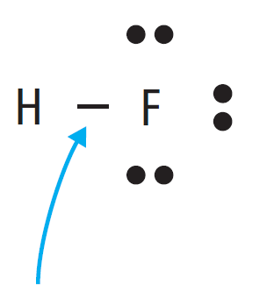
Lewis Diagrams of COVALENT BONDS
  LONE pair of electrons
  BONDING pair of electrons

Slide 69
Lewis Diagrams of COVALENT BONDS
  Draw Lewis diagram for
  H and O
  N and H
  C and H
How many BONDING PAIRS for…?
How many LONE PAIRS for…?

Slide 70
Lewis Diagrams of COVALENT BONDS
  Draw Lewis diagram for
  H and O
  N and H
  C and H

Slide 71
Lewis Diagrams of COVALENT BONDS
  Diatomic molecules, like O₂, F₂ or N₂ are also easy to draw as Lewis diagrams.
Valence electrons are shared
Several non-metals join to form diatomic molecules.

Slide 72
Lewis Diagrams of COVALENT BONDS
  Draw LEWIS STRUCTURE of O₂
O
O
O
O
O
O
  DOUBLE BOND

Slide 73
Lewis Diagrams of COVALENT BONDS
  Draw LEWIS STRUCTURE of N₂
N
N
N
N
N
N
  TRIPLE BOND

Slide 74
Lewis Diagrams of COVALENT BONDS
  Draw LEWIS STRUCTURE of CO₂
C
O
O
O
C
O
O
C
O

