Slide 1
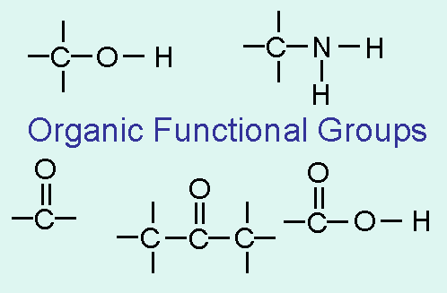
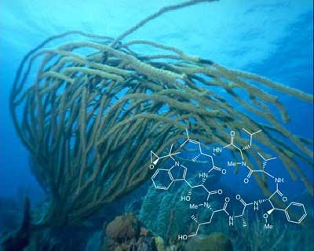
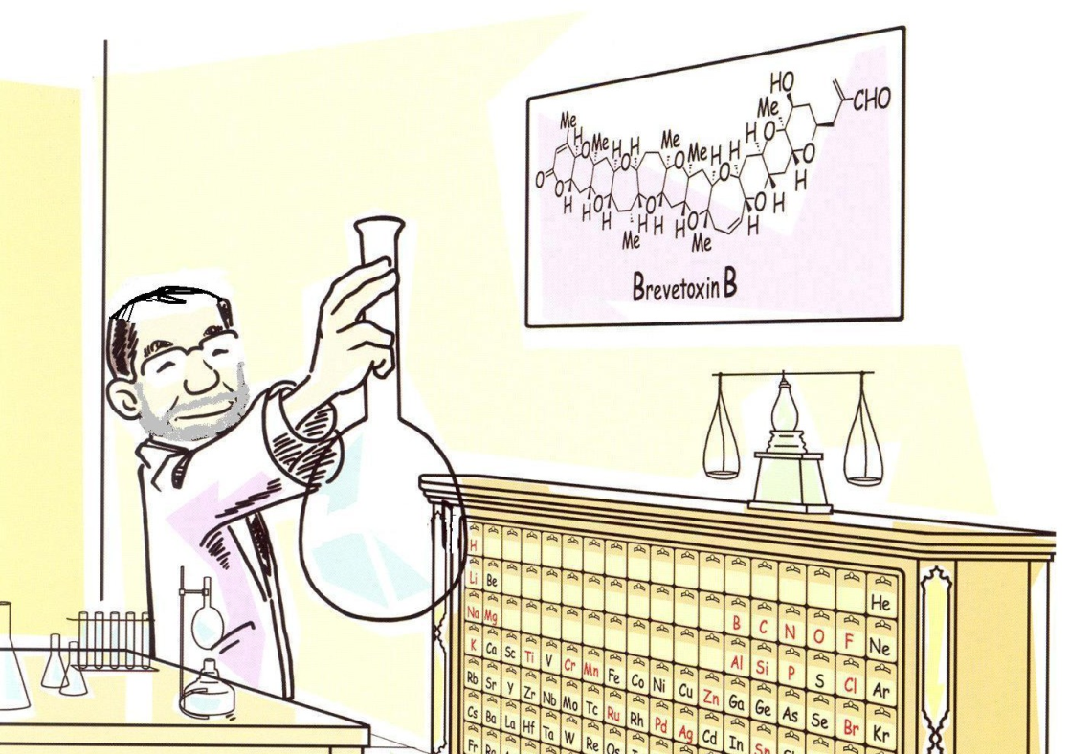
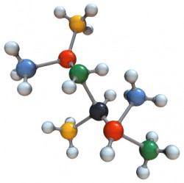
ORGANIC CHEMISTRY

Slide 2


ORGANIC CHEMISTRY
The chemistry of CARBON containing compounds
The majority of organic compounds include CARBON – CARBON chains
Most of the time HYDROGEN is present in organic molecules
Also, OXYGEN, NITROGEN and HALOGENS (FLUORINE, CHLORINE, BROMINE, IODINE)

Slide 3
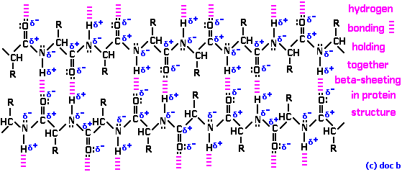
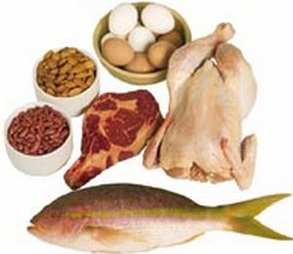
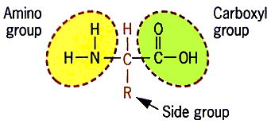
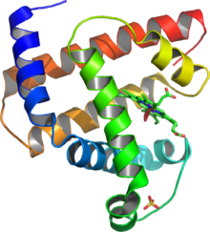
WHY IS ORGANIC CHEMISTRY IMPORTANT?
Organic chemicals are all around us and in all living things!
Proteins,

Slide 4
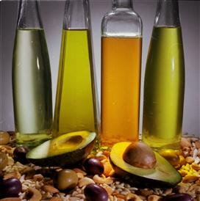
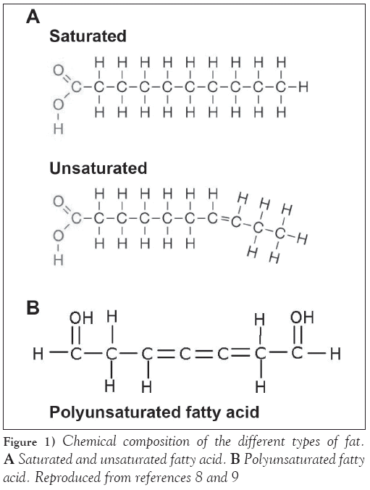
WHY IS ORGANIC CHEMISTRY IMPORTANT?
Organic chemicals are all around us and in all living things!
Proteins, fats,

Slide 5
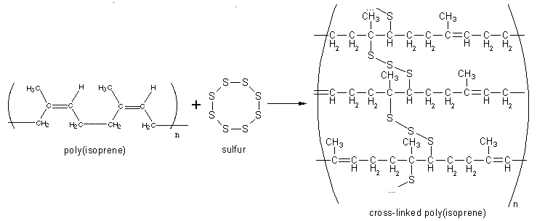
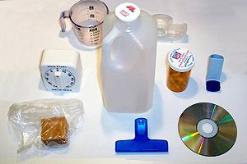

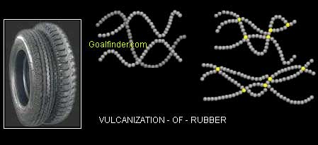
WHY IS ORGANIC CHEMISTRY IMPORTANT?
Organic chemicals are all around us and in all living things!
Proteins, fats, plastics,

Slide 6

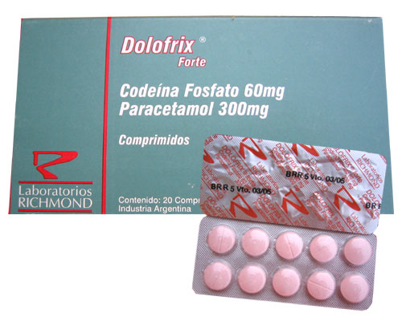
WHY IS ORGANIC CHEMISTRY IMPORTANT?
Organic chemicals are all around us and in all living things!
Proteins, fats, plastics, drugs,

Slide 7
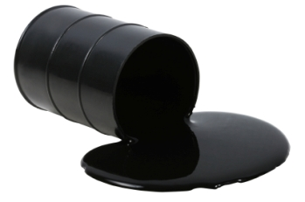

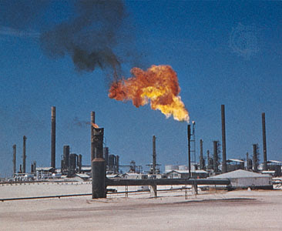
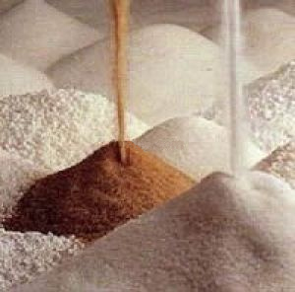
WHY IS ORGANIC CHEMISTRY IMPORTANT?
Organic chemicals are all around us and in all living things!
Proteins, fats, plastics, drugs, petroleum, benzene,

Slide 8
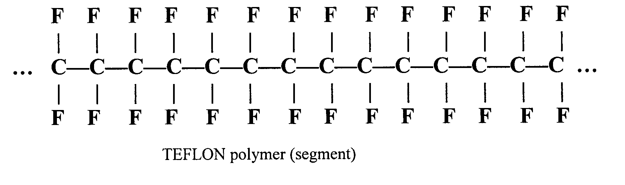
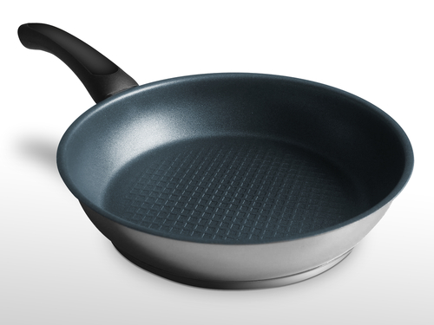

WHY IS ORGANIC CHEMISTRY IMPORTANT?
Organic chemicals are all around us and in all living things!
Proteins, fats, plastics, drugs, petroleum, benzene, teflon,

Slide 9
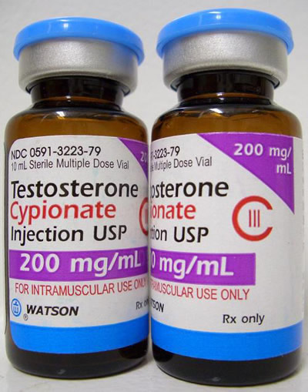
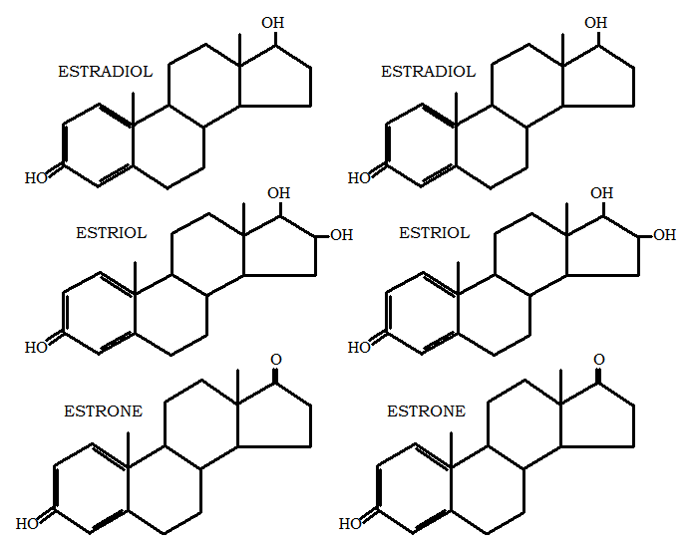
WHY IS ORGANIC CHEMISTRY IMPORTANT?
Organic chemicals are all around us and in all living things!
Proteins, fats, plastics, drugs, petroleum, benzene, teflon, hormones….

Slide 10
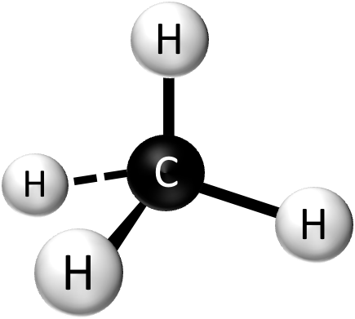
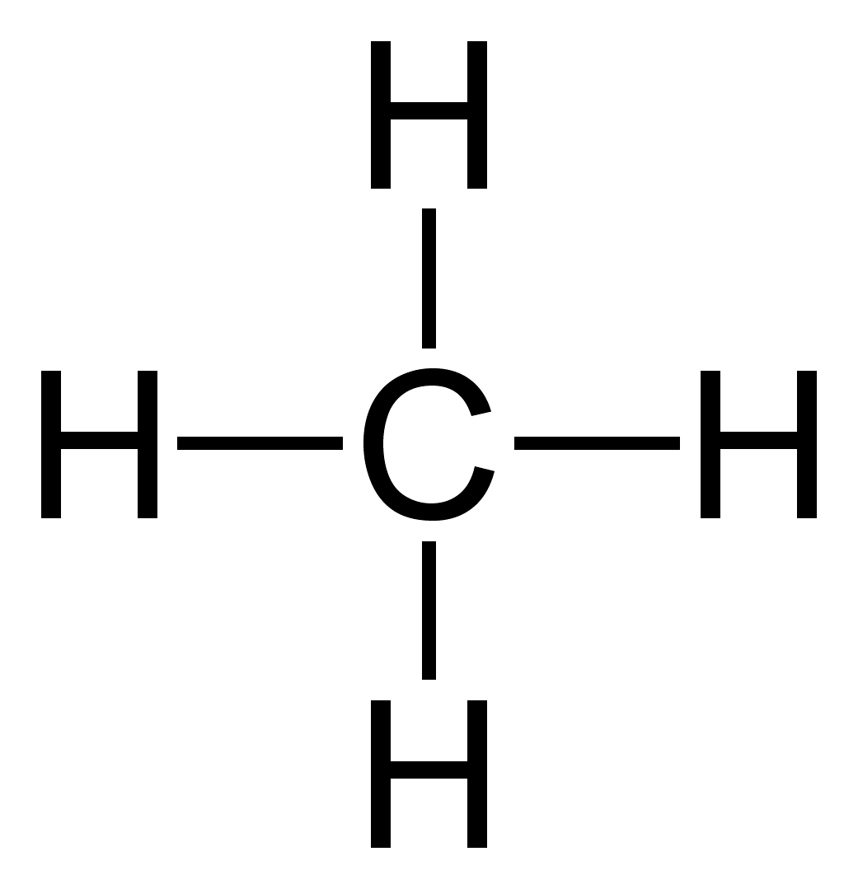
SINGLE, DOUBLE, and TRIPLE BONDS FOR CARBON
HOW MANY BONDS CAN A CARBON ATOM HAVE?
4

Slide 11

SINGLE, DOUBLE, and TRIPLE BONDS FOR CARBON
A CARBON atom has always 4 bonds
But depending on a compound, they can be SINGLE,

Slide 12
SINGLE, DOUBLE, and TRIPLE BONDS FOR CARBON
A CARBON atom has always 4 bonds
But depending on a compound, they can be SINGLE, DOUBLE

Slide 13
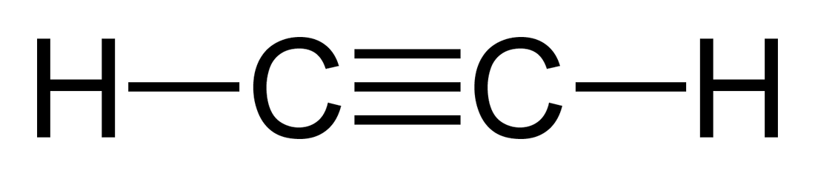
SINGLE, DOUBLE, and TRIPLE BONDS FOR CARBON
A CARBON atom has always 4 bonds
But depending on a compound, they can be SINGLE, DOUBLE or TRIPLE

Slide 14
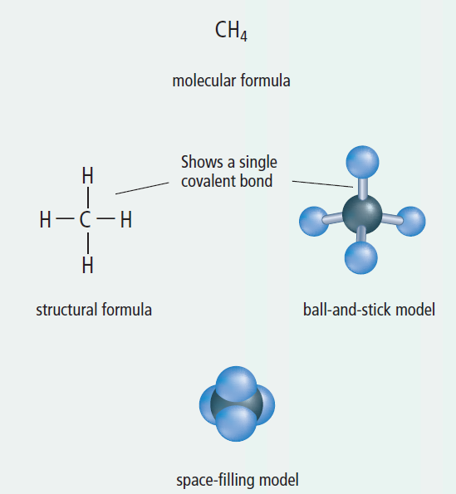
Think About It:
5 – 3A Sketching Organic Compounds
Page 245

Slide 15
Recognizing Organic Compounds
Organic Compounds:
  The molecular formula MUST contain carbon

Slide 16
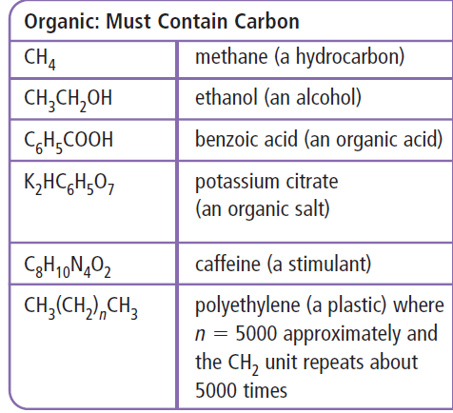
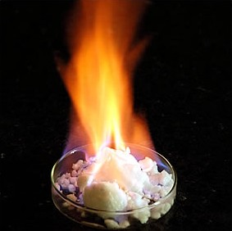
Recognizing Organic Compounds
Organic Compounds:
  The molecular formula MUST contain carbon

Slide 17

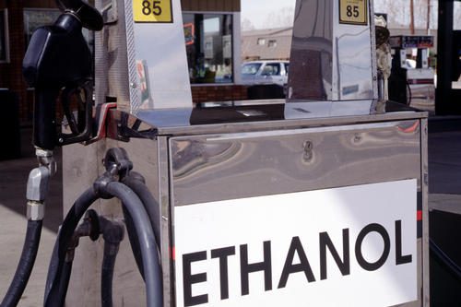
Recognizing Organic Compounds
Organic Compounds:
  The molecular formula MUST contain carbon

Slide 18
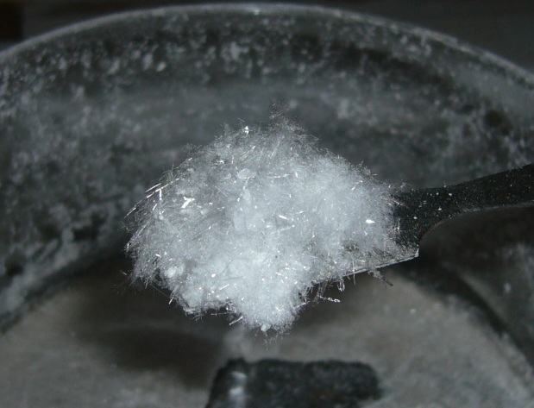
Recognizing Organic Compounds
Organic Compounds:
  The molecular formula MUST contain carbon

Slide 19
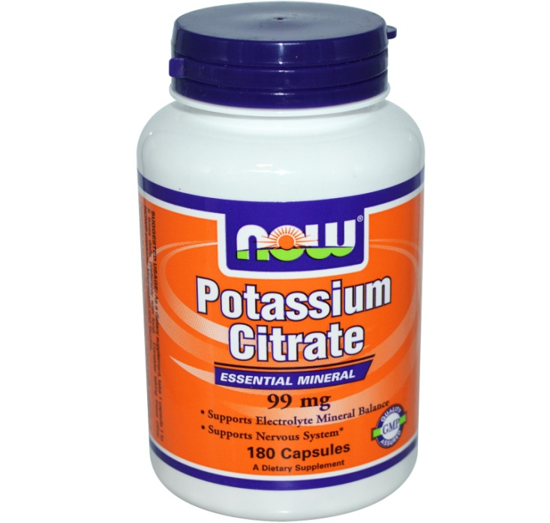
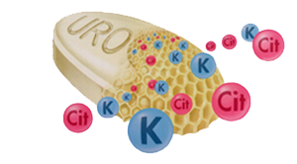
Recognizing Organic Compounds
Organic Compounds:
  The molecular formula MUST contain carbon

Slide 20
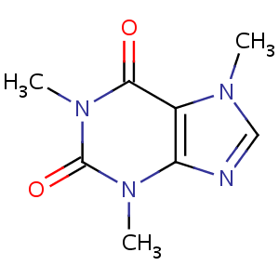
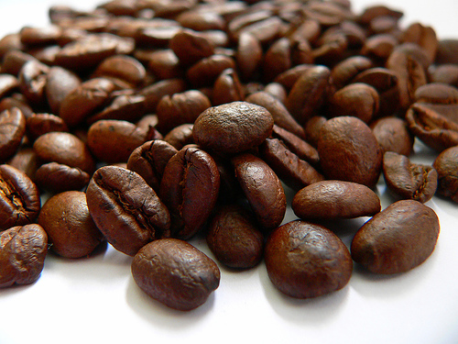
Recognizing Organic Compounds
Organic Compounds:
  The molecular formula MUST contain carbon

Slide 21
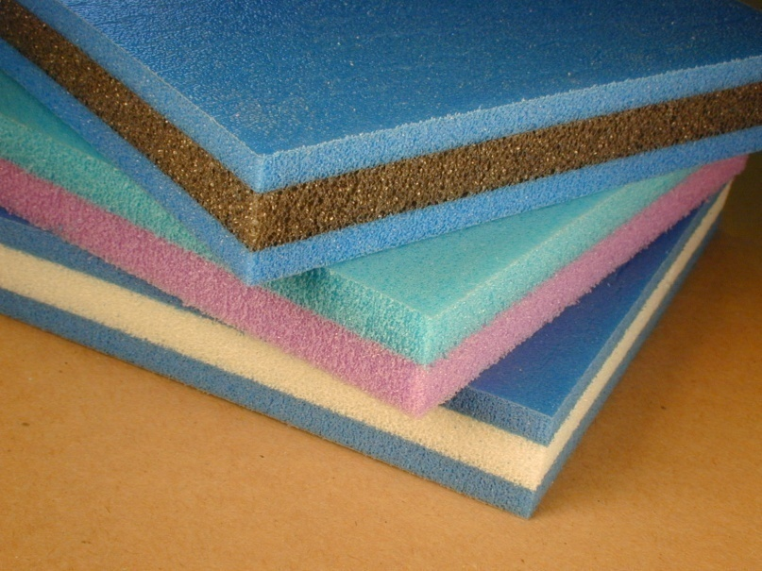
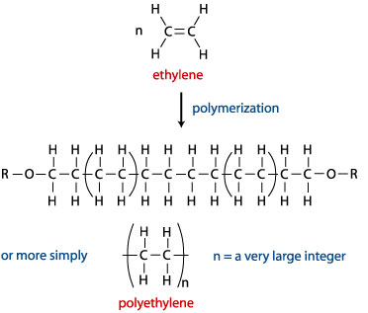
Recognizing Organic Compounds
Organic Compounds:
  The molecular formula MUST contain carbon

Slide 22
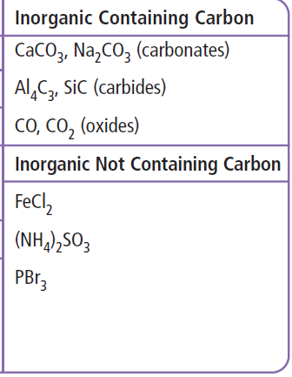
Recognizing Organic Compounds
Inorganic Compounds:
  The molecular formula can contain carbon but it is in a form of carbonates, carbides, and oxides
  No carbon at all

Slide 23
WORKBOOK
Page 98 – 99
Leave a question blank if we haven’t talked about it yet..

Slide 24
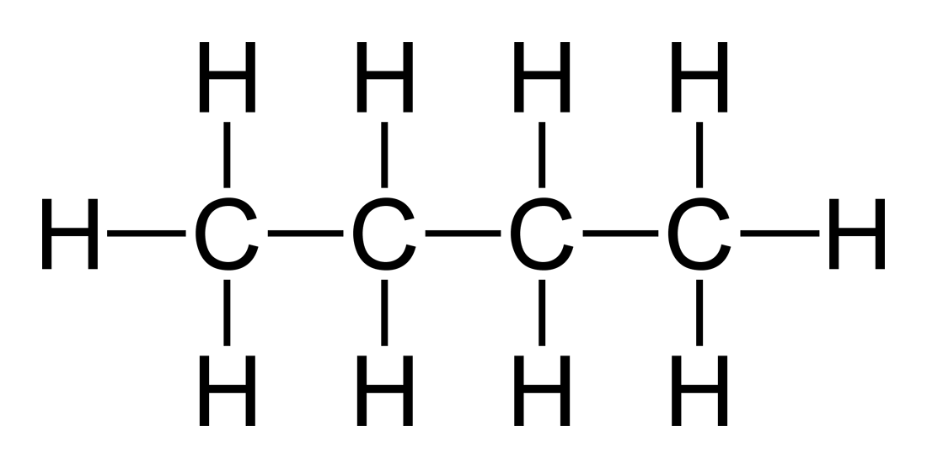
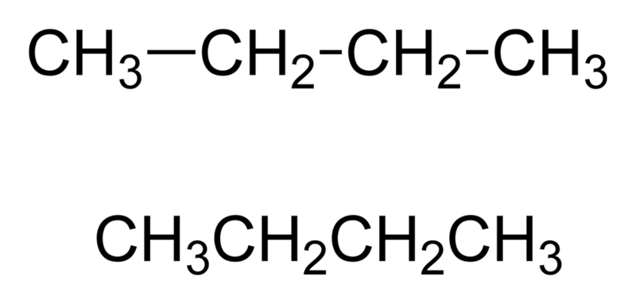
HYDROCARBONS
  Contain ONLY CARBONS and HYDROGENS

Slide 25
STRUCTURAL
FORMULA
SHORTHANDED STRUCTURAL FORMULA
MOLECULAR
FORMULA
C₄H₁₀

Slide 26
REPRESENT ALL POSSIBLE WAYS
FOR FOLLOWING HYDROCARBONS (ALKANES):
C₂H₆
C₃H₈
C₇H₁₆
STRUCTURAL
FORMULA
SHORTHANDED STRUCTURAL FORMULA

Slide 27
STRUCTURAL
FORMULA
SHORTHANDED STRUCTURAL FORMULA
CH₃ – CH₃
MOLECULAR
FORMULA
C₂H₆

Slide 28
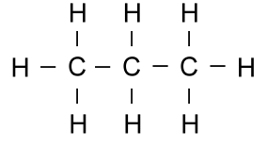
STRUCTURAL
FORMULA
SHORTHANDED STRUCTURAL FORMULA
CH₃ – CH₂ – CH₃
MOLECULAR
FORMULA
C₃H₈

Slide 29

STRUCTURAL
FORMULA
SHORTHANDED STRUCTURAL FORMULA
MOLECULAR
FORMULA
C₇H₁₆

Slide 30
HOMEWORK:
REPRESENT ALL POSSIBLE WAYS
FOR FOLLOWING HYDROCARBONS (ALKANES):
CH₄
C₉H₂₀
C₈H₁₈
STRUCTURAL
FORMULA
SHORTHANDED STRUCTURAL FORMULA

Slide 31
NAMING OF HYDROCARBONS
You just have to know the first ten HYDROCARBONS
The naming is based on the number of carbons
NUMBER OF CARBONS | NAME | MOLECULAR FORMULA | CONDENSED FORMULA = SHORTHAND FORMULA

Slide 32
NAMING OF HYDROCARBONS
NUMBER OF CARBONS | NAME | MOLECULAR FORMULA | CONDENSED FORMULA
1

Slide 33
NAMING OF HYDROCARBONS
NUMBER OF CARBONS | NAME | MOLECULAR FORMULA | CONDENSED FORMULA
1 | methane

Slide 34
NAMING OF UNBRANCHED
(STRAIGHT CHAIN) ALKANES
NAMING OF HYDROCARBONS
NUMBER OF CARBONS | NAME | MOLECULAR FORMULA | CONDENSED FORMULA
1 | methane | CH₄

Slide 35
NAMING OF UNBRANCHED
(STRAIGHT CHAIN) ALKANES
NAMING OF HYDROCARBONS
NUMBER OF CARBONS | NAME | MOLECULAR FORMULA | CONDENSED FORMULA
1 | methane | CH₄ | CH₄

Slide 36
NAMING OF UNBRANCHED
(STRAIGHT CHAIN) ALKANES
NAMING OF HYDROCARBONS
NUMBER OF CARBONS | NAME | MOLECULAR FORMULA | CONDENSED FORMULA
1 | methane | CH₄ | CH₄
2

Slide 37
NAMING OF UNBRANCHED
(STRAIGHT CHAIN) ALKANES
NAMING OF HYDROCARBONS
NUMBER OF CARBONS | NAME | MOLECULAR FORMULA | CONDENSED FORMULA
1 | methane | CH₄ | CH₄
2 | ethane

Slide 38
NAMING OF UNBRANCHED
(STRAIGHT CHAIN) ALKANES
NAMING OF HYDROCARBONS
NUMBER OF CARBONS | NAME | MOLECULAR FORMULA | CONDENSED FORMULA
1 | methane | CH₄ | CH₄
2 | ethane | C₂H₆

Slide 39
NAMING OF UNBRANCHED
(STRAIGHT CHAIN) ALKANES
NAMING OF HYDROCARBONS
NUMBER OF CARBONS | NAME | MOLECULAR FORMULA | CONDENSED FORMULA
1 | methane | CH₄ | CH₄
2 | ethane | C₂H₆ | CH₃ – CH₃

Slide 40
NAMING OF UNBRANCHED
(STRAIGHT CHAIN) ALKANES
NAMING OF HYDROCARBONS
NUMBER OF CARBONS | NAME | MOLECULAR FORMULA | CONDENSED FORMULA
1 | methane | CH₄ | CH₄
2 | ethane | C₂H₆ | CH₃ – CH₃
3

Slide 41
NAMING OF UNBRANCHED
(STRAIGHT CHAIN) ALKANES
NAMING OF HYDROCARBONS
NUMBER OF CARBONS | NAME | MOLECULAR FORMULA | CONDENSED FORMULA
1 | methane | CH₄ | CH₄
2 | ethane | C₂H₆ | CH₃ – CH₃
3 | propane

Slide 42
NAMING OF UNBRANCHED
(STRAIGHT CHAIN) ALKANES
NAMING OF HYDROCARBONS
NUMBER OF CARBONS | NAME | MOLECULAR FORMULA | CONDENSED FORMULA
1 | methane | CH₄ | CH₄
2 | ethane | C₂H₆ | CH₃ – CH₃
3 | propane | C₃H₈

Slide 43
NAMING OF UNBRANCHED
(STRAIGHT CHAIN) ALKANES
NAMING OF HYDROCARBONS
NUMBER OF CARBONS | NAME | MOLECULAR FORMULA | CONDENSED FORMULA
1 | methane | CH₄ | CH₄
2 | ethane | C₂H₆ | CH₃ – CH₃
3 | propane | C₃H₈ | CH₃ – CH₂ – CH₃

Slide 44
NAMING OF UNBRANCHED
(STRAIGHT CHAIN) ALKANES
NAMING OF HYDROCARBONS
NUMBER OF CARBONS | NAME | MOLECULAR FORMULA | CONDENSED FORMULA
1 | methane | CH₄ | CH₄
2 | ethane | C₂H₆ | CH₃ – CH₃
3 | propane | C₃H₈ | CH₃ – CH₂ – CH₃
4

Slide 45
NAMING OF UNBRANCHED
(STRAIGHT CHAIN) ALKANES
NAMING OF HYDROCARBONS
NUMBER OF CARBONS | NAME | MOLECULAR FORMULA | CONDENSED FORMULA
1 | methane | CH₄ | CH₄
2 | ethane | C₂H₆ | CH₃ – CH₃
3 | propane | C₃H₈ | CH₃ – CH₂ – CH₃
4 | butane

Slide 46
NAMING OF UNBRANCHED
(STRAIGHT CHAIN) ALKANES
NAMING OF HYDROCARBONS
NUMBER OF CARBONS | NAME | MOLECULAR FORMULA | CONDENSED FORMULA
1 | methane | CH₄ | CH₄
2 | ethane | C₂H₆ | CH₃ – CH₃
3 | propane | C₃H₈ | CH₃ – CH₂ – CH₃
4 | butane | C₄H₁₀

Slide 47
NAMING OF UNBRANCHED
(STRAIGHT CHAIN) ALKANES
NAMING OF HYDROCARBONS
NUMBER OF CARBONS | NAME | MOLECULAR FORMULA | CONDENSED FORMULA
1 | methane | CH₄ | CH₄
2 | ethane | C₂H₆ | CH₃ – CH₃
3 | propane | C₃H₈ | CH₃ – CH₂ – CH₃
4 | butane | C₄H₁₀ | CH₃ – CH₂ – CH₂ – CH₃

Slide 48
NAMING OF UNBRANCHED
(STRAIGHT CHAIN) ALKANES
NAMING OF HYDROCARBONS
NUMBER OF CARBONS | NAME | MOLECULAR FORMULA | CONDENSED FORMULA
1 | methane | CH₄ | CH₄
2 | ethane | C₂H₆ | CH₃ – CH₃
3 | propane | C₃H₈ | CH₃ – CH₂ – CH₃
4 | butane | C₄H₁₀ | CH₃ – CH₂ – CH₂ – CH₃
5

Slide 49
NAMING OF UNBRANCHED
(STRAIGHT CHAIN) ALKANES
NAMING OF HYDROCARBONS
NUMBER OF CARBONS | NAME | MOLECULAR FORMULA | CONDENSED FORMULA
1 | methane | CH₄ | CH₄
2 | ethane | C₂H₆ | CH₃ – CH₃
3 | propane | C₃H₈ | CH₃ – CH₂ – CH₃
4 | butane | C₄H₁₀ | CH₃ – CH₂ – CH₂ – CH₃
5 | pentane

Slide 50
NAMING OF UNBRANCHED
(STRAIGHT CHAIN) ALKANES
NAMING OF HYDROCARBONS
NUMBER OF CARBONS | NAME | MOLECULAR FORMULA | CONDENSED FORMULA
1 | methane | CH₄ | CH₄
2 | ethane | C₂H₆ | CH₃ – CH₃
3 | propane | C₃H₈ | CH₃ – CH₂ – CH₃
4 | butane | C₄H₁₀ | CH₃ – CH₂ – CH₂ – CH₃
5 | pentane | C₅H₁₂

Slide 51
NAMING OF UNBRANCHED
(STRAIGHT CHAIN) ALKANES
NAMING OF HYDROCARBONS
NUMBER OF CARBONS | NAME | MOLECULAR FORMULA | CONDENSED FORMULA
1 | methane | CH₄ | CH₄
2 | ethane | C₂H₆ | CH₃ – CH₃
3 | propane | C₃H₈ | CH₃ – CH₂ – CH₃
4 | butane | C₄H₁₀ | CH₃ – CH₂ – CH₂ – CH₃
5 | pentane | C₅H₁₂ | CH₃ – CH₂ – CH₂ – CH₂ – CH₃

Slide 52
NAMING OF UNBRANCHED
(STRAIGHT CHAIN) ALKANES
NAMING OF HYDROCARBONS
NUMBER OF CARBONS | NAME | MOLECULAR FORMULA | CONDENSED FORMULA
6
7
8
9
10

Slide 53
NAMING OF UNBRANCHED
(STRAIGHT CHAIN) ALKANES
NAMING OF HYDROCARBONS
NUMBER OF CARBONS | NAME | MOLECULAR FORMULA | CONDENSED FORMULA
6 | hexane

Slide 54
NAMING OF UNBRANCHED
(STRAIGHT CHAIN) ALKANES
NAMING OF HYDROCARBONS
NUMBER OF CARBONS | NAME | MOLECULAR FORMULA | CONDENSED FORMULA
6 | hexane | C₆H₁₄

Slide 55
NAMING OF UNBRANCHED
(STRAIGHT CHAIN) ALKANES
NAMING OF HYDROCARBONS
NUMBER OF CARBONS | NAME | MOLECULAR FORMULA | CONDENSED FORMULA
6 | hexane | C₆H₁₄ | CH₃ – CH₂ – CH₂ – CH₂ – CH₂ – CH₃

Slide 56
NAMING OF UNBRANCHED
(STRAIGHT CHAIN) ALKANES
NAMING OF HYDROCARBONS
NUMBER OF CARBONS | NAME | MOLECULAR FORMULA | CONDENSED FORMULA
6 | hexane | C₆H₁₄ | CH₃ – CH₂ – CH₂ – CH₂ – CH₂ – CH₃
7

Slide 57
NAMING OF UNBRANCHED
(STRAIGHT CHAIN) ALKANES
NAMING OF HYDROCARBONS
NUMBER OF CARBONS | NAME | MOLECULAR FORMULA | CONDENSED FORMULA
6 | hexane | C₆H₁₄ | CH₃ – CH₂ – CH₂ – CH₂ – CH₂ – CH₃
7 | heptane

Slide 58
NAMING OF UNBRANCHED
(STRAIGHT CHAIN) ALKANES
NAMING OF HYDROCARBONS
NUMBER OF CARBONS | NAME | MOLECULAR FORMULA | CONDENSED FORMULA
6 | hexane | C₆H₁₄ | CH₃ – CH₂ – CH₂ – CH₂ – CH₂ – CH₃
7 | heptane | C₇H₁₆

Slide 59
NAMING OF UNBRANCHED
(STRAIGHT CHAIN) ALKANES
NAMING OF HYDROCARBONS
NUMBER OF CARBONS | NAME | MOLECULAR FORMULA | CONDENSED FORMULA
6 | hexane | C₆H₁₄ | CH₃ – CH₂ – CH₂ – CH₂ – CH₂ – CH₃
7 | heptane | C₇H₁₆ | CH₃ – CH₂ – CH₂ – CH₂ – CH₂ – CH₂ – CH₃

Slide 60
NAMING OF UNBRANCHED
(STRAIGHT CHAIN) ALKANES
NAMING OF HYDROCARBONS
NUMBER OF CARBONS | NAME | MOLECULAR FORMULA | CONDENSED FORMULA
6 | hexane | C₆H₁₄ | CH₃ – CH₂ – CH₂ – CH₂ – CH₂ – CH₃
7 | heptane | C₇H₁₆ | CH₃ – CH₂ – CH₂ – CH₂ – CH₂ – CH₂ – CH₃
8

Slide 61
NAMING OF UNBRANCHED
(STRAIGHT CHAIN) ALKANES
NAMING OF HYDROCARBONS
NUMBER OF CARBONS | NAME | MOLECULAR FORMULA | CONDENSED FORMULA
6 | hexane | C₆H₁₄ | CH₃ – CH₂ – CH₂ – CH₂ – CH₂ – CH₃
7 | heptane | C₇H₁₆ | CH₃ – CH₂ – CH₂ – CH₂ – CH₂ – CH₂ – CH₃
8 | octane

Slide 62
NAMING OF UNBRANCHED
(STRAIGHT CHAIN) ALKANES
NAMING OF HYDROCARBONS
NUMBER OF CARBONS | NAME | MOLECULAR FORMULA | CONDENSED FORMULA
6 | hexane | C₆H₁₄ | CH₃ – CH₂ – CH₂ – CH₂ – CH₂ – CH₃
7 | heptane | C₇H₁₆ | CH₃ – CH₂ – CH₂ – CH₂ – CH₂ – CH₂ – CH₃
8 | octane | C₈H₁₈

Slide 63
NAMING OF UNBRANCHED
(STRAIGHT CHAIN) ALKANES
NAMING OF HYDROCARBONS
NUMBER OF CARBONS | NAME | MOLECULAR FORMULA | CONDENSED FORMULA
6 | hexane | C₆H₁₄ | CH₃ – CH₂ – CH₂ – CH₂ – CH₂ – CH₃
7 | heptane | C₇H₁₆ | CH₃ – CH₂ – CH₂ – CH₂ – CH₂ – CH₂ – CH₃
8 | octane | C₈H₁₈ | CH₃ – CH₂ – CH₂ – CH₂ – CH₂ – CH₂ – CH₂ – CH₃

Slide 64
NAMING OF UNBRANCHED
(STRAIGHT CHAIN) ALKANES
NAMING OF HYDROCARBONS
NUMBER OF CARBONS | NAME | MOLECULAR FORMULA | CONDENSED FORMULA
6 | hexane | C₆H₁₄ | CH₃ – CH₂ – CH₂ – CH₂ – CH₂ – CH₃
7 | heptane | C₇H₁₆ | CH₃ – CH₂ – CH₂ – CH₂ – CH₂ – CH₂ – CH₃
8 | octane | C₈H₁₈ | CH₃ – CH₂ – CH₂ – CH₂ – CH₂ – CH₂ – CH₂ – CH₃
9

Slide 65
NAMING OF UNBRANCHED
(STRAIGHT CHAIN) ALKANES
NAMING OF HYDROCARBONS
NUMBER OF CARBONS | NAME | MOLECULAR FORMULA | CONDENSED FORMULA
6 | hexane | C₆H₁₄ | CH₃ – CH₂ – CH₂ – CH₂ – CH₂ – CH₃
7 | heptane | C₇H₁₆ | CH₃ – CH₂ – CH₂ – CH₂ – CH₂ – CH₂ – CH₃
8 | octane | C₈H₁₈ | CH₃ – CH₂ – CH₂ – CH₂ – CH₂ – CH₂ – CH₂ – CH₃
9 | nonane

Slide 66
NAMING OF UNBRANCHED
(STRAIGHT CHAIN) ALKANES
NAMING OF HYDROCARBONS
NUMBER OF CARBONS | NAME | MOLECULAR FORMULA | CONDENSED FORMULA
6 | hexane | C₆H₁₄ | CH₃ – CH₂ – CH₂ – CH₂ – CH₂ – CH₃
7 | heptane | C₇H₁₆ | CH₃ – CH₂ – CH₂ – CH₂ – CH₂ – CH₂ – CH₃
8 | octane | C₈H₁₈ | CH₃ – CH₂ – CH₂ – CH₂ – CH₂ – CH₂ – CH₂ – CH₃
9 | nonane | C₉H₂₀

Slide 67
NAMING OF UNBRANCHED
(STRAIGHT CHAIN) ALKANES
NAMING OF HYDROCARBONS
NUMBER OF CARBONS | NAME | MOLECULAR FORMULA | CONDENSED FORMULA
6 | hexane | C₆H₁₄ | CH₃ – CH₂ – CH₂ – CH₂ – CH₂ – CH₃
7 | heptane | C₇H₁₆ | CH₃ – CH₂ – CH₂ – CH₂ – CH₂ – CH₂ – CH₃
8 | octane | C₈H₁₈ | CH₃ – CH₂ – CH₂ – CH₂ – CH₂ – CH₂ – CH₂ – CH₃
9 | nonane | C₉H₂₀ | CH₃ – CH₂ – CH₂ – CH₂ – CH₂ – CH₂ – CH₂ – CH₂ – CH₃

Slide 68
NAMING OF UNBRANCHED
(STRAIGHT CHAIN) ALKANES
NAMING OF HYDROCARBONS
NUMBER OF CARBONS | NAME | MOLECULAR FORMULA | CONDENSED FORMULA
6 | hexane | C₆H₁₄ | CH₃ – CH₂ – CH₂ – CH₂ – CH₂ – CH₃
7 | heptane | C₇H₁₆ | CH₃ – CH₂ – CH₂ – CH₂ – CH₂ – CH₂ – CH₃
8 | octane | C₈H₁₈ | CH₃ – CH₂ – CH₂ – CH₂ – CH₂ – CH₂ – CH₂ – CH₃
9 | nonane | C₉H₂₀ | CH₃ – CH₂ – CH₂ – CH₂ – CH₂ – CH₂ – CH₂ – CH₂ – CH₃
10

Slide 69
NAMING OF UNBRANCHED
(STRAIGHT CHAIN) ALKANES
NAMING OF HYDROCARBONS
NUMBER OF CARBONS | NAME | MOLECULAR FORMULA | CONDENSED FORMULA
6 | hexane | C₆H₁₄ | CH₃ – CH₂ – CH₂ – CH₂ – CH₂ – CH₃
7 | heptane | C₇H₁₆ | CH₃ – CH₂ – CH₂ – CH₂ – CH₂ – CH₂ – CH₃
8 | octane | C₈H₁₈ | CH₃ – CH₂ – CH₂ – CH₂ – CH₂ – CH₂ – CH₂ – CH₃
9 | nonane | C₉H₂₀ | CH₃ – CH₂ – CH₂ – CH₂ – CH₂ – CH₂ – CH₂ – CH₂ – CH₃
10 | decane

Slide 70
NAMING OF UNBRANCHED
(STRAIGHT CHAIN) ALKANES
NAMING OF HYDROCARBONS
NUMBER OF CARBONS | NAME | MOLECULAR FORMULA | CONDENSED FORMULA
6 | hexane | C₆H₁₄ | CH₃ – CH₂ – CH₂ – CH₂ – CH₂ – CH₃
7 | heptane | C₇H₁₆ | CH₃ – CH₂ – CH₂ – CH₂ – CH₂ – CH₂ – CH₃
8 | octane | C₈H₁₈ | CH₃ – CH₂ – CH₂ – CH₂ – CH₂ – CH₂ – CH₂ – CH₃
9 | nonane | C₉H₂₀ | CH₃ – CH₂ – CH₂ – CH₂ – CH₂ – CH₂ – CH₂ – CH₂ – CH₃
10 | decane | C₁₀H₂₂

Slide 71
NAMING OF UNBRANCHED
(STRAIGHT CHAIN) ALKANES
NAMING OF HYDROCARBONS
NUMBER OF CARBONS | NAME | MOLECULAR FORMULA | CONDENSED FORMULA
6 | hexane | C₆H₁₄ | CH₃ – CH₂ – CH₂ – CH₂ – CH₂ – CH₃
7 | heptane | C₇H₁₆ | CH₃ – CH₂ – CH₂ – CH₂ – CH₂ – CH₂ – CH₃
8 | octane | C₈H₁₈ | CH₃ – CH₂ – CH₂ – CH₂ – CH₂ – CH₂ – CH₂ – CH₃
9 | nonane | C₉H₂₀ | CH₃ – CH₂ – CH₂ – CH₂ – CH₂ – CH₂ – CH₂ – CH₂ – CH₃
10 | decane | C₁₀H₂₂ | CH₃ – CH₂ – CH₂ – CH₂ – CH₂ – CH₂ – CH₂ – CH₂ – CH₂ – CH₃

Slide 72
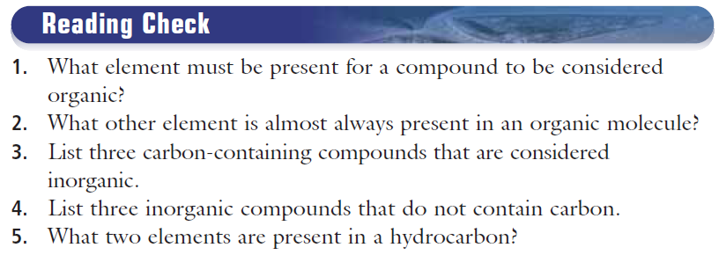
READING CHECK

Slide 73
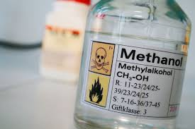
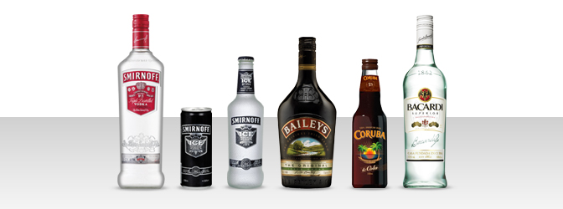
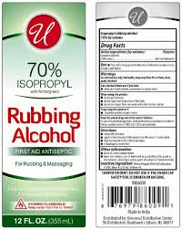
ALCOLHOLS
Organic Compound:
  That contains C, H, and O

Slide 74
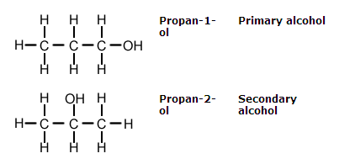
ALCOLHOLS
Organic Compound:
  That contains C, H, and O
  Alcohols dissolves many compounds which water will not

Slide 75
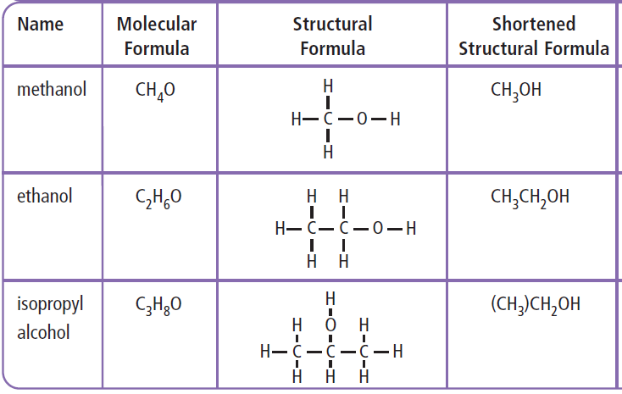

Slide 76
NAMING OF ALCOHOLS
The naming is the same as for alkanes
Replace -e with -ol
NUMBER OF CARBONS | NAME | MOLECULAR FORMULA | CONDENSED FORMULA = SHORTHAND FORMULA

Slide 77
NAMING OF UNBRANCHED
(STRAIGHT CHAIN) ALKANES
NAMING OF ALCOHOLS
NUMBER OF CARBONS | NAME | MOLECULAR FORMULA | CONDENSED FORMULA
1 | methanol | CH₄O | CH₃OH
2 | ethanol | C₂H₆O | CH₃ – CH₂OH
3 | propanol | C₃H₈O | CH₃ – CH₂ – CH₂OH
4 | butanol | C₄H₁₀O | CH₃ – CH₂ – CH₂ – CH₂OH
5 | pentanol | C₅H₁₂O | CH₃ –CH₂ – CH₂ – CH₂ – CH₂OH

Slide 78
CLASSWORK
Organic Compounds Worksheet
FOA 5-3C on page 249
78

Slide 79
WORKBOOK = Homework
Page 98 – 101
79

