Slide 1
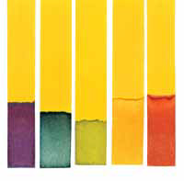
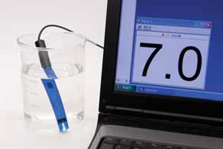
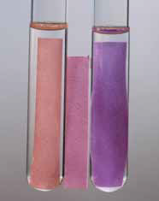
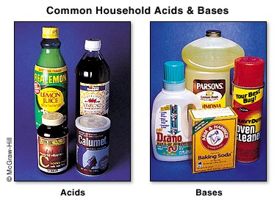
5.1 Acids and Bases

Slide 2
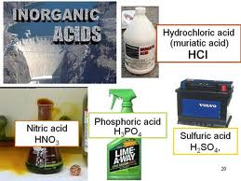
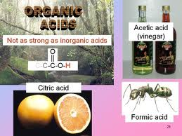
What are acids and how do they taste like?
What acids or acidic
solutions do you know?

Slide 3
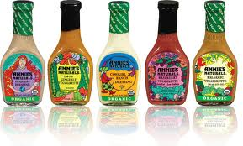
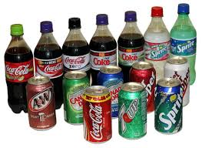
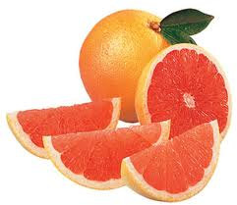
What are acids and how do they taste like?
Taste:
sour, tart, tangy

Slide 4
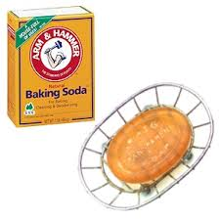
What are bases and how do they taste like?
What bases or basic
solutions do you know?

Slide 5
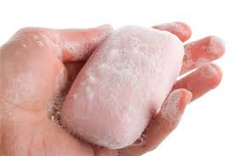
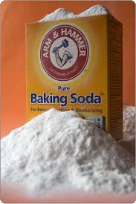
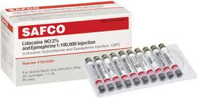
What are bases and how do they taste like?
Taste:
Bitter, feel slippery

Slide 6
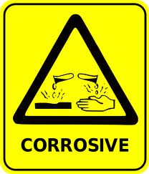
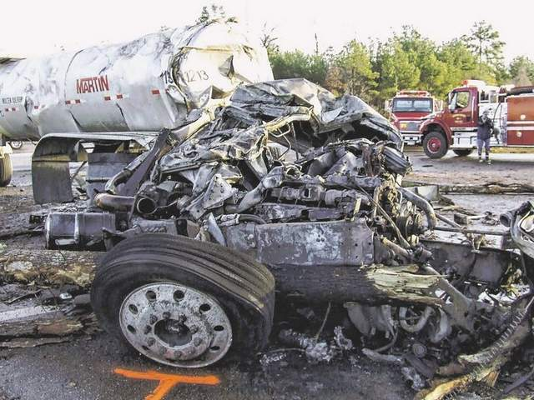
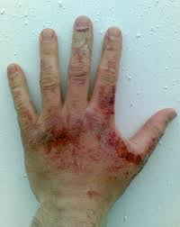
Acids and Bases should be handled with care sometimes

Slide 7
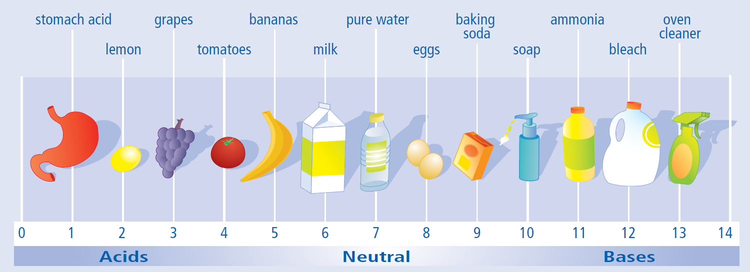
Is a number scale for measuring how acidic or basic something is
pH Scale

Slide 8
Is a number scale for measuring how acidic or basic something is - it goes from 0 to 14
pH Scale

Slide 9
Is a number scale for measuring how acidic or basic something is - it goes from 0 to 14 - no units
pH Scale

Slide 10
ACIDS: solutions that have pH from 0 – 7 (not including 7)
pH Scale

Slide 11
ACIDS: solutions that have pH from 0 – 7 (not including 7) BASES: solutions that have pH from 7 – 14 (not including 7)
pH Scale

Slide 12
ACIDS: solutions that have pH from 0 – 7 (not including 7) BASES: solutions that have pH from 7 – 14 (not including 7) NEUTRAL SOLUTIONS: produce solutions where pH = 7
pH Scale

Slide 13
- 1 unit of change of pH = 10 times change in the degree of acidity/basicity For example: tomatoes (pH = 4) is 10 times more acidic than bananas (pH = 5)
pH Scale

Slide 14
tomatoes (pH = 4) lemons (pH = 2)
How many times are
lemons more acidic than tomatoes?
milk less acidic than grapes?
oven cleaner more basic than soap
milk (pH = 6) grapes (pH = 3)
oven cleaner (pH = 13) soap (pH = 10)

Slide 15
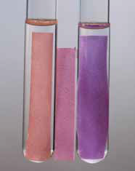
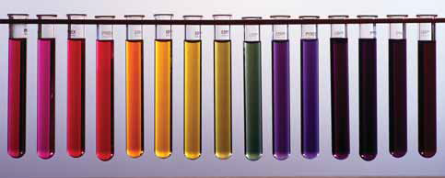
pH INDICATORS
Many acids/bases are colorless (like water)that’s why we need a way to tell them apart
Chemicals that change color depending on the pH of the solution they are placed in
Litmus Paper
Universal Indicator
Digital pH meter
pH paper

Slide 16
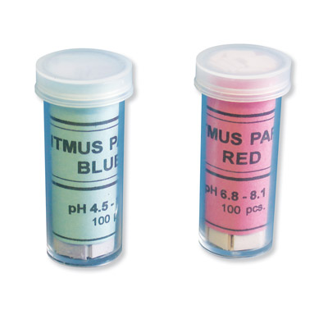
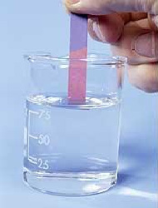
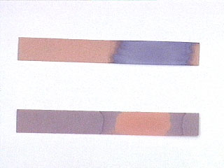
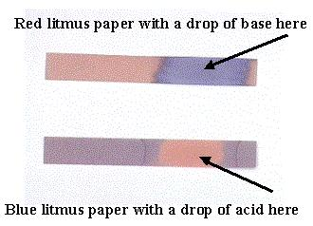
pH INDICATORS
Litmus Paper
Litmus paper comes in two forms, red and blue.
When blue litmus is placed in a solution that is acidic (below pH 7), the blue litmus paper turns red.
When red litmus paper is placed into a solution that is basic (above pH 7), the red litmus paper changes to blue.
If blue litmus stays blue = NEUTRAL SOLUTION
If red litmus stays red = NEUTRAL SOLUTION

Slide 17
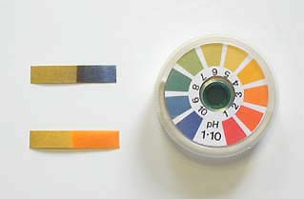
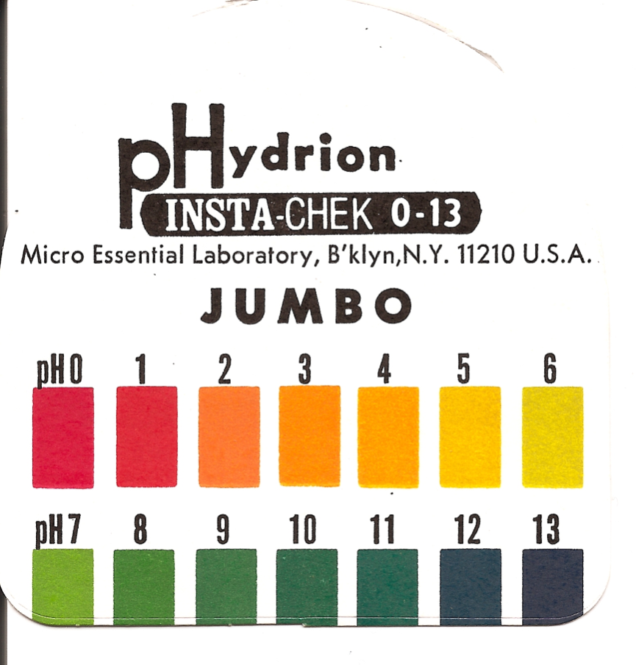
pH INDICATORS
pH paper
Paper that turns different color depending on the acidity/basicity of the solution

Slide 18
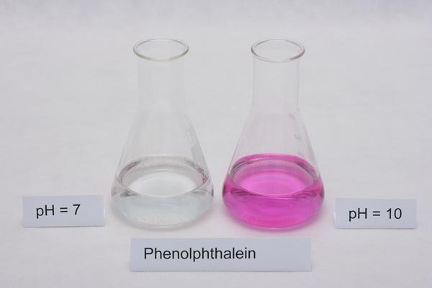
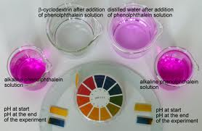
pH INDICATORS
Universal Indicator
A liquid that turns different color when you add acid or base to it (i.e. when the acidity or basicity changes)

Slide 19
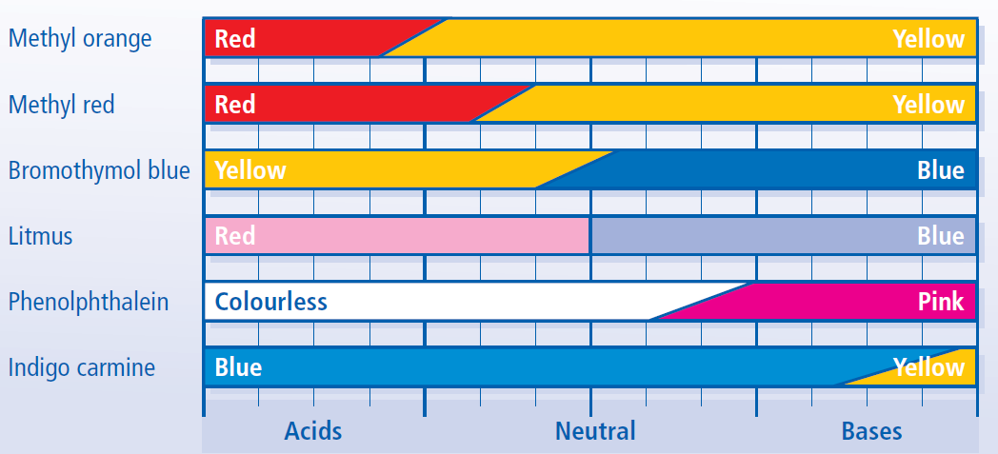
pH INDICATORS
Universal Indicator
A liquid that turns different color when you add acid or base to it (i.e. when the acidity or basicity changes)

Slide 20
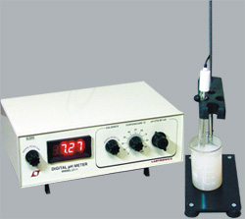
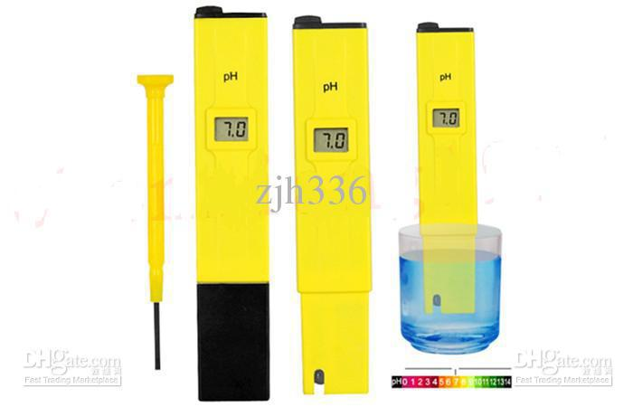
pH INDICATORS
The most accurate meter
Digital pH meter

Slide 21
1. Predict whether each liquid is ACIDIC, BASIC, or NEUTRAL? 2. Use pH paper to verify your predictions 3. Create a pH scale to show your results
FOA – Acidic, Basic, or Neutral

Slide 22
Read textbook (pg. 220 – 224) and answer the questions

Slide 23
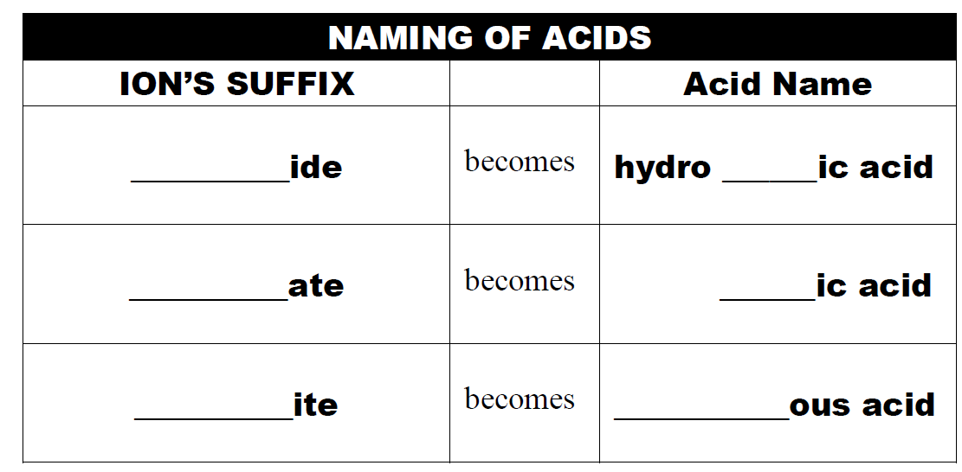
Naming of Acids

Slide 24
Naming Acids
A SIMPLE DESCRIPTION:
An acid is a compound which has its formula starting with “H”
The formula of an acid is one or more hydrogens bonded to a monatomic or polyatomic anion.
The way that the acid is named is determined by the suffix of the anion.
HCl, HF, H₂SO₄, HNO₃
WHAT IS AN ACID?

Slide 25
Naming Acids
Naming Acids
The way that the acid is named is determined by the suffix of the anion.
NO₃⁻
N³⁻
NO₂⁻
nitrate
nitride
nitrite

Slide 26
Naming Acids
Naming Acids
Name this compound
HNO₃
hydrogen nitrate

Slide 27
Naming Acids
Naming Acids
Name this compound
H₃N
hydrogen nitride

Slide 28
Naming Acids
Naming Acids
Name this compound
HNO₂
hydrogen nitrite

Slide 29
Naming Acids
Naming Acids
The way that the acid is named is determined by the suffix of the anion.
HNO₃
H₃N
HNO₂
hydrogen nitrate
hydrogen nitride
hydrogen nitrite
The naming is different though:
hydrogen nitrate
nitric acid
hydrogen nitride
hydronitric acid
hydrogen nitrite
nitrous acid

Slide 30
Naming Acids
Naming Acids
In general
hydrogen ___ide
hydro ___ic acid
hydrogen ___ate
______ic acid
hydrogen ___ite
_____ous acid

Slide 31
Naming Acids
Naming Acids
Examples:
HCl
H₂SO₄
HClO₂
HF

Slide 32
Naming Acids
Naming Acids
What is the suffix?
HCl
- ide
hydrochloric acid
H₂SO₄
- ate
sulphuric acid
HClO₂
- ite
chlorous acid
HF
- ide
hydrofluoric acid

Slide 33
Read textbook (pg. 225 – 226) and answer the questions

Slide 34
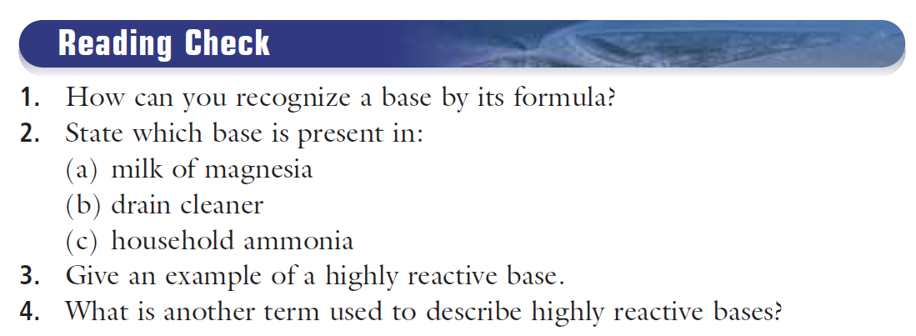
Read textbook (pg. 225 – 227) and answer the questions

Slide 35
Workbook (pg. 84 – 85)

Slide 36
Workbook (pg. 84 – 85)

Slide 37
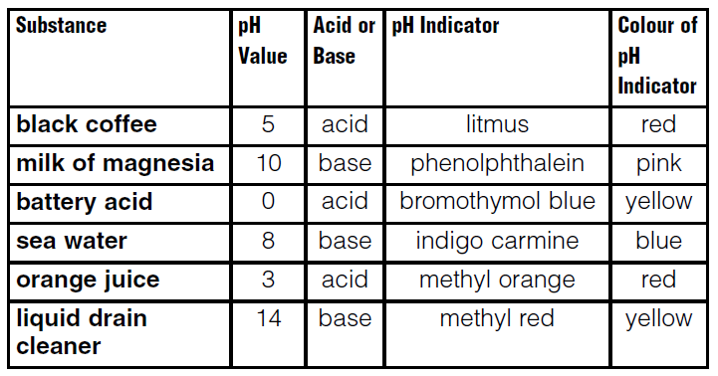
Workbook (pg. 84 – 85)

Slide 38
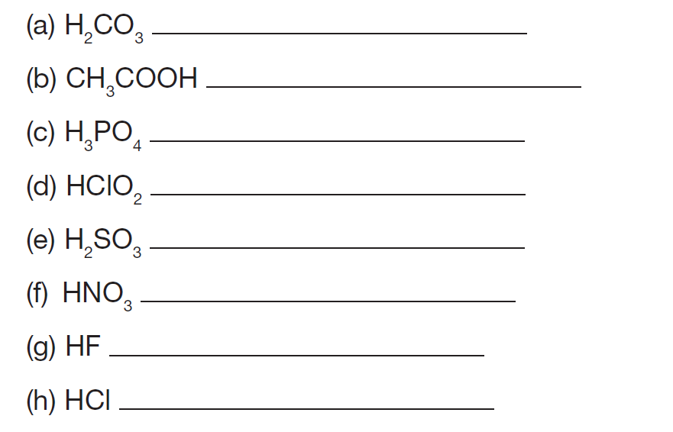
Workbook (pg. 86)

Slide 39
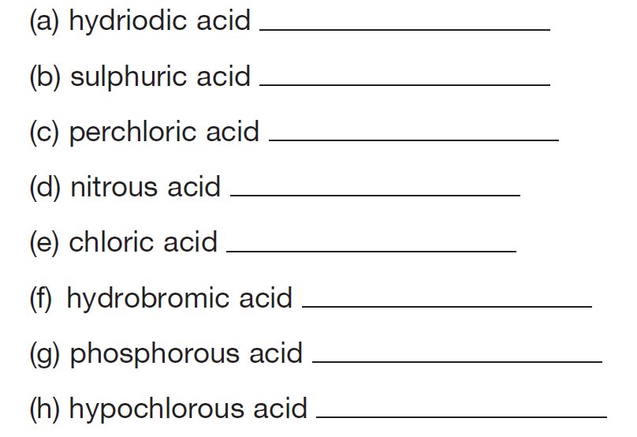

Slide 40
Production of Ions
Acids
Bases
HCl, H₂SO₄
HF, HNO₃
NaOH, Ca(OH)₂
KOH, NH₄OH

Slide 41
Production of Ions
Acids
Bases
HCl, H₂SO₄
HF, HNO₃
NaOH, Ca(OH)₂
KOH, NH₄OH
Produce H⁺

Slide 42
Production of Ions
Acids
Bases
HCl, H₂SO₄
HF, HNO₃
NaOH, Ca(OH)₂
KOH, NH₄OH
Produce H⁺
Produce OH⁻

Slide 43
pH = the amount of H⁺ in a solution
Testing for pH = test for H⁺
Acids
HCl, H₂SO₄
HF, HNO₃
the amount of H⁺
=
CONCENTRATION of H⁺
Produce H⁺

Slide 44
Testing for pH = test for H⁺
Low pH = LOT OF H⁺ = high concentration of H⁺
High pH = VERY LITTLE H⁺ = low concentration of H⁺
H⁺ and OH⁻ Are Chemical Opposites

Slide 45
Testing for pH = test for H⁺
Low pH = VERY LITTLE OH⁻ = low concentration of OH⁻
High pH = LOT OF OH⁻ = high concentration of OH⁻

Slide 46
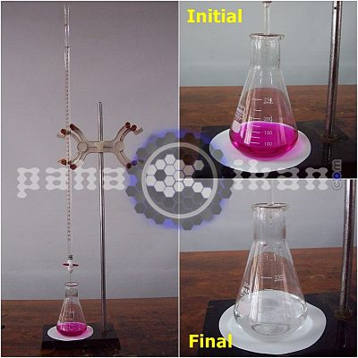
Neutralization = balance of H⁺ and OH⁻
When acids (containing H⁺) combine with bases (containing OH⁻), they form water
=
NEUTRAL SOLUTION
H⁺ + OH⁻ → HOH
H⁺ + OH⁻ → H₂O

Slide 47
Complete
BLM 2 – 25 Acids and Bases
BLM 2 – 26 Working with Acids and Bases

Slide 48
Complete
5.1 Check Your Understanding

