Slide 1
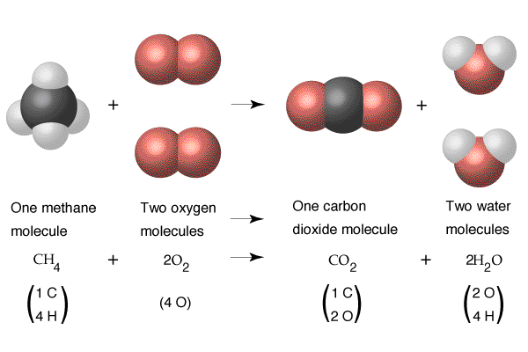
4.3 CHEMICAL EQUATIONS

Slide 2
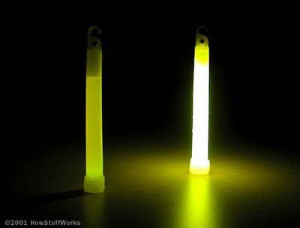
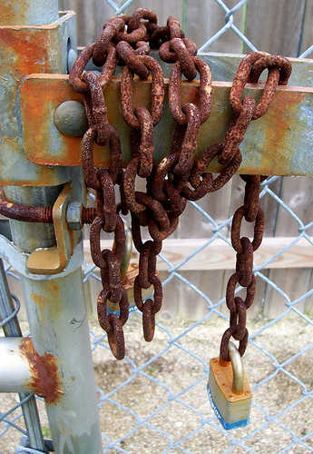
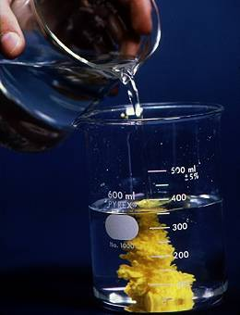
Introduction to Chemical Equations
How Do you Know whether a chemical reaction happened?
2

Slide 3
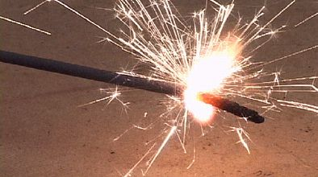
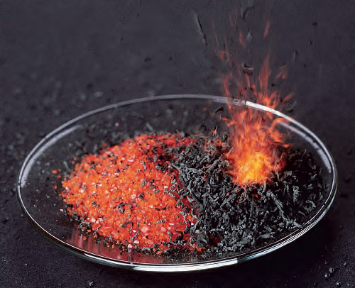
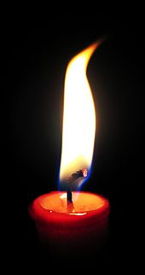
Introduction to Chemical Equations
Energy (temperature) CHANGE
Energy, in the form of heat, light, sound or electricity, is produced
3

Slide 4
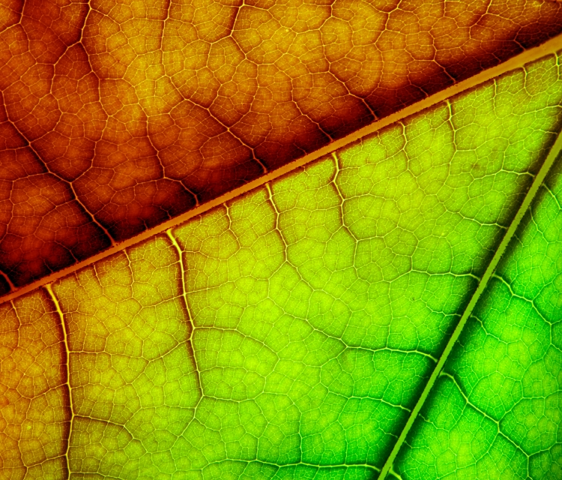
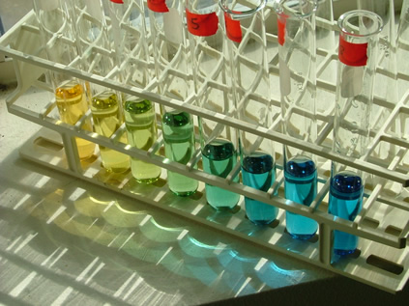
Introduction to Chemical Equations
COLOR CHANGE
The final product(s) may have a different color than the colors of the starting materials.
4

Slide 5
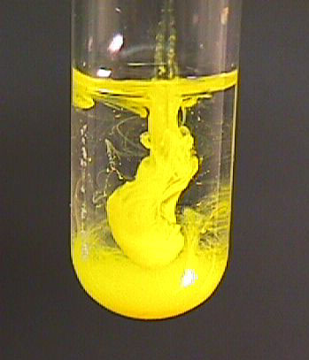
Introduction to Chemical Equations
STATE CHANGE
The final materials may include a substance in a state that is different from the starting materials
5

Slide 6
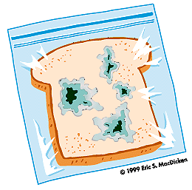
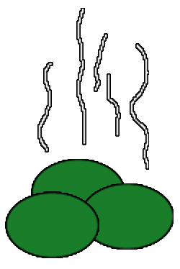
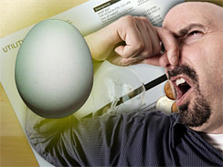
Introduction to Chemical Equations
ODOR (smell) CHANGE
The final materials may have different odours than those of the starting materials
6

Slide 7
In general…
A chemical reaction occurs when the starting species form different chemicals
7

Slide 8
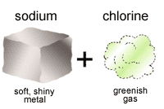
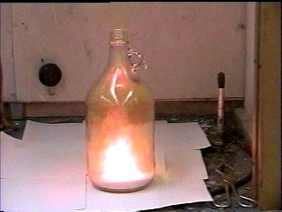
A Chemical Equation
Is an equation that shows the chemicals used up and produced during a chemical reaction
REACTANTS → PRODUCTS
2 Na + Cl₂ → 2 NaCl

Slide 9
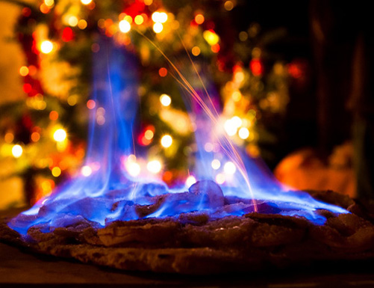
Can be represented by
Chemical REACTIONS
A symbolic
Chemical Equation
Ethanol + oxygen → carbon dioxide + water
A word
Chemical Equation

Slide 10
A Chemical Equation

Slide 11
The chemical equation for a reaction gives two important types of information:
The meaning a Chemical Equation
The Nature Of The Reactants And Products
The Relative Number Of
Reactants And Products

Slide 12
1. The Nature Of The Reactants And Products

Slide 13
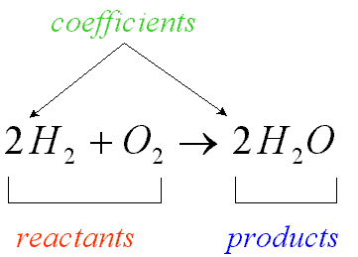
2. The Relative Number Of Reactants and Products

Slide 14
Refer to the following balanced chemical equation to answer these questions: 3H₂ + N₂ ➔ 2NH₃
1. List the names of the reactants.
2. Give the formula of the product.
3. How many molecules of hydrogen (H₂) will combine exactly with one molecule of nitrogen (N₂)?
4. How many molecules of nitrogen are required to produce 10 molecules of ammonia (NH₃)?
5. What is the symbol that means “produces” in a chemical reaction?

Slide 16
Conservation of mass in Chemical Reactions
What happens when atoms of Aluminum and bromine are brought together and ignited?
(video)

Slide 17
Conservation of mass in Chemical Reactions
What happens when atoms of Aluminum and bromine are brought together and ignited?
Are new atoms created?
Are some atoms destroyed?

Slide 18
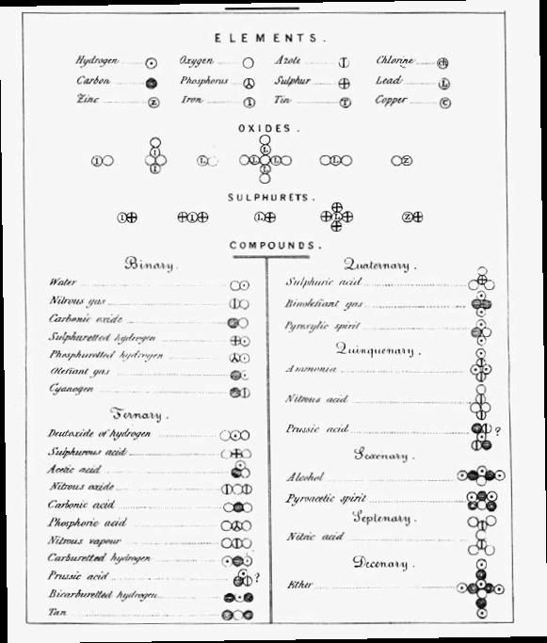
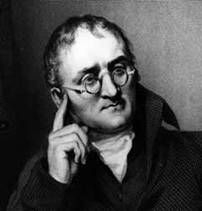
Conservation of mass in Chemical Reactions
John Dalton found out that:

Slide 19
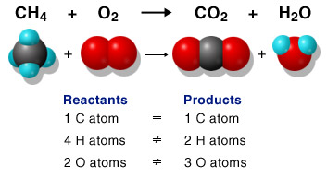
Conservation of mass in Chemical Reactions
John Dalton found out that:
Atoms re arrange themselves during chemical reactions

Slide 20
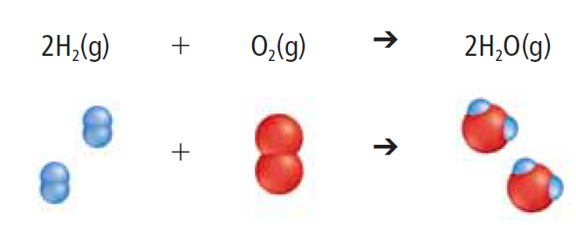
Conservation of mass in Chemical Reactions
John Dalton found out that:
Total number of atoms before the reaction = total number of atoms after a reaction

Slide 21
ATOMIC THEORY by DALTON
Atoms can neither be created nor destroyed in chemical reactions.

Slide 22
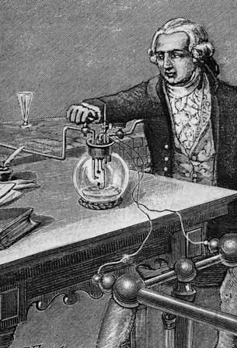
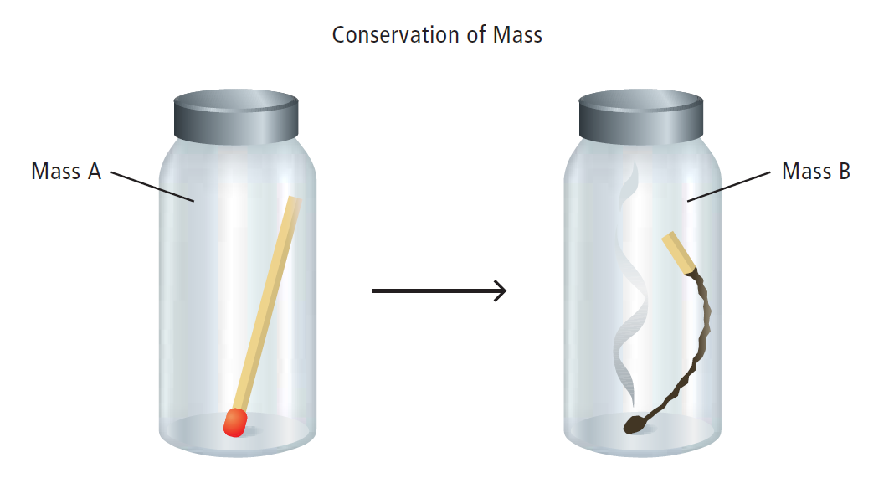
Conservation of Mass in Chemical Reactions
Antoine Lavoisier found out:

Slide 23
This principle is called The Law of Conservation of Mass
Mass is conserved in a chemical reaction:
the total mass of the products is always equal to the total mass of the reactants in a chemical reaction.
Antoine Lavoisier found out:

Slide 24
Balancing a Chemical Equation
Based on The Law of Conservation of Mass,
we have to make sure that each side of the chemical equation has the same number of each type of atom
We call this
BALANCING THE EQUATION

Slide 25
There must be the same number of each type of atom on the product side and on the reactant side of the arrow.
CH₄
O₂
CO₂
H₂O
Look at the equation…
Is there the same number of each type of atom on either side?

Slide 26
There must be the same number of each type of atom on the product side and on the reactant side of the arrow.
CH₄
O₂
CO₂
H₂O
Look at the equation…
Is there the same number of each type of atom on either side?
C = 1
C = 1
H = 4
H = 2
O = 2
O = 3

Slide 27
There must be the same number of each type of atom on the product side and on the reactant side of the arrow.
CH₄
O₂
CO₂
H₂O
C = 1
NO!
C = 1
H = 4
H = 2
O = 2
O = 3

Slide 28
There must be the same number of each type of atom on the product side and on the reactant side of the arrow.
We call this BALANCING THE EQUATION
CH₄
O₂
CO₂
H₂O
C = 1
C = 1
We must even this difference
out!
H = 4
H = 2
O = 2
O = 3

Slide 29
Balancing a Chemical Equation
(NH₄)₃PO4 +
NaOH
Na₃PO4 +
H₂O +
NH₃

Slide 30
Balancing a Chemical Equation
(NH₄)₃PO4 +
NaOH
Na₃PO₄+
H₂O +
NH₃
Easy Way To Balance an Equation?
Practice,
Practice,
Practice!

Slide 31
Balancing a Chemical Equation
(NH₄)₃PO4 +
NaOH
Na₃PO₄+
H₂O +
NH₃
Easy Way To Balance an Equation?
Our textbook offers many helpful hints!
You Can Develop Your Own Way!

Slide 32
Balancing a Chemical Equation
(NH₄)₃PO4 +
NaOH
Na₃PO4 +
H₂O +
NH₃
How many different atoms do we have?
5
N
H
O
Na
P

Slide 33
Balancing a Chemical Equation
(NH₄)₃PO4 +
NaOH
Na₃PO₄+
H₂O +
NH₃
How many of each atom on each side do we have?
N = 3
N = 1
H = 13
H = 5
O = 5
O = 5
P = 1
P = 1
Na = 1
Na = 3

Slide 34
Balancing a Chemical Equation
(NH₄)₃PO4 +
NaOH
Na₃PO₄+
H₂O +
NH₃
1. Hint: O and H are always the easiest to balance (using H₂O, H₂, or O₂ ). So do them at the end!
N = 3
N = 1
H = 13
H = 5
O = 5
O = 5
P = 1
P = 1
Na = 1
Na = 3

Slide 35
Balancing a Chemical Equation
(NH₄)₃PO4 +
NaOH
Na₃PO₄+
H₂O +
NH₃
2. Leave O, H and P (P is balanced right now) alone for now.
N = 3
N = 1
H = 13
H = 5
O = 5
O = 5
P = 1
P = 1
Na = 1
Na = 3

Slide 36
Balancing a Chemical Equation
3
(NH₄)₃PO4 +
NaOH
Na₃PO₄+
H₂O +
NH₃
3. Balance N
N = 3
N = 1
Multiply NH₃ by 3 to get 3 nitrogen atoms on the right side
H = 13
H = 5
O = 5
O = 5
P = 1
P = 1
Na = 1
Na = 3

Slide 37
Balancing a Chemical Equation
3
(NH₄)₃PO4 +
NaOH
Na₃PO₄+
H₂O +
NH₃
4. Adjust the number of N and H
N = 3
N = 1
H = 13
H = 5
O = 5
O = 5
P = 1
P = 1
Na = 1
Na = 3

Slide 38
Balancing a Chemical Equation
3
(NH₄)₃PO4 +
NaOH
Na₃PO₄+
H₂O +
NH₃
4. Adjust the number of N and H
N = 3
N = 3
H = 13
H = 5
O = 5
O = 5
P = 1
P = 1
Na = 1
Na = 3

Slide 39
Balancing a Chemical Equation
3
(NH₄)₃PO4 +
NaOH
Na₃PO₄+
H₂O +
NH₃
4. Adjust the number of N and H
N = 3
N = 3
H = 13
H = 11
O = 5
O = 5
P = 1
P = 1
Na = 1
Na = 3

Slide 40
Balancing a Chemical Equation
3
3
(NH₄)₃PO4 +
NaOH
Na₃PO₄+
H₂O +
NH₃
5. Balance Na
N = 3
N = 3
Multiply NaOH by 3 to get 3 sodium atoms on the right side
H = 13
H = 11
O = 5
O = 5
P = 1
P = 1
Na = 1
Na = 3

Slide 41
Balancing a Chemical Equation
3
3
(NH₄)₃PO4 +
NaOH
Na₃PO₄+
H₂O +
NH₃
6. Adjust the number of Na, O and H
N = 3
N = 3
H = 13
H = 11
O = 5
O = 5
P = 1
P = 1
Na = 1
Na = 3

Slide 42
Balancing a Chemical Equation
3
3
(NH₄)₃PO4 +
NaOH
Na₃PO₄+
H₂O +
NH₃
6. Adjust the number of Na, O and H
N = 3
N = 3
H = 13
H = 11
O = 5
O = 5
P = 1
P = 1
Na = 3
Na = 3

Slide 43
Balancing a Chemical Equation
3
3
(NH₄)₃PO4 +
NaOH
Na₃PO₄+
H₂O +
NH₃
6. Adjust the number of Na, O and H
N = 3
N = 3
H = 13
H = 11
O = 7
O = 5
P = 1
P = 1
Na = 3
Na = 3

Slide 44
Balancing a Chemical Equation
3
3
(NH₄)₃PO4 +
NaOH
Na₃PO₄+
H₂O +
NH₃
6. Adjust the number of Na, O and H
N = 3
N = 3
H = 15
H = 11
O = 7
O = 5
P = 1
P = 1
Na = 3
Na = 3

Slide 45
Balancing a Chemical Equation
3
3
3
(NH₄)₃PO4 +
NaOH
Na₃PO₄+
H₂O +
NH₃
7. Balance O and H using H₂O
N = 3
N = 3
H = 15
H = 11
O = 7
Multiply H₂O by 3
O = 5
P = 1
P = 1
Na = 3
Na = 3

Slide 46
Balancing a Chemical Equation
3
3
3
(NH₄)₃PO4 +
NaOH
Na₃PO₄+
H₂O +
NH₃
8. Adjust the number O and H
N = 3
N = 3
H = 15
H = 11
O = 7
O = 5
P = 1
P = 1
Na = 3
Na = 3

Slide 47
Balancing a Chemical Equation
3
3
3
(NH₄)₃PO4 +
NaOH
Na₃PO₄+
H₂O +
NH₃
8. Adjust the number O and H
N = 3
N = 3
H = 15
H = 11
O = 7
O = 7
P = 1
P = 1
Na = 3
Na = 3

Slide 48
Balancing a Chemical Equation
3
3
3
(NH₄)₃PO4 +
NaOH
Na₃PO₄+
H₂O +
NH₃
8. Adjust the number O and H
N = 3
N = 3
H = 15
DONE!
H = 15
O = 7
O = 7
P = 1
P = 1
Na = 3
Na = 3

Slide 49
SAS Curriculum Pathway
Google: SAS Curriculum Pathways
Log in name: row57itself
Select: Science - Chemical Equations

Slide 50
Using Chemical Word Equations
You have to be able to translate this kind of word equations into “regular” chemical equations:
Liquid water reacts with powdered sodium oxide to produce aqueous sodium hydroxide

Slide 51
Using Chemical Word Equations
You have to be able to translate this kind of word equations into “regular” chemical equations:
Aqueous hydrochloric acid reacts with calcium carbonate crystals, producing aqueous calcium chloride, gaseous carbon dioxide, and liquid water

Slide 52
Liquid water reacts with powdered sodium oxide to produce aqueous sodium hydroxide
Words like:
“powder,”
“crystals,”
“precipitate”

Slide 53
Liquid water reacts with powdered sodium oxide to produce aqueous sodium hydroxide
mean
that particular species is a solid

Slide 54
Liquid water reacts with powdered sodium oxide to produce aqueous sodium hydroxide

Slide 55
Liquid water reacts with powdered sodium oxide to produce aqueous sodium hydroxide
2
H₂O(l) +
Na₂O(s)
NaOH(aq)
BALANCE THE EQUATION!

Slide 56
Aqueous hydrochloric acid reacts with calcium carbonate crystals, producing aqueous calcium chloride, gaseous carbon dioxide, and liquid water

Slide 57
Aqueous hydrochloric acid reacts with calcium carbonate crystals, producing aqueous calcium chloride, gaseous carbon dioxide, and liquid water
2
CaCl₂(aq) +
CaCO₃(s) +
HCl(aq)
H₂O(l) +
CO2(g)
BALANCE THE EQUATION!

Slide 58
Aqueous hydrochloric acid reacts with calcium carbonate crystals, producing aqueous calcium chloride, gaseous carbon dioxide, and liquid water

Slide 59
Aqueous hydrochloric acid reacts with calcium carbonate crystals, producing aqueous calcium chloride, gaseous carbon dioxide, and liquid water
2
CaCl₂(aq) +
CaCO₃(s) +
HCl(aq)
H₂O(l) +
CO2(g)
BALANCE THE EQUATION!

Slide 60
TEXTBOOK
PAGE: 211
PROBLEMS: Practice Problems

Slide 61
WORKBOOK
PAGE: 77 - 78
PROBLEMS: all

Slide 62
WORKBOOK
PAGE: 77 - 78
PROBLEMS: all

