Slide 1
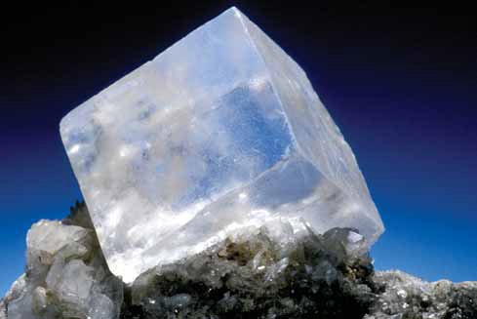
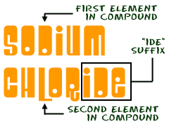
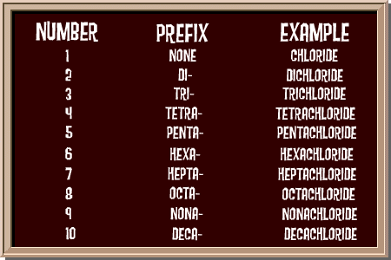
4.2 Names and Formulas of Compounds
Pages 184 - 200

Slide 2
SHOWBIE App
The class code for your Science 10 class is: BDDYG

Slide 3
Evernote App
The class code for your Science 10 class is: BDDYG

Slide 4
QUICK REVIEW OF ELEMENTS, IONS, and COMPOUNDS

Slide 5
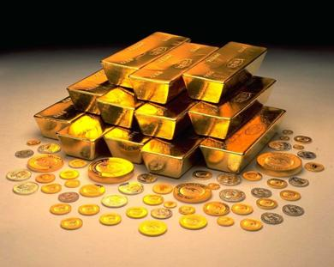
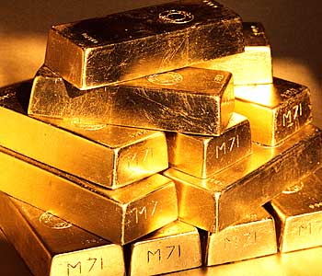
The Chemical Elements
Rules for Naming and Writing:
1.) Each element has a name and a symbol
NAME
SYMBOL
Gold
Au

Slide 6
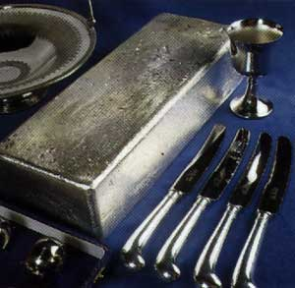
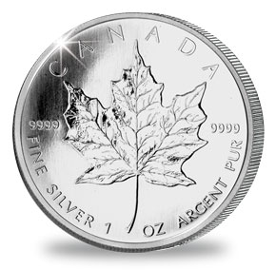
The Chemical Elements
Rules for Naming and Writing:
1.) Each element has a name and a symbol
NAME
SYMBOL
Gold
Silver
Au
Ag

Slide 7
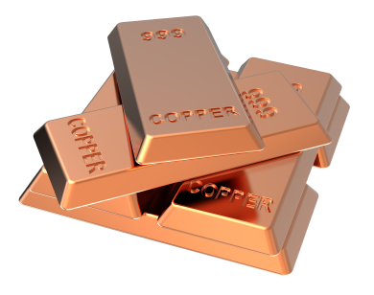
The Chemical Elements
Rules for Naming and Writing:
1.) Each element has a name and a symbol
NAME
SYMBOL
Gold
Silver
Copper
Au
Ag
Cu

Slide 8
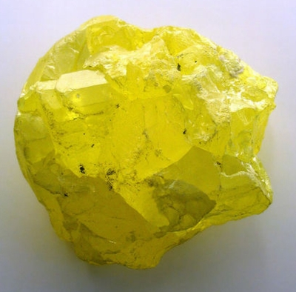
The Chemical Elements
Rules for Naming and Writing:
1.) Each element has a name and a symbol
NAME
SYMBOL
Gold
Silver
Copper
Sulphur
Au
Ag
Cu
S

Slide 9
The Chemical Elements
Rules for Naming and Writing:
2.) The first letter in the symbol is always in the upper case, the second (if present) is always in the lower case
Al

Slide 10
The Chemical Elements
Rules for Naming and Writing:
2.) The first letter in the symbol is always in the upper case,
the second (if present) is always in the lower case
P

Slide 11
Naming and Writing Formulae of Ionic Compounds
What is an Ionic Compound?
A compound made up of ions of a metal AND
a non-metal or a polyatomic ion
A compound in which a metal and a non-metal/polyatomic ion donate and accept electrons
The net (overall) charge of the ionic compound is 0
i.e. the compound is NEUTRAL

Slide 12
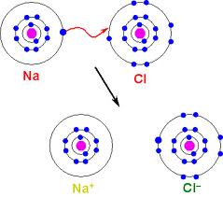
IONIC COMPOUNDS
Formed by an attraction of positively charged ion and negatively charged ion
Chemical formula
NaCl

Slide 13
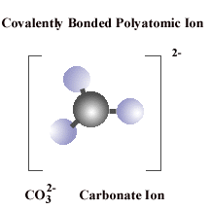
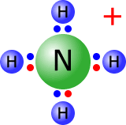
Naming of IONIC COMPOUNDS
metal
nonmetal
metal
polyatomic
ion
UNIVALENT
MULTIVALENT
polyatomic
ion
polyatomic
ion
Al³⁺
Fe³⁺
Fe²⁺

Slide 14
Naming of IONIC COMPOUNDS
metal
nonmetal
UNIVALENT
MULTIVALENT
Al³⁺
Fe³⁺
Fe²⁺

Slide 15
Chemical names of Ionic Compounds
Have always two parts: one for a metal ion (Ca²⁺) and one for non metal ion (Cl⁻)
CaCl₂
Name the metal ion (a positive ion)
Name the non-metal ion (a negative ion)
Put 1 + 2 together
Let’s learn how to name the metal ions first!

Slide 16
There Are Two Types Of Metal Ions
metal
More than one charge
UNIVALENT
MULTIVALENT
Al³⁺
Fe³⁺
only one charge
Fe²⁺

Slide 17
There Are Two Types Of Metal Ions
If a metal has only one charge
METAL NAME | METAL SYMBOL | METAL ION NAME | METAL ION SYMBOL

Slide 18
UNIVALENT METAL ION (cation)
If a metal has only one charge
METAL NAME | METAL SYMBOL | METAL ION NAME | METAL ION SYMBOL

Slide 19
To name a cation...
Use only the name of a metal
METAL SYMBOL | METAL NAME | METAL ION SYMBOL | METAL ION NAME
Ca | calcium | Ca²⁺ | calcium
K | potassium | K⁺ | potassium
Mg | magnesium | Mg²⁺ | magnesium
Ag | silver | Ag⁺ | silver
Li | lithium | Li⁺ | lithium
Al | aluminum | Al³⁺ | aluminum
Ba | barium | Ba²⁺ | barium
Cs | cesium | Cs⁺ | cesium

Slide 20
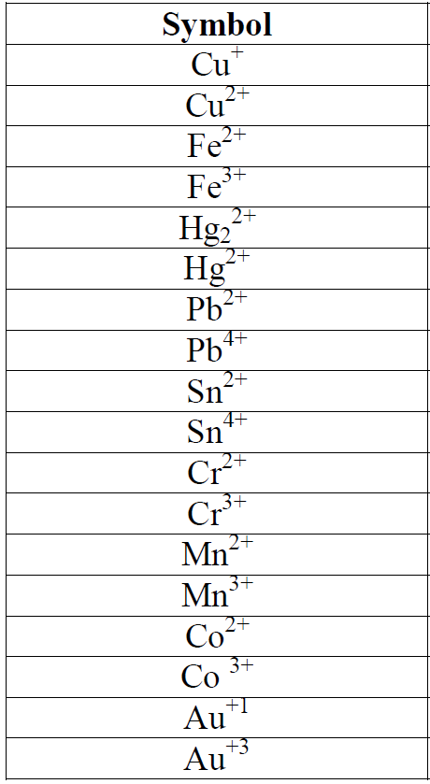
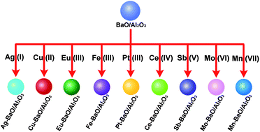
MULTIVALENT METAL ION (cations)
If a metal has more than one charge…

Slide 21
To name a MULTIVALENT ION
Name exactly like an Univalent Metal Ion, but...
You MUST indicate the charge by a Roman numeral, in parentheses, immediately following the name of the metal ion
Fe²⁺ = iron (II) (“iron two”)
Fe³⁺ = iron (III) (“iron three”)

Slide 22
MULTIVALENT METALS (cations)
METAL ION SYMBOL | METAL ION NAME USING THE STOCK NAMING SYSTEM | A NAME USING THE CLASSICAL SYSTEM
Cu²⁺ | copper (ll) | cupric
Au⁺ | gold (l) | aurous
Fe²⁺ | iron (ll) | ferrous
Pb²⁺ | lead (ll) | plumbous
Sn²⁺ | tin (ll) | stannous
Au³⁺ | gold (lll) | auric
Co²⁺ | cobalt (ll) | cobaltous
Hg²⁺ | mercury (ll) | mercuric

Slide 23
Chemical names of Ionic Compounds
Have always two parts: one for a metal ion (Ca₂⁺) and one for non metal ion (Cl⁻)
CaCl₂
Name the metal ion (a positive ion)
Name the non-metal ion (a negative ion)
Put 1 + 2 together
Let’s learn how to name the non - metal ions now!

Slide 24
NON – METAL IONS (anions)
Omit the original ending of the element’s name and add an “ide” ending
“ide” ending means that the ion has a negative charge
For example:
Cl
Cl⁻
chlorine
chloride

Slide 25
NON – METAL IONS (anions)
ELEMENT SYMBOL | ELEMENT NAME | ION SYMBOL | ION NAME
F | fluorine | F⁻ | fluoride
Cl | chlorine | Cl⁻ | chloride
Br | bromine | Br⁻ | bromide
I | iodine | I⁻ | iodide
O | oxygen | O²⁻ | oxide
S | sulphur | S²⁻ | sulphide
N | nitrogen | N³⁻ | nitride
P | phosphorus | P³⁻ | phosphide

Slide 26
Chemical names of Ionic Compounds
Have always two parts: one for a metal ion (Ca₂⁺) and one for non metal ion (Cl⁻)
CaCl₂
Name the metal ion (a positive ion)
Name the non-metal ion (a negative ion)
Put 1 + 2 together
Let’s put #1 and #2 together!!

Slide 27
Rules For Naming Ionic Compounds
Example 1:
Zn
Cl₂
zinc
chloride
Simply name the ions one after the another!
(Remember that the first ion has a positive charge (metal) and the second ion has a negative charge (non - metal)

Slide 28
Rules For Naming Ionic Compounds
Example 2:
Ca
O
calcium
oxide

Slide 29
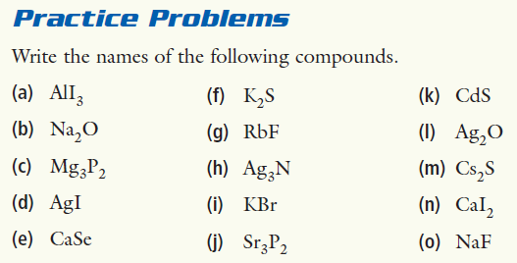
Naming Ionic Compounds

Slide 30
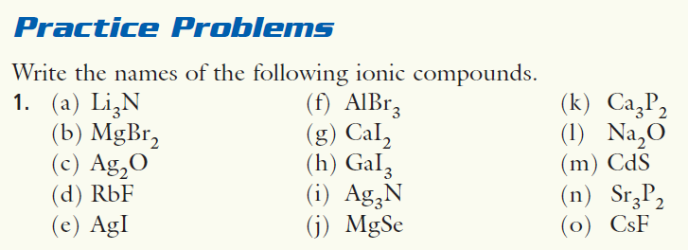
Naming Ionic Compounds

Slide 31
Rules For Naming Ionic Compounds containing Multivalent Metals
If the first ion (metal) is a multivalent metal ion, use the second ion’s charge to determine the first ion’s name
Fe²⁺ = iron (II) (“iron two”)
Fe³⁺ = iron (III) (“iron three”)

Slide 32
Rules For Naming Ionic Compounds containing Multivalent Metals
Example 2:
Pb
O₂
Which lead is it?
lead (II)
OR
lead (IV)
How will you find out?

Slide 33
Rules For Naming Ionic Compounds containing Multivalent Metals
Example 2:
Pb
O₂
Which lead is it?
lead (II)
OR
lead (IV)
Look at the charge on the second ion (OXYGEN)!

Slide 34
Rules For Naming Ionic Compounds containing Multivalent Metals
Example 2:
Pb
O₂
Which lead is it?
lead (II)
OR
lead (IV)
You know:
1. The compound is neutral (overall 0 charge), so the charge of the first ion (lead) MUST EQUAL the charge on the second ion (oxide)

Slide 35
Rules For Naming Ionic Compounds containing Multivalent Metals
Example 2:
Pb
O₂
Which lead is it?
lead (II)
OR
lead (IV)
-2
So, the charge of the two oxides is twice as much:
One oxide’s (O²⁻) charge is:
O₂
-4
We have two oxides:

Slide 36
Rules For Naming Ionic Compounds containing Multivalent Metals
Example 2:
Pb
O₂
Which lead is it?
lead (II)
OR
lead (IV)
The charge on the positive ion then MUST be +4
to balance the negative charge of -4

Slide 37
Rules For Naming Ionic Compounds containing Multivalent Metals
Example 2:
Pb
O₂
Which lead is it?
lead (II)
OR
lead (IV)
The correct ion is then:

Slide 38
Rules For Naming Ionic Compounds containing Multivalent Metals
Example 2:
Pb
O₂
Which lead is it?
lead (II)
OR
lead (IV)
And the name for this compound is:
lead (IV)
oxide

Slide 40
Writing Formulas of Ionic Compounds
potassium oxide
2 methods to do this!
The positive charge MUST ALWAYS balance the negative charge in the ionic compound

Slide 41
Method #1
potassium oxide
Write the formulas + charges for the metal ion (cation) and the nonmetal ion (anion)(or a polyatomic ion)
K⁺ and O²⁻

Slide 42
Method #1
potassium oxide
2. Balance the charges, so the overall charge of the compound = 0
What is the overall charge right now?
K⁺ and O²⁻
+1
-2
=
-1
We need it to be 0!

Slide 43
Method #1
potassium oxide
2. Balance the charges, so the overall charge of the compound = 0
ADD ONE MORE POTASSIUM
K⁺ and O²⁻
+1
-2
=
-1
We need it to be 0!

Slide 44
Method #1
potassium oxide
2. Balance the charges, so the overall charge of the compound = 0
ADD ONE MORE POTASSIUM
K⁺ and
K⁺ and O²⁻
+1
+1
-2
=
-1
We need it to be 0!

Slide 45
Method #1
potassium oxide
2. Balance the charges, so the overall charge of the compound = 0
ADD ONE MORE POTASSIUM
K⁺ and
K⁺ and O²⁻
+1
+1
-2
K₂O
=
0
We need it to be 0!

Slide 46
Method #2 = CROSSOVER METHOD
potassium oxide

Slide 47
Method #2 = CROSSOVER METHOD
potassium oxide
K¹⁺ and O²⁻

Slide 48
Method #2 = CROSSOVER METHOD
potassium oxide
K¹⁺ and O²⁻
K₂O₁

Slide 49
Method #2 = CROSSOVER METHOD
potassium oxide
K¹⁺ and O²⁻
K₂O

Slide 50
Method #1 vs Method #2
titanium(iv) oxide

Slide 51
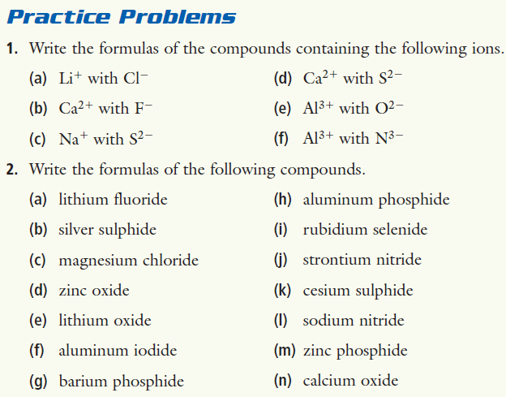
Writing Formulas of Ionic Compounds

Slide 52
Writing the Formulas of Ionic Compounds containing Multivalent Metals
If you have a name of an ionic compound containing a multivalent metal,
Fe²⁺ = iron (II) (“iron two”)
Fe³⁺ = iron (III) (“iron three”)

Slide 53
To name a MULTIVALENT ION
Name it exactly like you do with Univalent Metal Ions, but...
You MUST indicated the charge by a Roman numeral, in parentheses, immediately following the name of the metal ion
Fe²⁺ = iron (II) (“iron two”)
Fe³⁺ = iron (III) (“iron three”)

Slide 54
Writing the Formulas of Ionic Compounds containing Multivalent Metals
Identify each ion and its charge
Use A CROSSOVER METHOD (or Method #1) to balance the charges on each ion so you have ZERO (0) overall charge!!
iron(III)sulphide
Fe³⁺ and S²⁻
Fe₂S₃

Slide 55
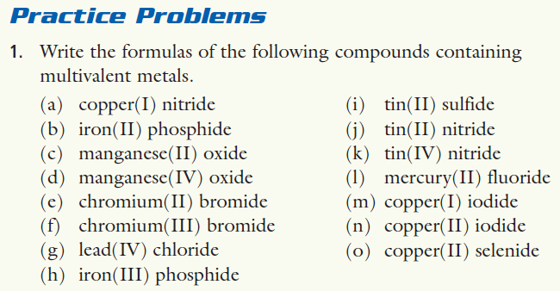

Slide 56
Conduct an INVESTIGATION

Slide 57
Conduct an INVESTIGATION

Slide 58
Conduct an INVESTIGATION

Slide 59
HOMEWORK – make a table of values
TITLE of a TABLE
REACTION | Observation after mixing | Observation of a solid produced | Observation of the flame test

Slide 60
Naming of IONIC COMPOUNDS
metal
nonmetal
metal
polyatomic
ion
UNIVALENT
MULTIVALENT
polyatomic
ion
polyatomic
ion
Al³⁺
Fe³⁺
Fe²⁺

Slide 61
Naming of IONIC COMPOUNDS
metal
nonmetal
metal
polyatomic
ion
UNIVALENT
MULTIVALENT
polyatomic
ion
polyatomic
ion
Al³⁺
Fe³⁺
Fe²⁺

Slide 62
Polyatomic Ions
A polyatomic ion contains more than one atom
OH⁻, CN⁻, NH₄⁺, NO₃⁻

Slide 63
Polyatomic Ions
You have to memorize the names, formulae, and charges of these polyatomic ions + other ones (see the worksheet):
Name | Formula and charge
carbonate | CO₃²⁻
chromate | CrO₄²⁻
dichromate | Cr₂O₇²⁻
sulphate | SO₄²⁻
sulphite | SO₃²⁻
nitrate | NO₃⁻
nitrite | NO₂⁻
ammonium | NH₄⁺
Name | Formula and charge
acetate | H₃C₂O₂⁻
permanganate | MnO₄⁻
perchlorate | ClO₄⁻
oxalate | C₂O₄²⁻
cyanide | CN⁻
chlorite | ClO₂⁻
phosphate | PO₄³⁻
hydroxide | OH⁻

Slide 64
Writing the Formulas of Ionic Compounds containing Polyatomic Ions
Identify each ion and its charge
Use A CROSSOVER METHOD (or Method #1) to balance the charges on each ion so you have ZERO (0) overall charge!!
iron(III)sulphate
Fe³⁺ and SO₄²⁻
Fe₂(SO₄)₃

Slide 66
Naming the Formulas of Ionic Compounds containing Polyatomic Ions
Pb
(OH)₂
Which lead is it?
lead (II)
OR
lead (IV)
How will you find out?

Slide 67
Rules For Naming Ionic Compounds containing Multivalent Metals
Pb
(OH)₂
Which lead is it?
lead (II)
OR
lead (IV)
Look at the charge on the hydroxide ion!

Slide 68
The compound is neutral (overall charge = 0), so...
The charge of the metal ion (lead) = the charge on the polyatomic ion(s) (hydroxide)
Pb
(OH)₂
Which lead is it?
lead (II)
OR
lead (IV)

Slide 69
OH⁻
1-
hydroxide’s charge is:
OH⁻
OH⁻
1-
1-
We have two hydroxides :
Pb
(OH)₂
Which lead is it?
lead (II)
OR
lead (IV)

Slide 70
OH⁻
1-
hydroxide’s charge is:
OH⁻
OH⁻
1-
2-
1-
We have two hydroxides :
Pb
(OH)₂
Which lead is it?
lead (II)
OR
lead (IV)

Slide 71
OH⁻
1-
hydroxide’s charge is:
OH⁻
OH⁻
2-
We have two hydroxides :
Pb
(OH)₂
Which lead is it?
lead (II)
OR
lead (IV)
The charge on lead ion then MUST be 2+
to balance the hydroxide ions’ charge of 2-

Slide 72
OH⁻
1-
hydroxide’s charge is:
OH⁻
OH⁻
2-
We have two hydroxides :
Pb
(OH)₂
Which lead is it?
lead (II)
OR
lead (IV)
The charge on lead ion then MUST be 2+
to balance the hydroxide ions’ charge of 2-

Slide 73
OH⁻
1-
hydroxide’s charge is:
OH⁻
OH⁻
2-
We have two hydroxides :
Pb
(OH)₂
Which lead is it?
lead (II)
OR
lead (IV)
lead(II)hydroxide

Slide 74
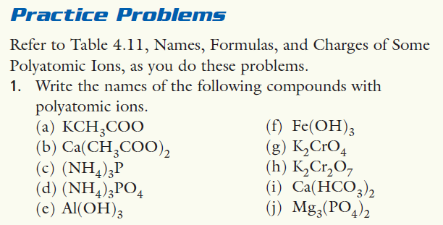

Slide 75
Naming and Writing Formulas of Covalent Compounds (molecules)
COVALENT COMPOUNDS (molecules):
contain a non metal(s) bonding to a non metal(s)
because non-metals combine in more than one ratio, we must use prefixes to indicate the number of atoms of each element in the formula.
if the prefix is followed by a vowel, the final "a" or "o" is dropped (not for DI- or TRI-)
EXCEPTION: the prefix mono is omitted for the first element only

Slide 76
PREFIX | Number of atoms
mono | 1
di | 2
tri | 3
tetra | 4
penta | 5
hexa | 6
hepta | 7
octa | 8
nona | 9
deca | 10

Slide 77
Naming and Writing Formulas of Covalent Compounds (molecules)
PREFIX | Number of atoms
mono | 1
di | 2
tri | 3
tetra | 4
penta | 5
hexa | 6
hepta | 7
octa | 8
nona | 9
deca | 10
EXAMPLES:
N₂O
dinitrogen monoxide
N₂O₅
dinitrogen pentoxide
CO
monocarbon monoxide
carbon monoxide
CO₂
carbon dioxide

Slide 78
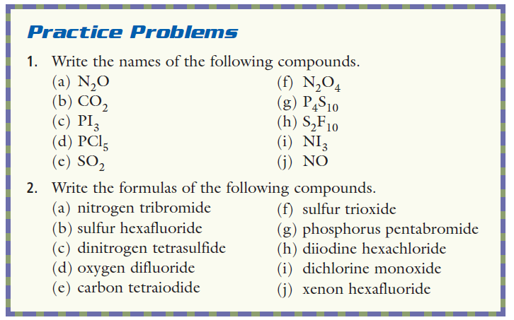

Slide 79
HOMEWORK
Showbie – 4 assignments
– see the due dates

Slide 80
QUIZ
TBD

