Slide 1
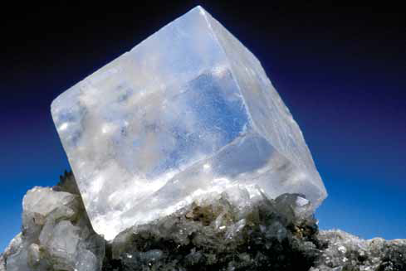
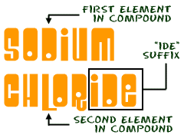
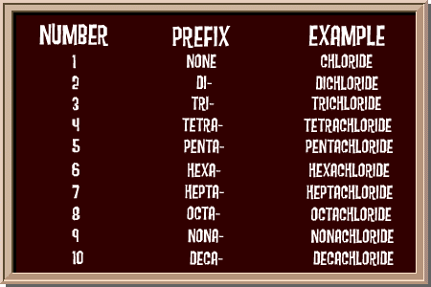
4.2 Names and Formulas of Compounds
Pages 184 - 200

Slide 2
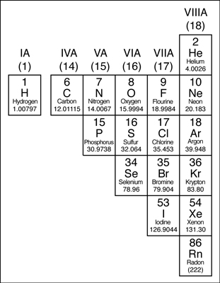
Naming and Writing Formulas of Covalent Compounds (molecules)
COVALENT COMPOUNDS (molecules):
contain a non metal(s) bonding to a non metal(s)
CH₄ NO₂
CO₂
H₂O

Slide 3
Naming and Writing Formulas of Covalent Compounds (molecules)
COVALENT COMPOUNDS (molecules):
contain a non metal(s) bonding to a non metal(s)
because non-metals combine in more than one ratio (i.e. oxygen and nitrogen can make more than one compound),
NO or NO₂ or
N₂O₂ or N₂O₄

Slide 4
Naming and Writing Formulas of Covalent Compounds (molecules)
COVALENT COMPOUNDS (molecules):
contain a non metal(s) bonding to a non metal(s)
because non-metals combine in more than one ratio (i.e. oxygen and nitrogen can make more than one compound), we must use prefixes to indicate the number of atoms of each element in the formula.
NO or NO₂ or
N₂O₂ or N₂O₄

Slide 5
Naming and Writing Formulas of Covalent Compounds (molecules)
COVALENT COMPOUNDS (molecules):
contain a non metal(s) bonding to a non metal(s)
because non-metals combine in more than one ratio (i.e. oxygen and nitrogen can make more than one compound), we must use prefixes to indicate the number of atoms of each element in the formula.
if the prefix is followed by a vowel, the final "a" or "o" is dropped (does not apply for prefixes DI- or TRI-)
EXCEPTION: the prefix MONO- is omitted for the first element only

Slide 6
PREFIXES | Number of atoms
mono | 1
di | 2
tri | 3
tetra | 4
penta | 5
hexa | 6
hepta | 7
octa | 8
nona | 9
deca | 10

Slide 7
Naming and Writing Formulas of Covalent Compounds (molecules)
PREFIX | Number of atoms
mono | 1
di | 2
tri | 3
tetra | 4
penta | 5
hexa | 6
hepta | 7
octa | 8
nona | 9
deca | 10
EXAMPLES:
N₂O
dinitrogen monoxide
N₂O₅
dinitrogen pentoxide
NO
mononitrogen monoxide
nitrogen monoxide
NO₂
nitrogen dioxide

Slide 8
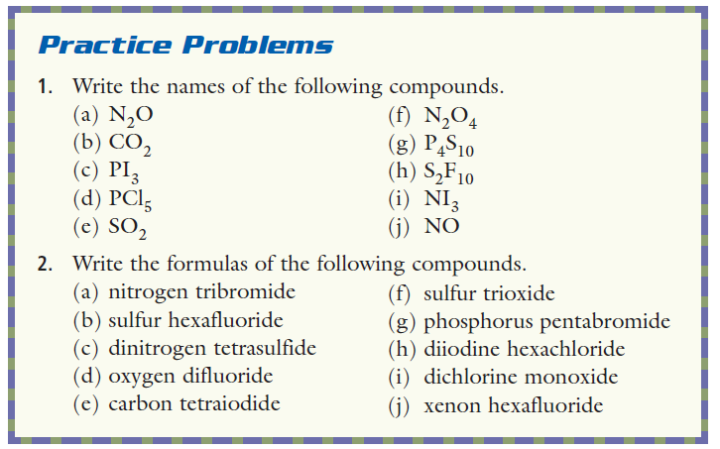

Slide 9
HOMEWORK
Showbie – 4 assignments
– see the due dates
WORKBOOK – pages 71 -73
– all of them

Slide 10
QUIZ
TBD

