Slide 1
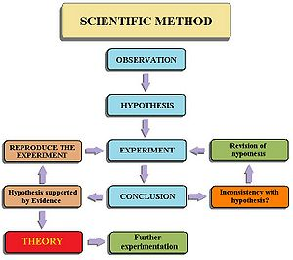
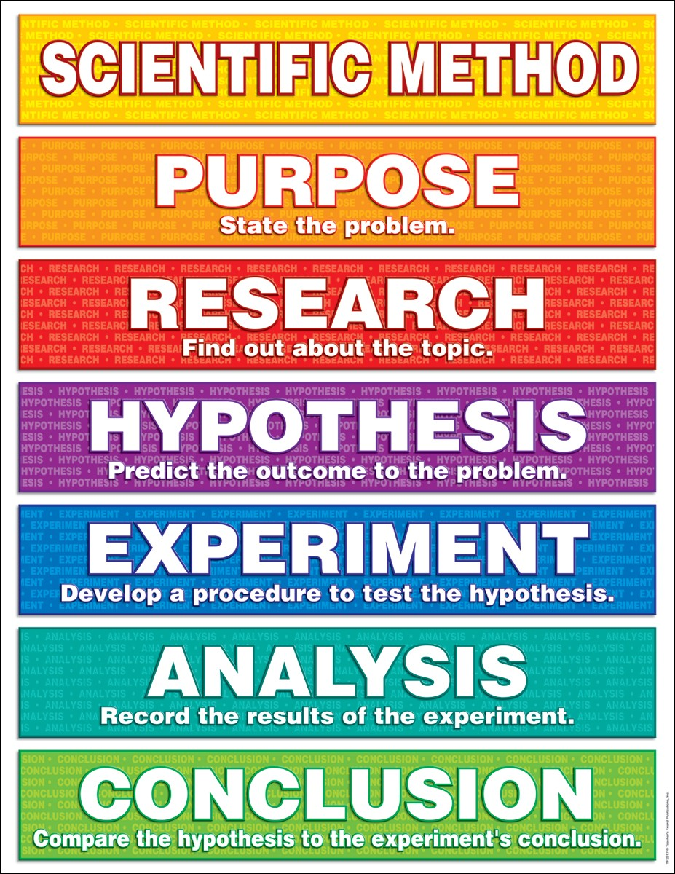
The Scientific Method

Slide 2
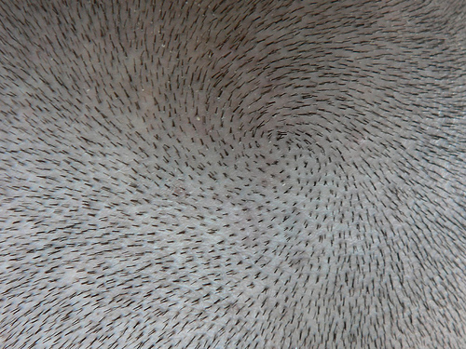
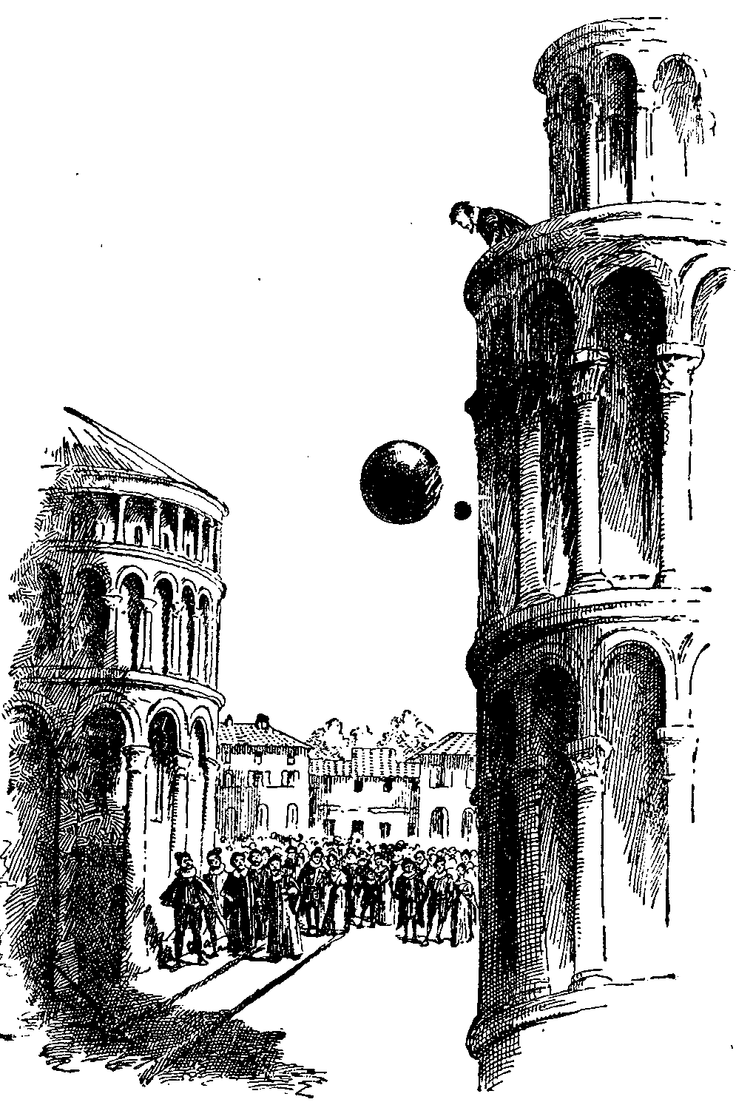
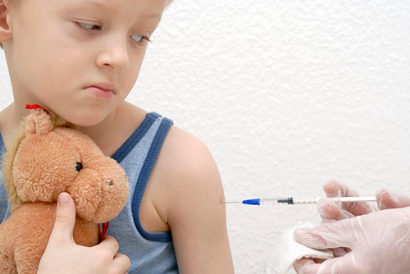
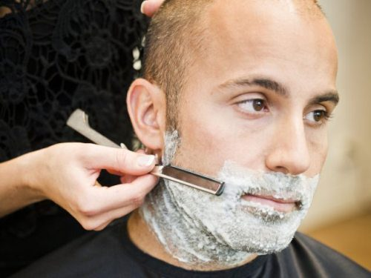
THE SCIENTISTS METHOD
THE MORE YOU SHAVE YOUR HAIR,THE MORE HAIR WILL APPEAR
THE HEAVIER OBJECTS FALL TO THEGROUND FASTER THAN THE LIGHTER ONES
CHILDREN’S VACCINES CAUSE AUTISM

Slide 3
Do You Believe in Any of These Claims?
THE MORE YOU SHAVE YOUR HAIR,THE MORE HAIR WILL APPEAR
THE HEAVIER OBJECTS FALL TO THEGROUND FASTER THAN THE LIGHTER ONES
CHILDREN’S VACCINES CAUSE AUTISM

Slide 4
How Can You Find Out if These Claims are True or Not?
THE MORE YOU SHAVE YOUR HAIR,THE MORE HAIR WILL APPEAR
THE HEAVIER OBJECTS FALL TO THEGROUND FASTER THAN THE LIGHTER ONES
CHILDREN’S VACCINES CAUSE AUTISM

Slide 5
How Can You Find Out if These Claims are True or Not?
THE MORE YOU SHAVE YOUR HAIR,THE MORE HAIR WILL APPEAR
THE HEAVIER OBJECTS FALL TO THEGROUND FASTER THAN THE LIGHTER ONES
CHILDREN’S VACCINES CAUSE AUTISM

Slide 6
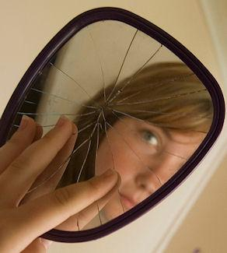
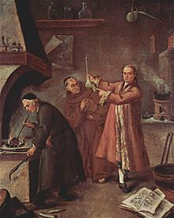

But….
More than 300 hundreds years ago, people didn’t use the Scientific Method to explain different phenomena
They believed ,mostly, what was passed on them from their parents or grandparents i.e. basically they accepted what had been accepted before without too much questioning

Slide 7
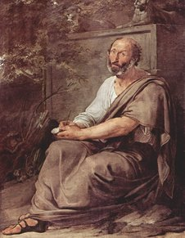
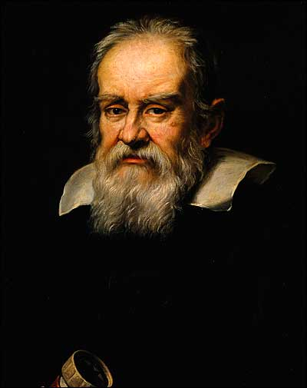
How Did It Really Work Before?
the scientists of ancient civilization did not conduct experiments to test their theories
their theories were based on common sense logic. If it made sense on the face of it, it would be accepted as truth.
The Law of Falling Bodies
ARISTOTLE
GALILEO
vs.

Slide 8
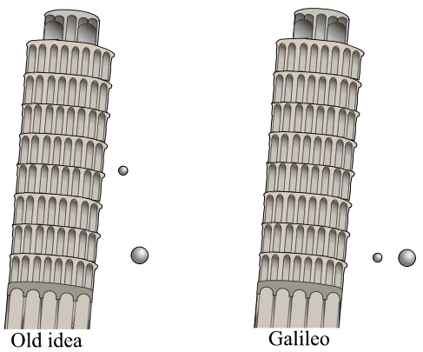
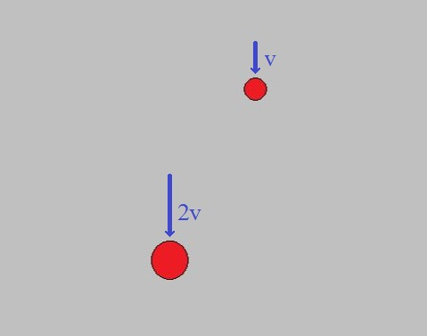
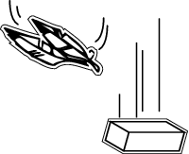
The Law of Falling Bodies
ARISTOTLE believed that:
if two bodies of different mass were dropped from the same height at the same time, the heavier one would hit the ground first

Slide 9
The Law of Falling Bodies
ARISTOTLE
The theory was not tested
It made sense to people, therefore, it was accepted as truth.

Slide 10
The Law of Falling Bodies
GALILEO believed that:
if two bodies of different mass were dropped from the same height at the same time, they would hit the ground together

Slide 11
The Law of Falling Bodies
GALILEO believed that:
if two bodies of different mass were dropped from the same height at the same time, they would hit the ground together

Slide 12
The Law of Falling Bodies
GALILEO
The theory was vigorously tested by him, but…
It DID NOT make sense to people, therefore, it was not accepted as truth.

Slide 13
ARISTOTLE is winning
Until…..
About 1650s, when the air pump was invented and vacuum experiments could have been done
The Law of Falling Bodies
ARISTOTLE
GALILEO
vs.

Slide 14
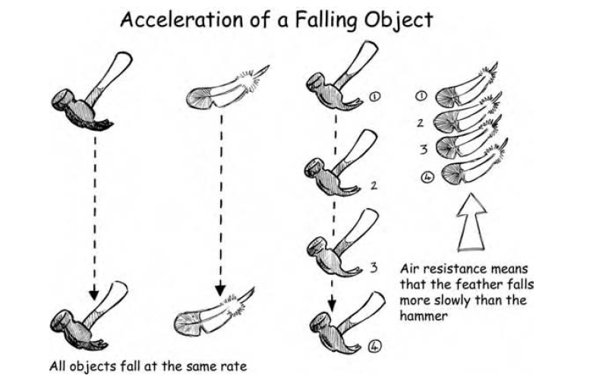
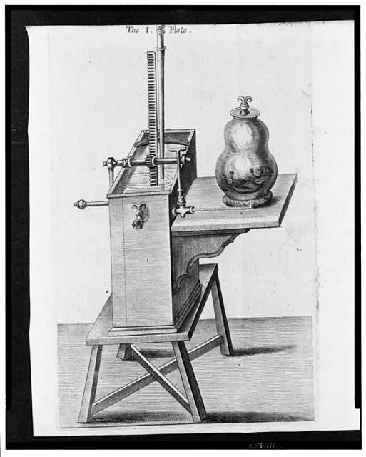
GALILEO WINS
Then it could have been proved that it was gravity that drew bodies toward the earth and that gravity acts on all bodies in the same way, regardless of shape, size, or density

Slide 15
These days, we can easily confirm this result
Using the SCIENTIFIC METHOD

Slide 16
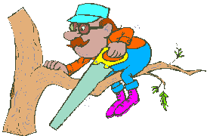
THE SCIENTFIC METHOD
Copyright © 2010 Ryan P. Murphy

Slide 17
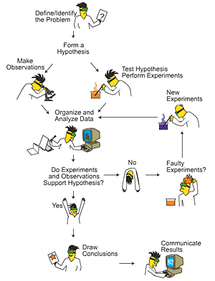
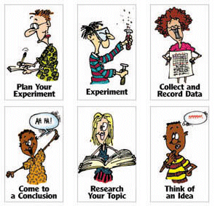
What is the Scientific Method?
A series of steps that scientists use to find the answer to questions

Slide 18
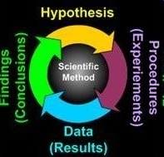
Copyright © 2010 Ryan P. Murphy

Slide 19
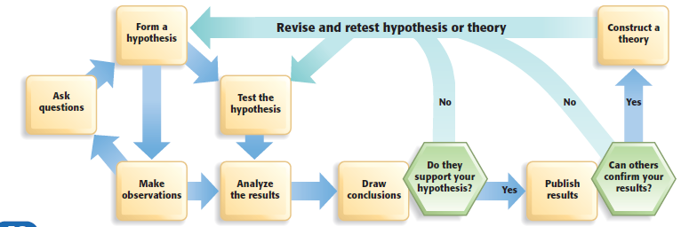

Slide 20
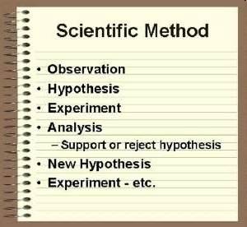
Stating the problem or asking the question

Slide 21
Stating the problem or asking the question
Copyright © 2010 Ryan P. Murphy

Slide 22
Stating the problem or asking the question
Copyright © 2010 Ryan P. Murphy

Slide 23
Stating the problem or asking the question
Copyright © 2010 Ryan P. Murphy

Slide 24
Stating the problem or asking the question
Copyright © 2010 Ryan P. Murphy

Slide 25
Stating the problem or asking the question
Copyright © 2010 Ryan P. Murphy

Slide 26
Stating the problem or asking the question
Copyright © 2010 Ryan P. Murphy

Slide 27
Stating the problem or asking the question
Copyright © 2010 Ryan P. Murphy

Slide 28
Stating the problem or asking the question
Copyright © 2010 Ryan P. Murphy

Slide 29

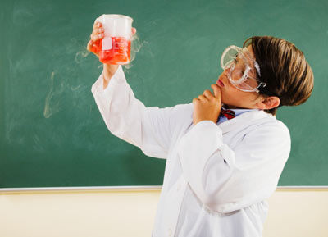
SCIENTIFIC METHOD
1. Stating the problem or asking the question:
- this is the problem or question for which you are seeking the answer.

Slide 30
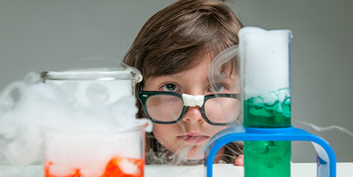
SCIENTIFIC METHOD
2. Observation/Research on the Subject:
The scientist needs to consider what is already known on the subject.
He/she would try to gather as much information as possible before starting a new investigation. This information may include the scientist’s own observations, and any previous research that has been tested and proven

Slide 31

SCIENTIFIC METHOD
3. Forming a Hypothesis:
Once you have considered what you already know on the subject, you need to make your best guess as to what you think the answer to your problem or question is.

Slide 32
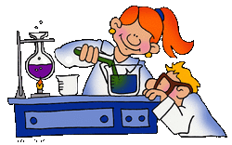
SCIENTIFIC METHOD
4. Experiment – Testing the Hypothesis:
The person conducting the experiment must record the steps in such a way that each step can be repeated by someone else in exactly the same way.
Only one variable can be changed at a time, the others must remain the same.

Slide 33

SCIENTIFIC METHOD
5. Analysis - Interpreting the data and drawing a conclusion:
Collecting data and explaining them
Support or reject hypothesis
If you reject hypothesis:
form a new hypothesis and test it again
If you support hypothesis:
repeat experiment to make sure it can produce the same result
add to a background (previous) information

Slide 34
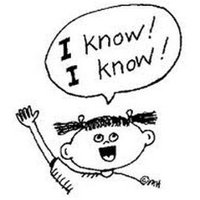
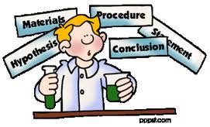
SCIENTIFIC METHOD
6. Conclusion:
Based on the observations of the experiment, is the hypothesis correct?

Slide 35
Observe
and question
Copyright © 2010 Ryan P. Murphy

Slide 36
Observe
Collect background information
Copyright © 2010 Ryan P. Murphy
Copyright © 2010 Ryan P. Murphy
Copyright © 2010 Ryan P. Murphy

Slide 37
Observe
Collect background information
Form a
Hypothesis

Slide 38
Observe
Collect background information
Form a
Hypothesis
Create an
experiment with a
control group and
experimental group.

Slide 39
Observe
Collect background information
Form a
Hypothesis
Create an
experiment with a
control group and
experimental group.
Collect data
Copyright © 2010 Ryan P. Murphy

Slide 40
Observe
Collect background information
Form a
Hypothesis
Create an
experiment with a
control group and
experimental group.
Analyze the data
Collect data
Copyright © 2010 Ryan P. Murphy

Slide 41
Observe
Collect background information
Form a
Hypothesis
Create an
experiment with a
control group and
experimental group.
Analyze the data
Collect data
Reject
hypothesis
Copyright © 2010 Ryan P. Murphy

Slide 42
Observe
Collect background information
Form a new
Hypothesis
Create an
experiment with a
control group and
experimental group.
Analyze the data
Collect data
Reject
hypothesis
Copyright © 2010 Ryan P. Murphy

Slide 43
Observe
Collect background information
Form a new
Hypothesis
Create a new
experiment with a
control group and
experimental group.
Analyze the data
Collect data
Reject
hypothesis
Copyright © 2010 Ryan P. Murphy

Slide 44
Observe
Collect background information
Form a new
Hypothesis
Create an
experiment with a
control group and
experimental group.
Analyze the data
Collect data
Support
hypothesis
Reject
hypothesis
Copyright © 2010 Ryan P. Murphy

Slide 45
Observe
Collect background information
Form a new
Hypothesis
Create an
experiment with a
control group and
experimental group.
Analyze the data
Collect data
Support
hypothesis
Reject
hypothesis
Repeat
experiment
Copyright © 2010 Ryan P. Murphy

Slide 46
Observe
Collect background information
Form a new
Hypothesis
Create an
experiment with a
control group and
experimental group.
Analyze the data
Collect data
Support
hypothesis
Reject
hypothesis
Repeat
experiment
Copyright © 2010 Ryan P. Murphy

Slide 47
Observe
Collect background information
Form a new
Hypothesis
Create an
experiment with a
control group and
experimental group.
Analyze the data
Collect data
Support
hypothesis
Reject
hypothesis
Repeat
experiment
Do something
With the findings.
Copyright © 2010 Ryan P. Murphy

Slide 48
Observe
Add to background information
Form a new
Hypothesis
Create an
experiment with a
control group and
experimental group.
Analyze the data
Collect data
Support
hypothesis
Reject
hypothesis
Repeat
experiment
Do something
With the findings.
Copyright © 2010 Ryan P. Murphy

Slide 49
Observe
Add to background information
Form a new
Hypothesis
Create an
experiment with a
control group and
experimental group.
Analyze the data
Collect data
Support
hypothesis
Reject
hypothesis
Everything in the
experiment should be
the same except for
the independent variable
which is the one thing
that is different.
Repeat
experiment
Do something
With the findings.
Copyright © 2010 Ryan P. Murphy

Slide 50
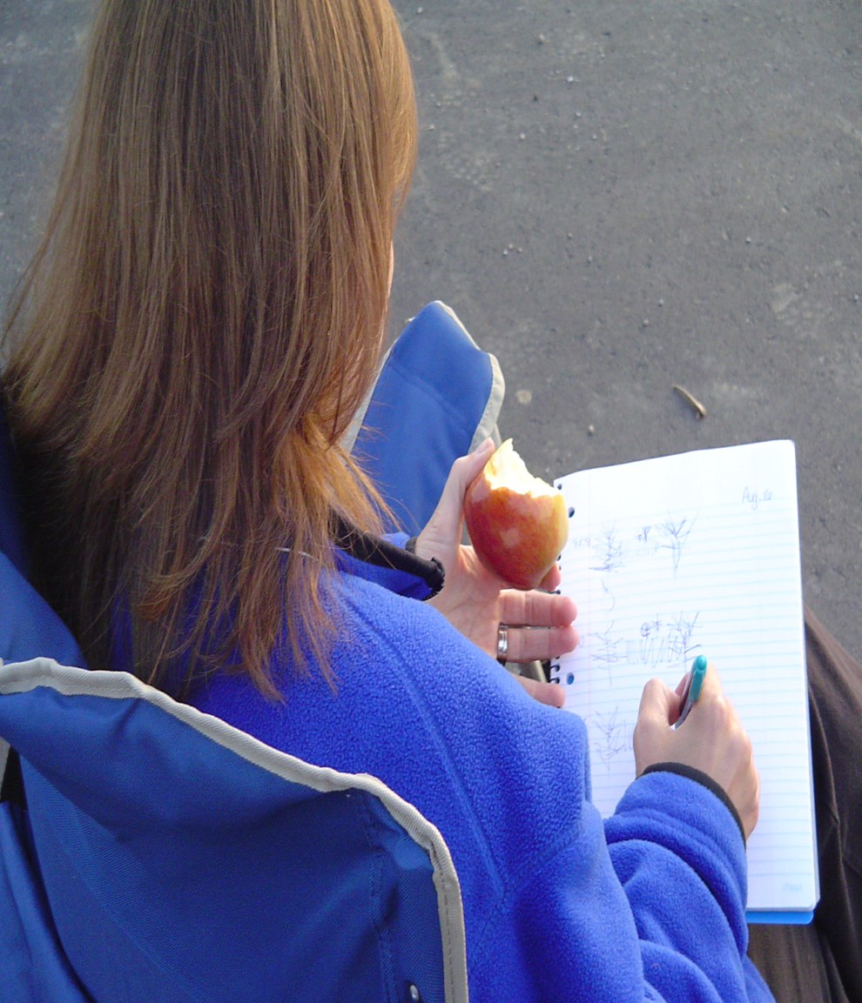
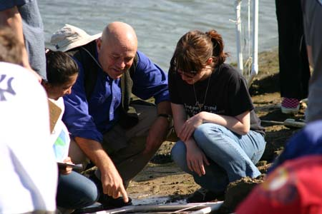
1. OBSERVATIONS

Slide 51

#1
Step One:
OBSERVATION
Begin with observations
  Use all five senses – what do you see, hear, smell, taste, and feel?
  OBSERVATIONS are not INFERENCES

Slide 52
OBSERVATIONS vs INFERENCE

Slide 53
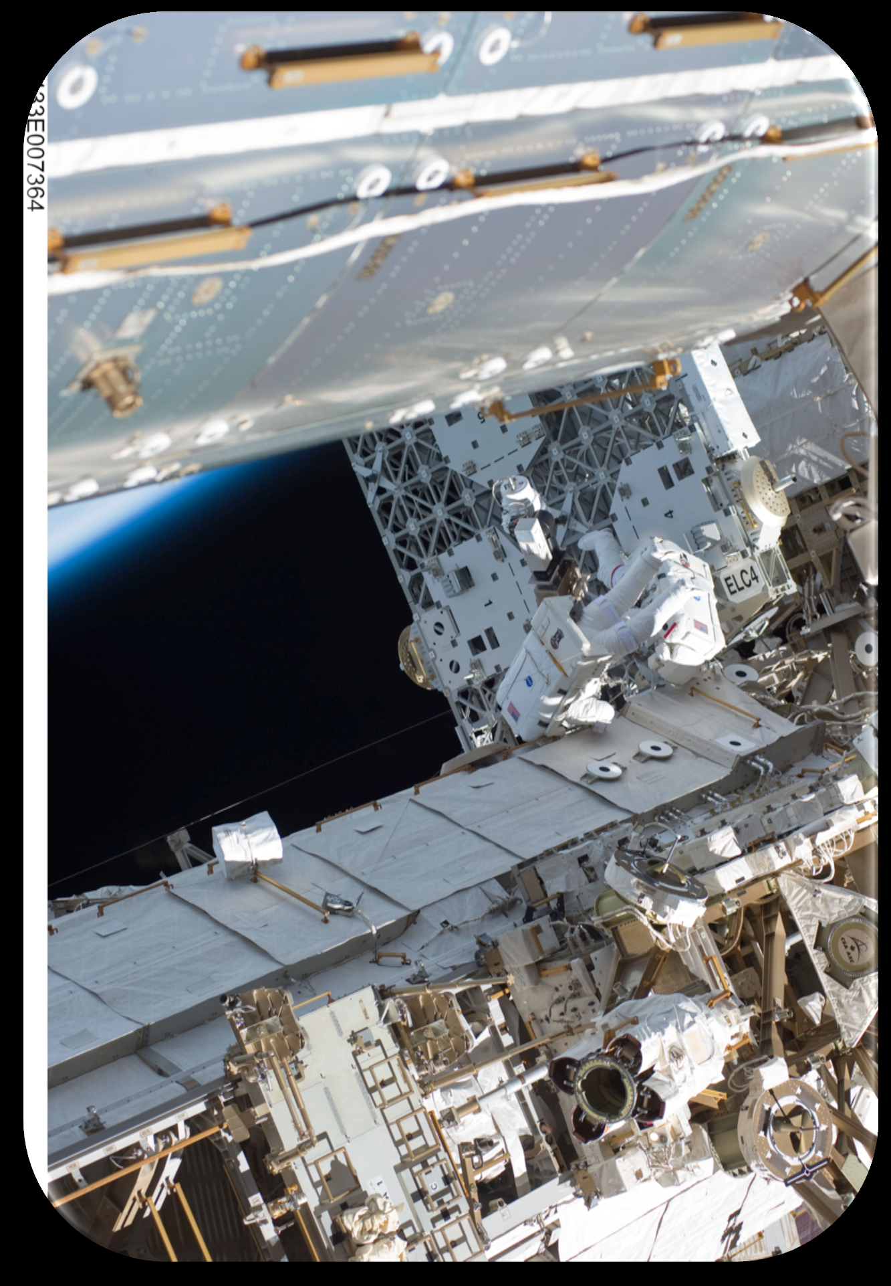
OBSERVATIONS vs INFERENCE

Slide 54
OBSERVATIONS vs INFERENCE
Direct method of gathering
and recording information
Process of combining what you know with what you have learned to draw logical conclusions

Slide 55
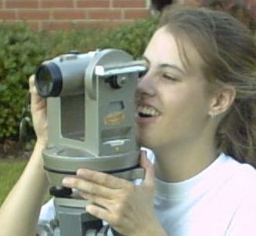
Activity! How well do you observe the world around you.
  Observe each scene for 30 seconds and then answer some questions afterward.

Slide 56


Slide 57
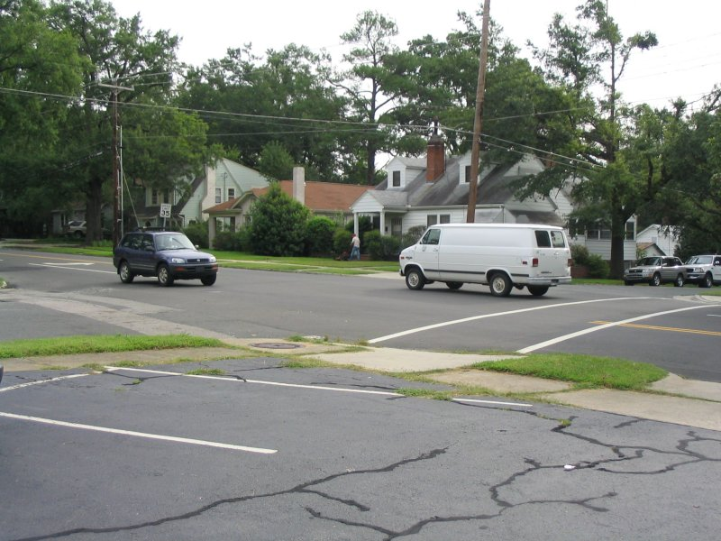

Slide 58

Questions for the street scene.
Copyright © 2010 Ryan P. Murphy

Slide 59
Questions for the street scene.
  How many vehicles were driving?

Slide 60
Questions for the street scene.
  How many vehicles were driving?
    Two were driving, three were parked

Slide 62
  What type of vehicles were they?

Slide 63
  What type of vehicles were they?
    Utility van with no labels and small 4 door SUV.
Copyright © 2010 Ryan P. Murphy

Slide 65
  What colors were they?
Copyright © 2010 Ryan P. Murphy

Slide 66
    Utility van was white
    SUV was dark blue with no license plate on the front.

Slide 68
  What was the roof color of the house behind the van?
    gray

Slide 70
  What season is this picture from?

Slide 71
  What season is this picture from?
  summer

Slide 73
  How many witnesses were there, what were they doing?

Slide 74
  How many witnesses were there, what were they doing?
  One man
  Mowing the lawn

Slide 76
  What was he wearing?
  White shirt
  Blue jeans

Slide 79
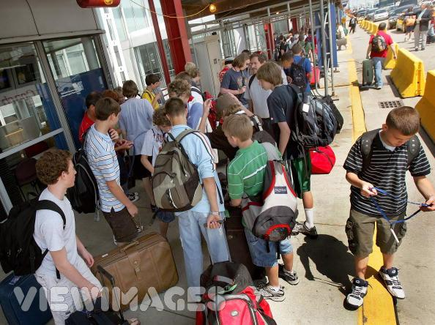

Slide 80
Questions about the street scene?
Copyright © 2010 Ryan P. Murphy

Slide 81
  What type of location are the people at?
  Airport, Train Station, Bus Station?

Slide 83
  Describe the person who walked away with green suitcase.

Slide 84
  Describe the person who walked away with green suitcase.
  Male,
  Black Hair
  Red, short sleeved shirt
  blue jeans
  wearing a backpack

Slide 87
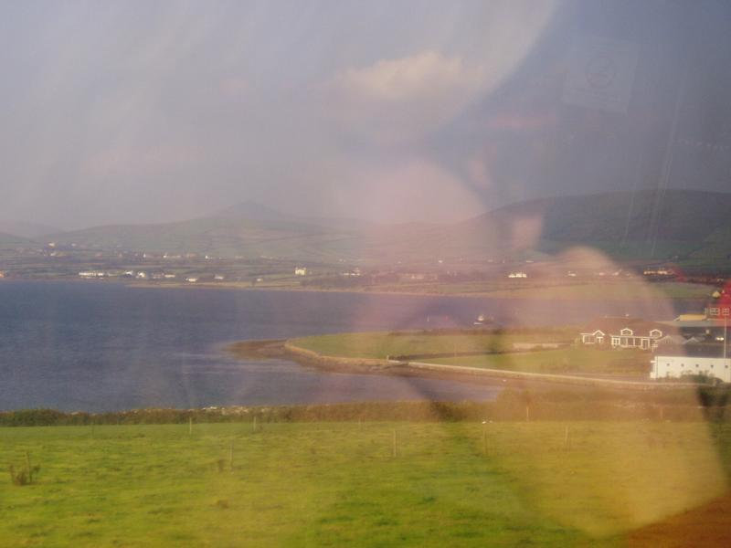

Slide 88
  Who is this a picture of?

Slide 89
  A woman (adult) with blonde hair, maroon shirt and wearing eyeglasses

Slide 92
  Specifically, where was this photo taken?
Copyright © 2010 Ryan P. Murphy

Slide 93
  Picture taken by passenger on a bus or train (tinted windows). Image is of a women sitting by the window seat. No smoking sign can be seen in the reflection. Her left arm is against her cheek.

Slide 95
Copyright © 2010 Ryan P. Murphy

Slide 96
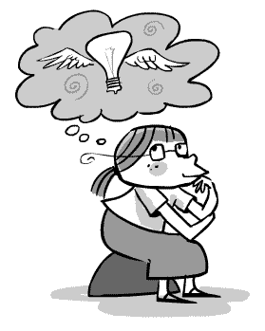

2. FORM a HYPOTHESIS

Slide 97
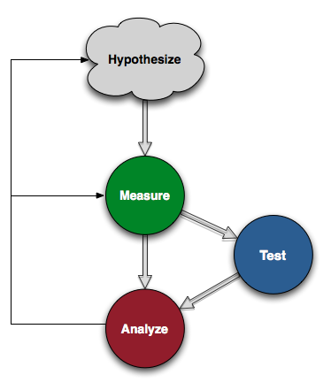
Hypothesis: An educated guess to your problem / question that is testable.
Copyright © 2010 Ryan P. Murphy

Slide 98
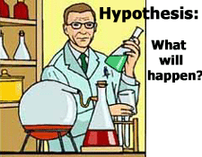
A HYPOTHESIS is a testable prediction about a problem. It is usually presented with an if… then… statement.

Slide 99
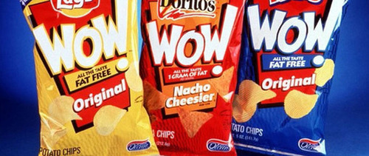
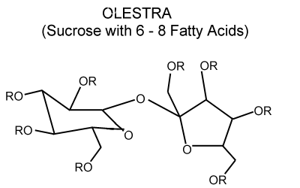
2. FORM a HYPOTHESIS
In 1996 the FDA approved Olestra®, a type of synthetic fat replacement made from sugar and vegetable oil, as a food additive. Potato chips were the first “Olestralaced” food product on the market in the United States.

Slide 100

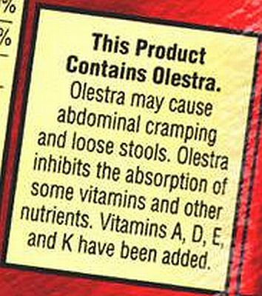
2. FORM a HYPOTHESIS
Controversy soon raged. Some people complained of intestinal cramps after eating the chips and concluded that Olestra caused them.

Slide 101
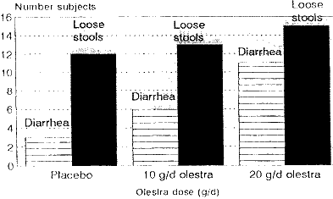
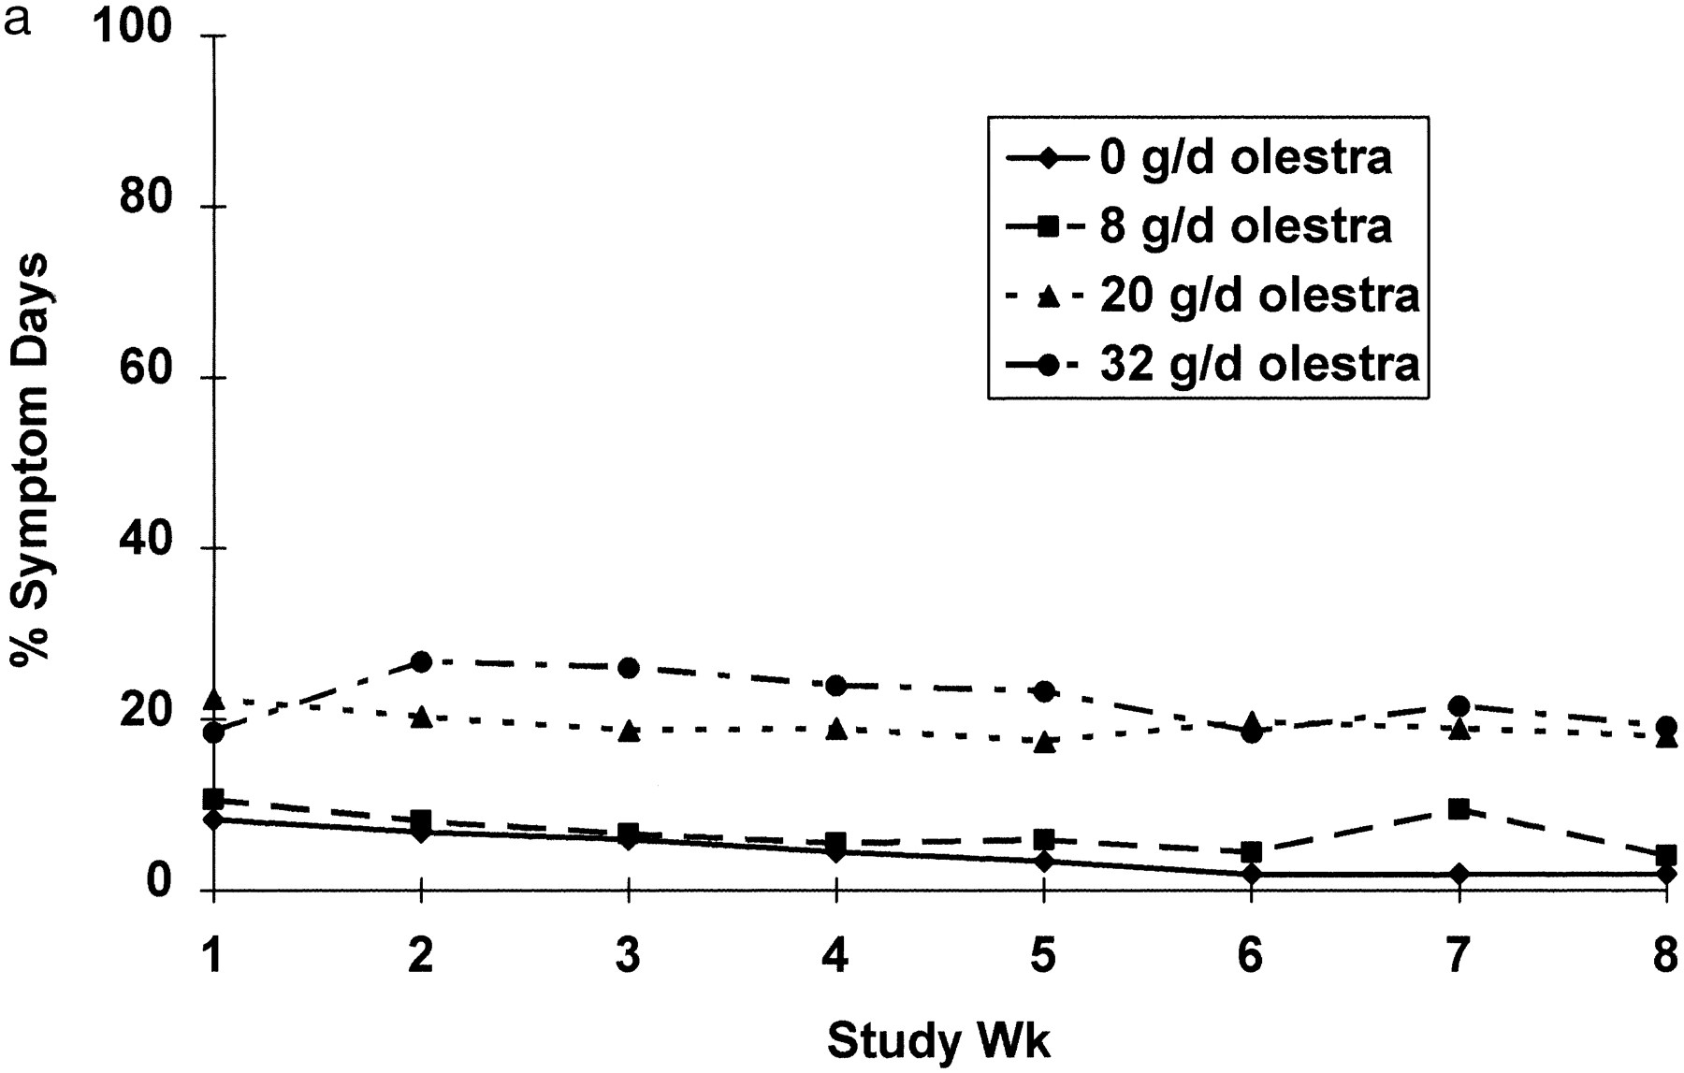
2. FORM a HYPOTHESIS
Two years later, four researchers designed an experiment to test the hypothesis that this food additive causes cramps.

Slide 102
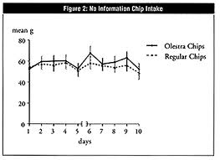
2. FORM a HYPOTHESIS
They predicted that if Olestra causes cramps, then people who eat Olestra will be more likely to get cramps than people who do not.

Slide 103
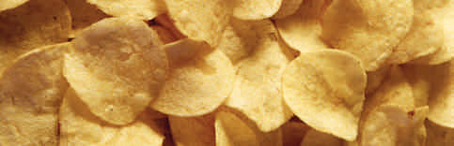
2. FORM a HYPOTHESIS
IF Olestra causes cramps, THEN people who eat Olestra will be more likely to get cramps than people who do not.

Slide 104
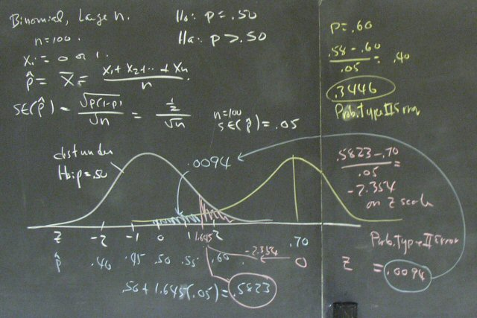
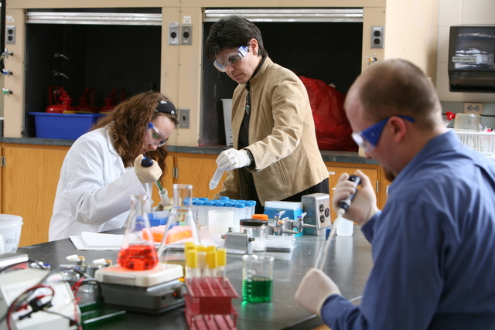
3. TEST YOUR HYPOTHESIS (DO THE EXPERIMENT)

Slide 105
Create a controlled experiment
Chicago theatre
1100 people
aged 13 – 38
Each person got a 13 oz. unmarked bag of chips
About 50% of bags contained Olestra

Slide 106
2 Experimental Groups and Variables
VARIABLE:
Thing(s) that can be changed during and can affect an experiment
EXPERIMENTAL GROUP:
A group in which ONLY ONE of the VARIABLES was changed
CONTROL GROUP:
A group in which NO VARIABLE was changed and to which the results from the experimental group will be compared to

Slide 107
IF Olestra causes cramps, THEN people who eat Olestra will be more likely to get cramps than people who do not.
Chicago theatre
1100 people
aged 13 – 38
Each person got a 13 oz. unmarked bag of chips
About 50% of bags contained Olestra
VARIABLES????
Location
Number of subjects (people)
Same amount of chips
Olestra

Slide 108
IF Olestra causes cramps, THEN people who eat Olestra will be more likely to get cramps than people who do not.
VARIABLES:
Location
Number of subjects (people)
Same amount of chips
Olestra

Slide 109
IF Olestra causes cramps, THEN people who eat Olestra will be more likely to get cramps than people who do not.
EXPERIMENTAL GROUP:
Chicago Theatre
CONTROL GROUP:
Chicago Theatre
VARIABLES:
Location
Number of subjects (people)
Same amount of chips
Olestra

Slide 110
IF Olestra causes cramps, THEN people who eat Olestra will be more likely to get cramps than people who do not.
EXPERIMENTAL GROUP:
Chicago Theatre
500 people
CONTROL GROUP:
Chicago Theatre
500 people
VARIABLES:
Location
Number of subjects (people)
Same amount of chips
Olestra

Slide 111
IF Olestra causes cramps, THEN people who eat Olestra will be more likely to get cramps than people who do not.
EXPERIMENTAL GROUP:
Chicago Theatre
500 people
13 oz.
CONTROL GROUP:
Chicago Theatre
500 people
13 oz.
VARIABLES:
Location
Number of subjects (people)
Same amount of chips
Olestra

Slide 112
IF Olestra causes cramps, THEN people who eat Olestra will be more likely to get cramps than people who do not.
EXPERIMENTAL GROUP:
Chicago Theatre
500 people
13 oz.
YES – Olestra
CONTROL GROUP:
Chicago Theatre
500 people
13 oz.
NO – Olestra
VARIABLES:
Location
Number of subjects (people)
Same amount of chips
Olestra

Slide 113
IF Olestra causes cramps, THEN people who eat Olestra will be more likely to get cramps than people who do not.
EXPERIMENTAL GROUP:
Chicago Theatre
500 people
13 oz.
YES – Olestra
CONTROL GROUP:
Chicago Theatre
500 people
13 oz.
NO – Olestra
VARIABLES:
Location
Number of subjects (people)
Same amount of chips
Olestra

Slide 114
INDEPENDENT VARIABLE
The variable (thing) that is CHANGED and TESTED during the experiment
VARIABLES:
Location
Number of subjects (people)
Same amount of chips
Olestra
EXPERIMENTAL GROUP:
Chicago Theatre
500 people
13 oz.
YES – Olestra
CONTROL
GROUP:
Chicago Theatre
500 people
13 oz.
NO – Olestra

Slide 115
INDEPENDENT VARIABLE
Which variable did we change during the experiment??
VARIABLES:
Location
Number of subjects (people)
Same amount of chips
Olestra
EXPERIMENTAL GROUP:
Chicago Theatre
500 people
13 oz.
YES – Olestra
CONTROL
GROUP:
Chicago Theatre
500 people
13 oz.
NO – Olestra

Slide 116
INDEPENDENT VARIABLE
Which variable did we change during the experiment??
VARIABLES:
Location
Number of subjects (people)
Same amount of chips
Olestra
EXPERIMENTAL GROUP:
Chicago Theatre
500 people
13 oz.
YES – Olestra
CONTROL
GROUP:
Chicago Theatre
500 people
13 oz.
NO – Olestra

Slide 117
DEPENDENT VARIABLE
The variable (thing) that responds to the change and is being measured during the experiment
VARIABLES:
Location
Number of subjects (people)
Same amount of chips
Olestra
EXPERIMENTAL GROUP:
Chicago Theatre
500 people
13 oz.
YES – Olestra
CONTROL
GROUP:
Chicago Theatre
500 people
13 oz.
NO – Olestra

Slide 118
DEPENDENT VARIABLE
Which variable did we measure to find out if our hypothesis was correct??
VARIABLES:
Location
Number of subjects (people)
Same amount of chips
Olestra
EXPERIMENTAL GROUP:
Chicago Theatre
500 people
13 oz.
YES – Olestra
CONTROL
GROUP:
Chicago Theatre
500 people
13 oz.
NO – Olestra

Slide 119
DEPENDENT VARIABLE
The number of people having intestinal cramps
VARIABLES:
Location
Number of subjects (people)
Same amount of chips
Olestra
EXPERIMENTAL GROUP:
Chicago Theatre
500 people
13 oz.
YES – Olestra
CONTROL
GROUP:
Chicago Theatre
500 people
13 oz.
NO – Olestra

Slide 120
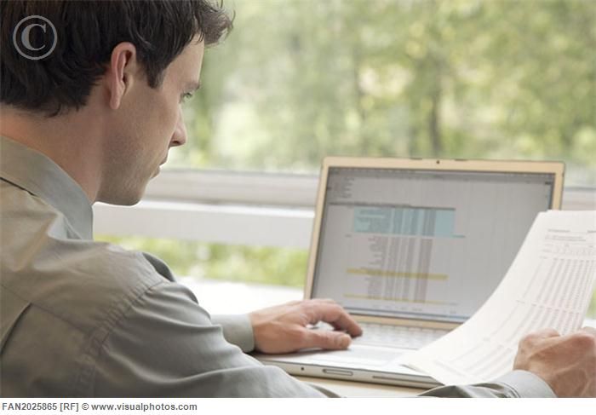
4. ANALYZE YOUR EXPERIMENT

Slide 121
4. ANALYZE YOUR EXPERIMENT

Slide 122
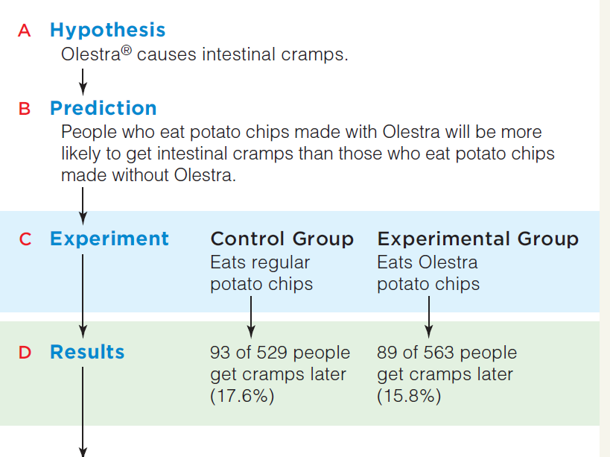

Slide 126
9. SUPPORT YOUR HYPOTHESIS
9. REJECT YOUR HYPOTHESIS
OR
7. Test Your New Hypothesis
8. Analyze Your Experiment
6. Form a New Hypothesis

Slide 127
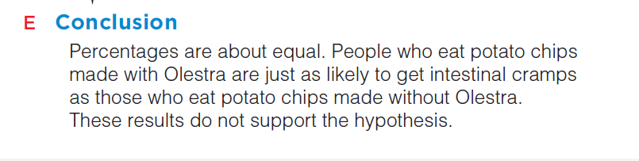
5. CONCLUSION: SUPPORT OR REJECT YOUR HYPOTHESIS
REJECT YOUR HYPOTHESIS

Slide 128
Your Hypothesis Was NOT Correct!
5. REJECT YOUR HYPOTHESIS
7. Test Your New Hypothesis
8. Analyze Your Experiment
6. Form a New Hypothesis

Slide 129

Your Hypothesis Was Correct!
5. SUPPORT YOUR HYPOTHESIS
6. Re – Do the experiment to confirm the results
6. Do something with the results

Slide 130
SUMMARY
Observation
Hypothesis (prediction)
Experiment
Analysis (is your hypothesis correct or not)
New hypothesis?
Scientific Theory

Slide 131
YOUR TURN TO TEST THIS HYPOTHESIS
Observation | Olestra® might causes intestinal cramps.
Hypothesis (prediction)
Experiment
Analysis (is your hypothesis correct or not)
New hypothesis?
Scientific Theory

Slide 132
YOUR TURN TO TEST THIS HYPOTHESIS
Observation | Olestra® might causes intestinal cramps.
Hypothesis (prediction) | People who eat potato chips made with Olestra will be more likely to get intestinal cramps than those who eat potato chips made without Olestra.
Experiment
Analysis (is your hypothesis correct or not)
New hypothesis?
Scientific Theory

Slide 133
YOUR TURN TO TEST THIS HYPOTHESIS
Observation | Olestra® might causes intestinal cramps.
Hypothesis (prediction) | People who eat potato chips made with Olestra will be more likely to get intestinal cramps than those who eat potato chips made without Olestra.
Experiment | Give one group of people chips with Olestra and one group of people chips without Olestra.
Analysis (is your hypothesis correct or not)
New hypothesis?
Scientific Theory

Slide 134
YOUR TURN TO TEST THIS HYPOTHESIS
Observation | Olestra® might causes intestinal cramps.
Hypothesis (prediction) | People who eat potato chips made with Olestra will be more likely to get intestinal cramps than those who eat potato chips made without Olestra.
Experiment | Give one group of people chips with Olestra and one group of people chips without Olestra.
Analysis (is your hypothesis correct or not) | Did people who ate Olestra – Chips get more, less, or similar number of cramps as people who ate chips without Olestra?
New hypothesis?
Scientific Theory

Slide 135
YOUR TURN TO TEST THIS HYPOTHESIS
Observation | Olestra® might causes intestinal cramps.
Hypothesis (prediction) | People who eat potato chips made with Olestra will be more likely to get intestinal cramps than those who eat potato chips made without Olestra.
Experiment | Give one group of people chips with Olestra and one group of people chips without Olestra.
Analysis (is your hypothesis correct or not) | Did people who ate Olestra – Chips get more, less, or similar number of cramps as people who ate chips without Olestra?
New hypothesis? | The results DO NOT support the hypothesis. A new hypothesis is needed
Scientific Theory

Slide 136
YOUR TURN TO TEST THIS HYPOTHESIS
Observation | Olestra® might causes intestinal cramps.
Hypothesis (prediction) | People who eat potato chips made with Olestra will be more likely to get intestinal cramps than those who eat potato chips made without Olestra.
Experiment | Give one group of people chips with Olestra and one group of people chips without Olestra.
Analysis (is your hypothesis correct or not) | Did people who ate Olestra – Chips get more, less, or similar number of cramps as people who ate chips without Olestra?
New hypothesis? | The results DO NOT support the hypothesis. A new hypothesis is needed
Scientific Theory | N/A

Slide 137
More notes about hypothesis…..
A scientific hypothesis must be proposed in a way that enables it to be tested and it is usable only if the question can be proven false.
The nature of science is such that we can prove a hypothesis false by presenting evidence from an investigation that does not support the hypothesis.
We can never prove a hypothesis true!

Slide 138
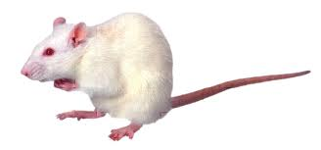
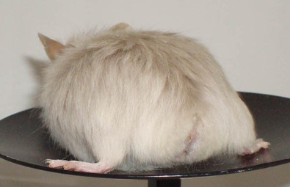
More notes about hypothesis…..
“All mice have tails.”
Why You Can Never Prove This Hypothesis True?
This can never be proven true because we can never observe every mouse.
It can, however, be proven false by observing a single mouse without a tail.

Slide 139


Smithers thinks that a special juice will increase the productivity of workers. He creates two groups of 50 workers each and assigns each group the same task (in this case, they're supposed to staple a set of papers). Group A is given the special juice to drink while they work. Group B is not given the special juice. After an hour, Smithers counts how many stacks of papers each group has made. Group A made 1,587 stacks, Group B made 2,113 stacks.

Slide 140
Smithers thinks that a special juice will increase the productivity of workers. He creates two groups of 50 workers each and assigns each group the same task (in this case, they're supposed to staple a set of papers). Group A is given the special juice to drink while they work. Group B is not given the special juice. After an hour, Smithers counts how many stacks of papers each group has made. Group A made 1,587 stacks, Group B made 2,113 stacks. Identify:
Control Group: Group B
Independent Variable: Special Juice
Dependent Variable: The amount of stapled papers
Smither’s Conclusion: The special juice will not make workers more productive
How could you improve the experiment:
more time for stapling, more juice...

Slide 141

Homer notices that his shower is covered in a strange green slime. His friend Barney tells him that coconut juice will get rid of the green slime. Homer decides to check this out by spraying half of the shower with coconut juice. He sprays the other half of the shower with water. After 3 days of "treatment" there is no change in the appearance of the green slime on either side of the shower.
Initial Observation:
Control Group:
Independent Variable:
Dependent Variable:
Homer’s Conclusion:

Slide 142
Homer notices that his shower is covered in a strange green slime. His friend Barney tells him that coconut juice will get rid of the green slime. Homer decides to check this out by spraying half of the shower with coconut juice. He sprays the other half of the shower with water. After 3 days of "treatment" there is no change in the appearance of the green slime on either side of the shower.
Initial Observation: Green slime on his shower
Control Group: Half of the shower sprayed with water
Independent Variable: Coconut Juice
Dependent Variable: The amount of green slime
Homer’s Conclusion: The coconut juice did not work on green slime

Slide 143

Bart believes that mice exposed to radio waves will become extra strong (maybe he's been reading too much Radioactive Man). He decides to perform this experiment by placing 10 mice near a radio for 5 hours. He compared these 10 mice to another 10 mice that had not been exposed. His test consisted of a heavy block of wood that blocked the mouse food. he found that 8 out of 10 of the radio waved mice were able to push the block away. 7 out of 10 of the other mice were able to do the same.
Control Group:
Independent Variable:
Dependent Variable:
Bart’s Conclusion:
How could you improve the experiment:

Slide 144
Bart believes that mice exposed to radio waves will become extra strong (maybe he's been reading too much Radioactive Man). He decides to perform this experiment by placing 10 mice near a radio for 5 hours. He compared these 10 mice to another 10 mice that had not been exposed. His test consisted of a heavy block of wood that blocked the mouse food. he found that 8 out of 10 of the radio waved mice were able to push the block away. 7 out of 10 of the other mice were able to do the same.
Control Group: 10 mice NOT exposed to radio waves
Independent Variable: Exposure to radio waves
Dependent Variable: The ability to push the heavy block of wood away
Bart’s Conclusion: The radio waves will NOT help mice become stronger
How could you improve the experiment:
Longer exposure time, bigger sample size, better source of radio waves...

Slide 145

Krusty was told that a certain itching powder was the newest best thing on the market, it even claims to cause 50% longer lasting itches. Interested in this product, he buys the itching powder and compares it to his usual product. One test subject (A) is sprinkled with the original itching powder, and another test subject (B) was sprinkled with the Experimental itching powder. Subject A reported having itches for 30 minutes. Subject B reported to have itches for 45 minutes.
Control Group:
Independent Variable:
Dependent Variable:
Do the data support the advertisement:

Slide 146
Krusty was told that a certain itching powder was the newest best thing on the market, it even claims to cause 50% longer lasting itches. Interested in this product, he buys the itching powder and compares it to his usual product. One test subject (A) is sprinkled with the original itching powder, and another test subject (B) was sprinkled with the Experimental itching powder. Subject A reported having itches for 30 minutes. Subject B reported to have itches for 45 minutes.
Control Group: Subject A
Independent Variable: Type of itching powder
Dependent Variable: The time of itching
Do the data support the advertisement:
Yes, the group B itched for 50% longer (as advertised)

Slide 147

Lisa is working on a science project. Her task is to answer the question: "Does Rogooti (which is a commercial hair product) affect the speed of hair growth". Her family is willing to volunteer for the experiment.

Slide 148
She would use Bart and Homer as their test subjects. They would cut their hair to 1 cm long. Then they would use Rogooti for 2 months. After 2 months, she would measure the length of their hair. After that, they would, again, cut their hair to 1 cm long, but would not use Rogooti at all. After 2 months, Lisa would measure their hair and compare the length with the original measurements.
Control Group: Bart, Homer
Independent Variable: The use of Rogooti
Dependent Variable: The length of hair

Slide 149
Brown Out
Things You Need to Hand in:
Hypothesis
A detailed procedure of the experiment and the experimental setup
Clearly stated independent and dependent variables, an experimental group, and a control group along with quantities
A material list for your experiment
Prepared data tables
ALL MUST BE WRITTEN IN YOUR LAB. NOTEBOOK
(due on Thursday)

Slide 150
Brown Out
Things to Think About?
What are the possible variables for this reaction?
What are the possible variables that can affect this reaction?
pH, light, air, temperature, carbon dioxide, oxygen gas...

